Slide 1
3.5 Working across one whole: improper fractions and mixed numbers
Representations | Year 4
Fractions

Slide 2
How to use this presentation
You can find the teacher guide 3.5 Working across one whole: improper fractions and mixed numbers by following the link below.

Slide 3
3.5 Improper fractions & mixed numbers
Step 1:1
How many oranges altogether?
Notes:
Jonny has two oranges.
Ellen has half an orange.
How many oranges do the Jonny and Ellen have altogether?

Slide 4
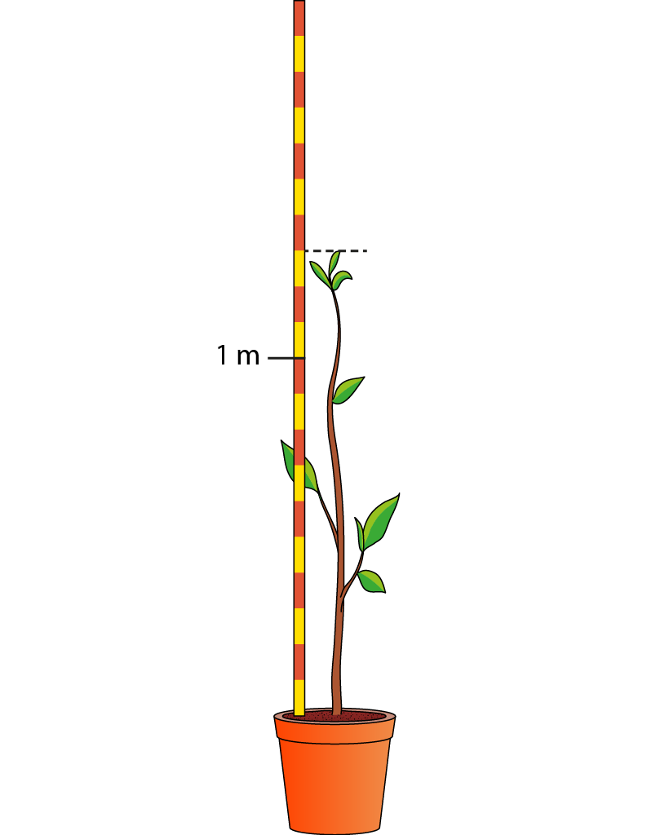
3.5 Improper fractions & mixed numbers
Step 1:1
How tall is the plant in metres?
Notes:
How tall is the plant in metres?

Slide 5
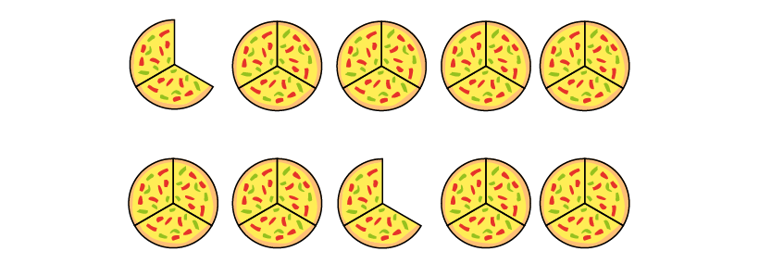
3.5 Improper fractions & mixed numbers
Step 1:1
How many pizzas are there?
Notes:
What is the same? What is different?

Slide 6
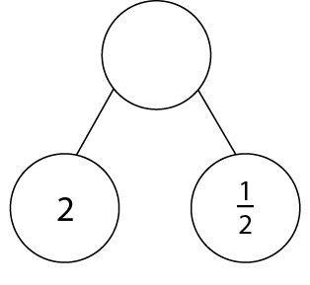
3.5 Improper fractions & mixed numbers
Step 1:2
Notes:
Quantities made up of both whole numbers and a fractional part can be expressed as mixed numbers.

Slide 7
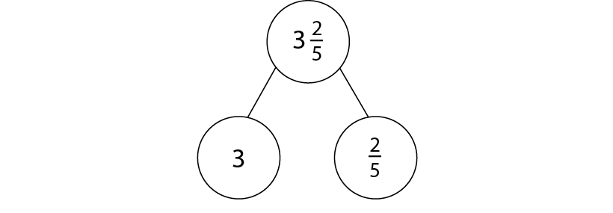
3.5 Improper fractions & mixed numbers
Step 1:4

Slide 8
3.5 Improper fractions & mixed numbers
Step 2:1
Notes:
There are ___ parts between zero and one. This means we are counting in units of ­­­­___.

Slide 9
3.5 Improper fractions & mixed numbers
Step 2:2
Notes:
There are ___ parts between zero and one. This means we are counting in units of ­­­­___.

Slide 10
3.5 Improper fractions & mixed numbers
Step 2:3
Notes:
The line is divided into ___ equal parts. This allows us to count in ­­­­­­___.

Slide 11
3.5 Improper fractions & mixed numbers
Step 2:3
Notes:
The line is divided into ___ equal parts. This allows us to count in ­­­­­­___.

Slide 12
3.5 Improper fractions & mixed numbers
Step 2:3
8
5
Notes:
The line is divided into ___ equal parts. This allows us to count in ­­­­­­___.

Slide 13
3.5 Improper fractions & mixed numbers
Step 2:4
Notes:
Each interval on the line is divided into four equal parts. This allows us to count in quarters.

Slide 14
3.5 Improper fractions & mixed numbers
Step 2:4
Notes:
Each interval on the line is divided into five equal parts. This allows us to count in fifths.

Slide 15
3.5 Improper fractions & mixed numbers
Step 2:5

Slide 16
3.5 Improper fractions & mixed numbers
Step 2:5
Explain the mistake.
Notes:
Sonny has labelled this number line incorrectly. Explain his mistake.

Slide 17
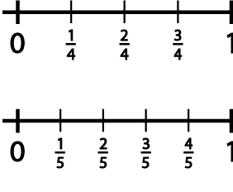
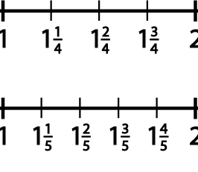
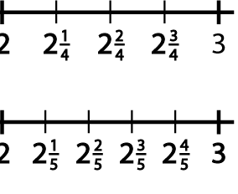
3.5 Improper fractions & mixed numbers
Step 2:6
Notes:
Tell me any number between two and three.
Tell me a number very close to three.
Tell me any number even closer to three than the previous number.
Tell me a number greater than two that is very close to two.
Tell me a number smaller than two that is very close to two.

Slide 18
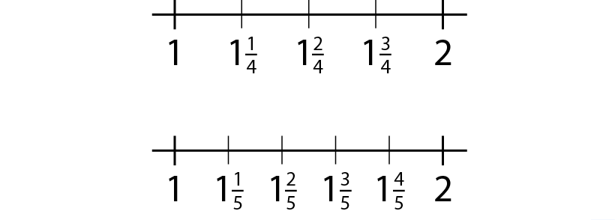
3.5 Improper fractions & mixed numbers
Step 2:6

Slide 19
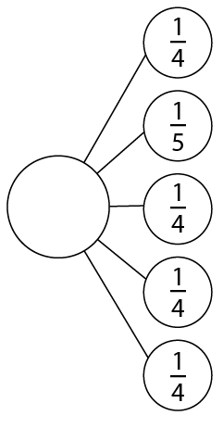
3.5 Improper fractions & mixed numbers
Step 2:6
Notes:
What mixed number can be written from the following fractional parts?

Slide 20
3.5 Improper fractions & mixed numbers
Step 2:7
Notes:
Position these numbers on the number line.

Slide 21
3.5 Improper fractions & mixed numbers
Step 2:8
Notes:
The line is divided into ___ equal parts. This allows us to count in ­­­­­­___.

Slide 22
3.5 Improper fractions & mixed numbers
Step 2:9
Notes:
Estimate the position of the following numbers on this number line.

Slide 23
3.5 Improper fractions & mixed numbers
Step 2:10
Notes:
Estimate the position of these numbers on this number line.

Slide 24
3.5 Improper fractions & mixed numbers
Step 2:11
Which of these numbers is represented by ‘a’?
✓

Slide 25
3.5 Improper fractions & mixed numbers
Step 3:1
Notes:
Identify the numbers represented by the letters.
Use them to help you fill in the missing symbols (<, > or =) in the comparison statements.
If the whole-number part of the numbers being compared is different, use this to compare the numbers.
If the whole-number part of the numbers being compared is the same, use the fractional part to compare the numbers

Slide 26
3.5 Improper fractions & mixed numbers
Step 3:3
Notes:
Tell the children that you have a theory:
Because we know that $\frac{3}{8}$ < $\frac{5}{8}$ ,
we must also know that 1$\frac{3}{8}$ < 1 $\frac{5}{8}$ .
Is my theory correct?

Slide 27
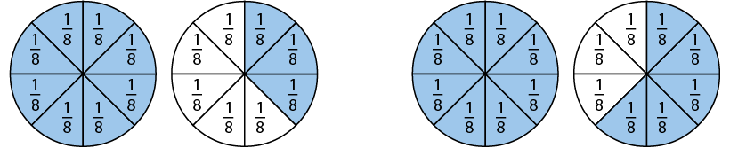
3.5 Improper fractions & mixed numbers
Step 3:3
Notes:
Tell the children that you have a theory:
Because we know that $\frac{3}{8}$ < $\frac{5}{8}$ ,
we must also know that 1$\frac{3}{8}$ < 1 $\frac{5}{8}$ .
Is my theory correct?

Slide 28
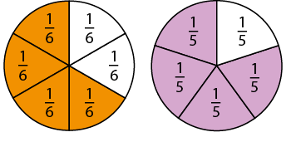
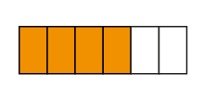
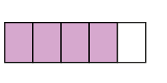
3.5 Improper fractions & mixed numbers
Step 3:5

Slide 29
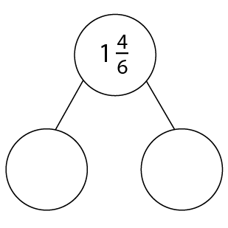
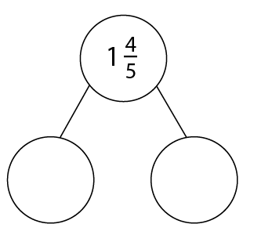
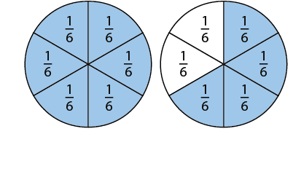
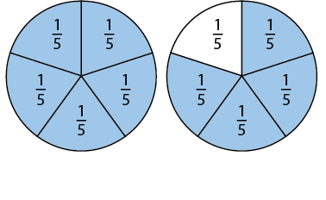
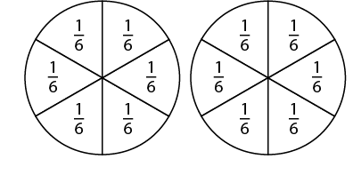
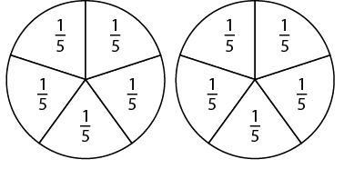
3.5 Improper fractions & mixed numbers
Step 3:5
Notes:
Can I conclude that, because I know that$\frac{4}{6}$ < $\frac{4}{5}$ ,
I must also know that 1$\frac{4}{6}$ < 1 $\frac{4}{5}$ ?

Slide 30
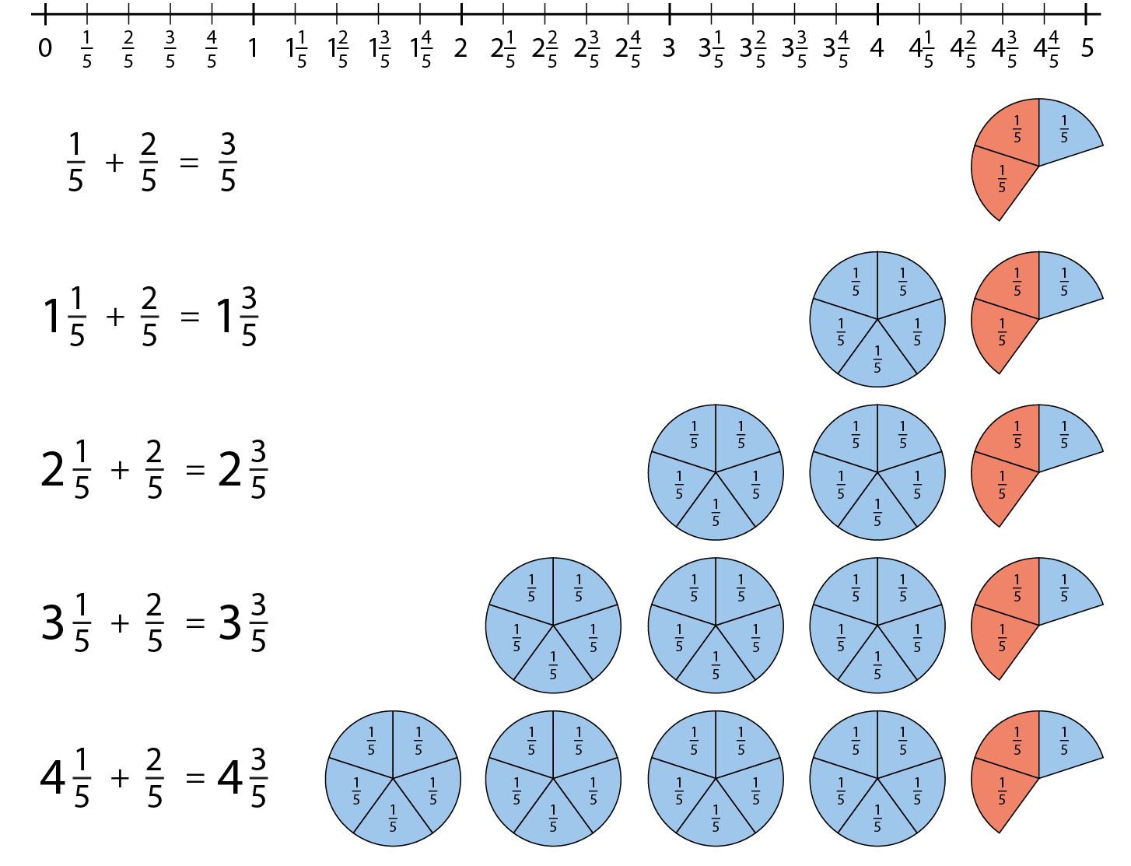
3.5 Improper fractions & mixed numbers
Step 4:1
Notes:
What would the next equation in the sequence be?
How would each of these equations be shown on a number line?
How might each of these equations be shown using an area model?

Slide 31
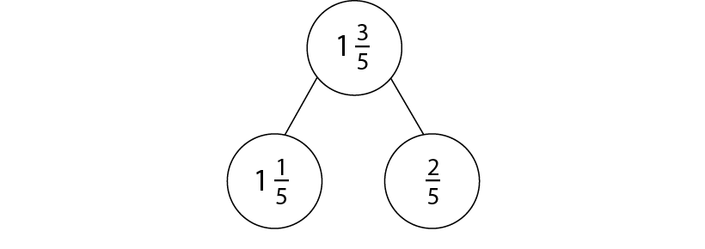
3.5 Improper fractions & mixed numbers
Step 4:1
Notes:
How could each of these equations be shown using a part–part–whole model?

Slide 32
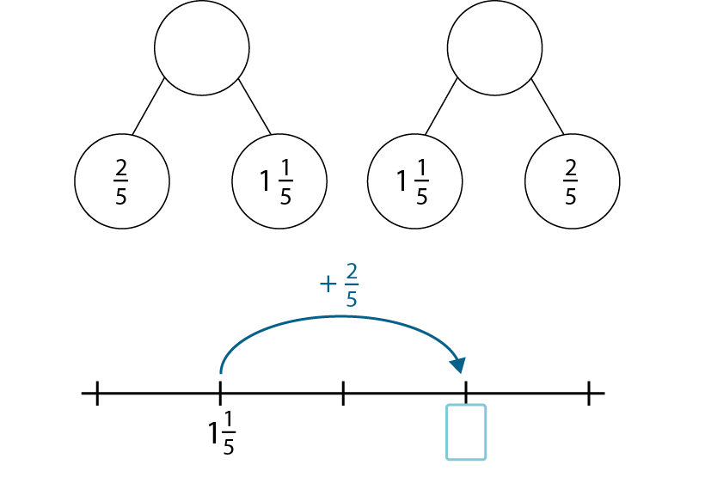
3.5 Improper fractions & mixed numbers
Step 4:2
Notes:
Verbalise this with a stem sentence:
The parts are ___and ___. The total, or whole, is ___.
E.g. The parts are $\frac{2}{5}$ and 1 $\frac{1}{5}$ . The total of the whole is 1$\frac{3}{5}$ .

Slide 33
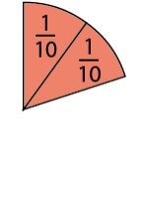
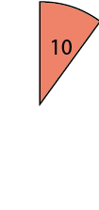
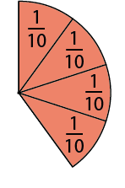
3.5 Improper fractions & mixed numbers
Step 4:3

Slide 34
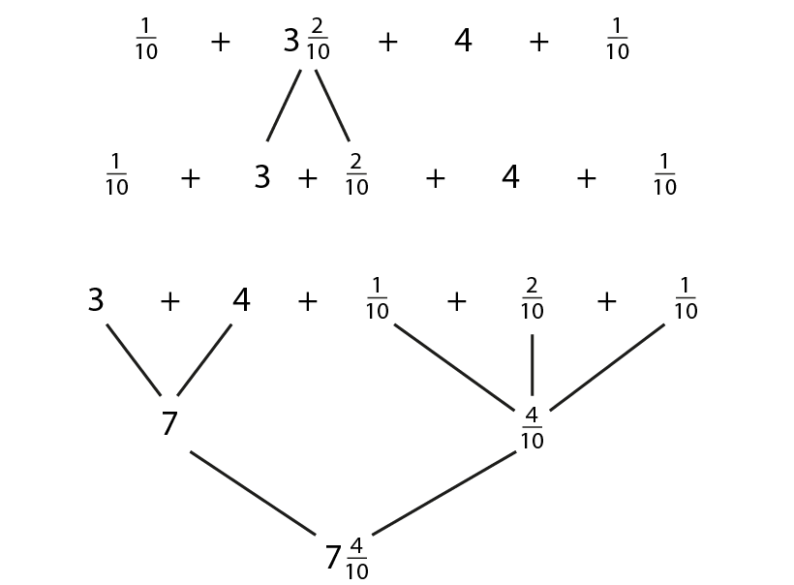
3.5 Improper fractions & mixed numbers
Step 4:3
Notes:
Justify the order you use when finding the answer.

Slide 35
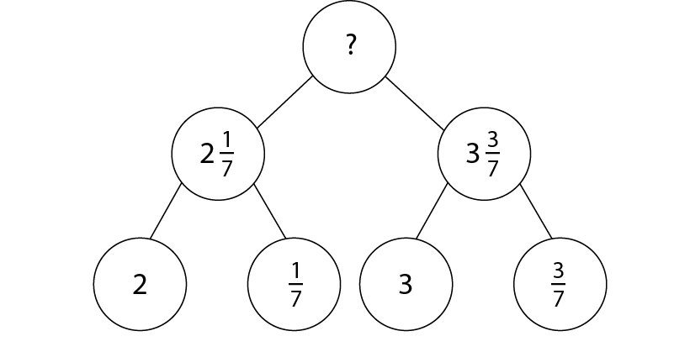
3.5 Improper fractions & mixed numbers
Step 4:4

Slide 36
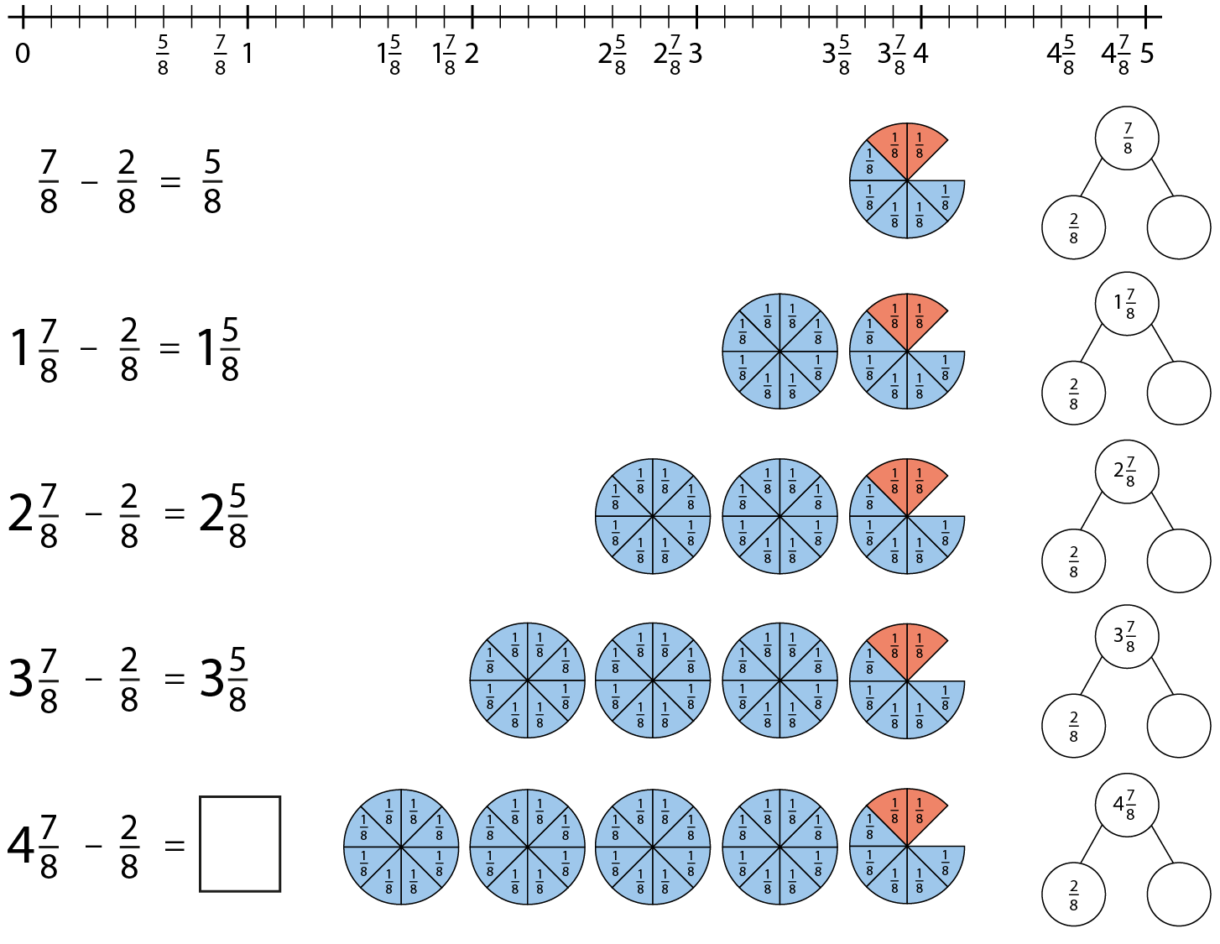
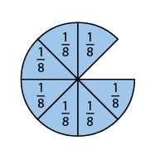
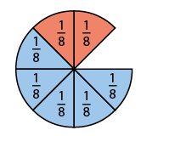
3.5 Improper fractions & mixed numbers
Step 4:5
Notes:
What would the next equation in the sequence be?
How would each of these equations be shown on a number line?
How would each of these equations be shown using an area model?

Slide 37
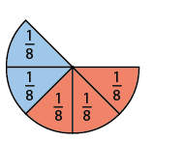
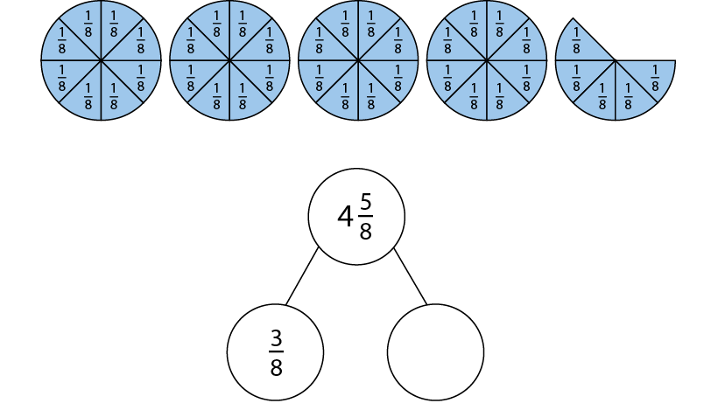
3.5 Improper fractions & mixed numbers
Step 4:6

Slide 38
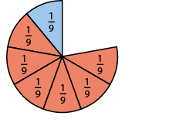
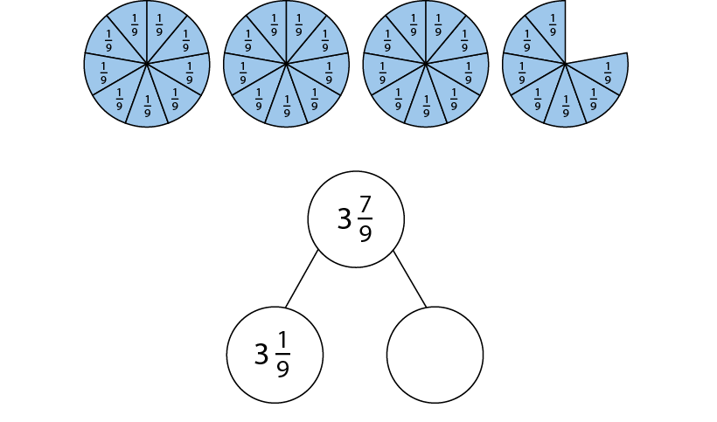
3.5 Improper fractions & mixed numbers
Step 4:6

Slide 39
3.5 Improper fractions & mixed numbers
Step 4:7

Slide 40
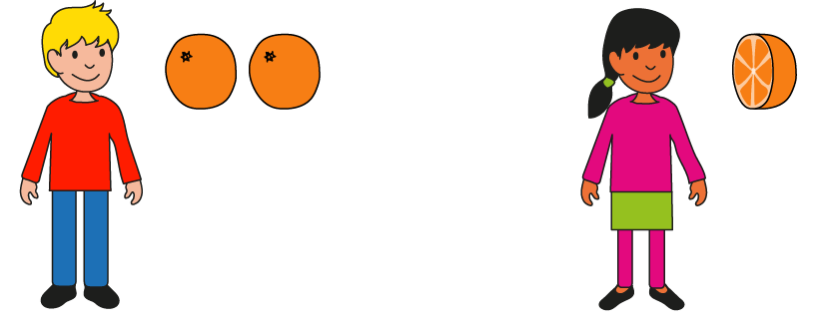
3.5 Improper fractions & mixed numbers
Step 5:1
Each whole orange is split into
2 equal parts
and we have 5 of
those parts.
Notes:
How many oranges are there altogether?
How many halves are there?

Slide 41
3.5 Improper fractions & mixed numbers
Step 5:2

Slide 42
3.5 Improper fractions & mixed numbers
Step 5:3
Notes:
Count:
‘One orange, two oranges, three oranges…’
‘One group of four-quarters, two groups of four-quarters, three groups of four-quarters…’
‘Four-quarters, eight-quarters, twelve-quarters…’

Slide 43
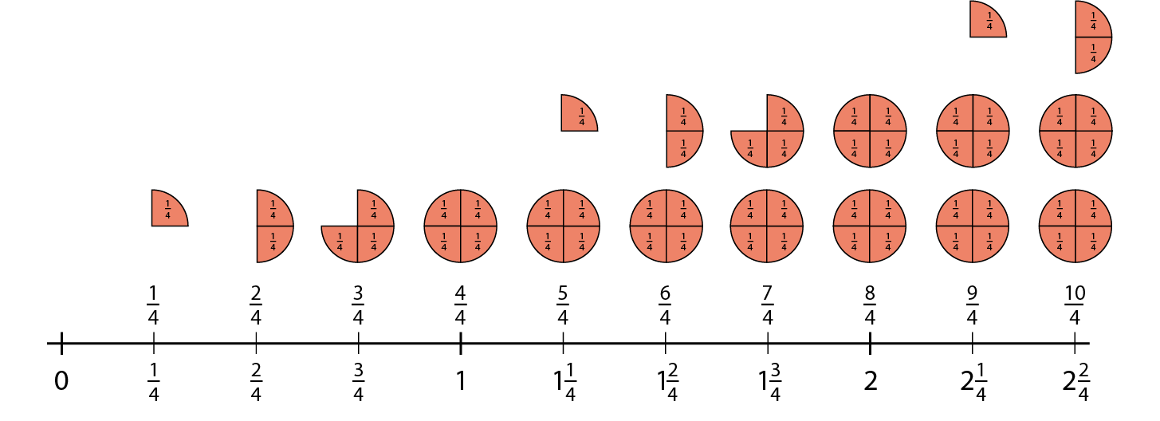
3.5 Improper fractions & mixed numbers
Step 5:4
Notes:
For support, use the stem sentence:
Each whole is divided into four equal parts. There are ___ of these equal parts. This represents ___ quarter(s).

Slide 44
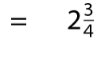
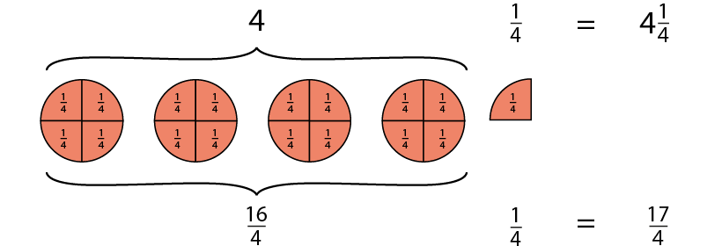
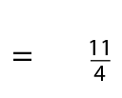
3.5 Improper fractions & mixed numbers
Step 5:5

Slide 45
3.5 Improper fractions & mixed numbers
Step 5:8
Notes:
The denominator is four. This means that each whole has been split into four equal parts.
The numerator is ten. This means that there are ten equal parts.
It is possible to make two full groups of four-quarters and there are two more quarters.

Slide 46
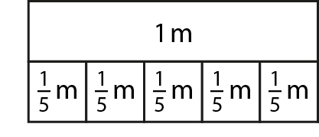
3.5 Improper fractions & mixed numbers
Step 5:9

Slide 47
3.5 Improper fractions & mixed numbers
Step 5:10

Slide 48
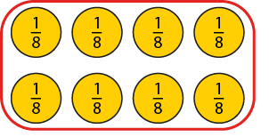
3.5 Improper fractions & mixed numbers
Step 5:13
Notes:
Our unit is eighths so we will be thinking about groups of eight.
There are eight-eighths in one whole.

Slide 49
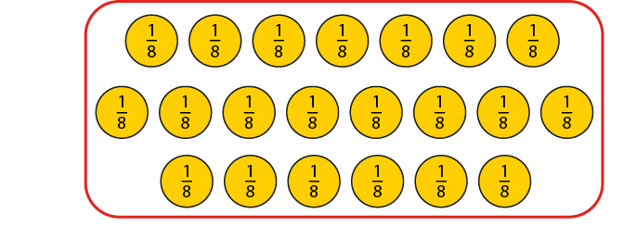
3.5 Improper fractions & mixed numbers
Step 5:14

Slide 50
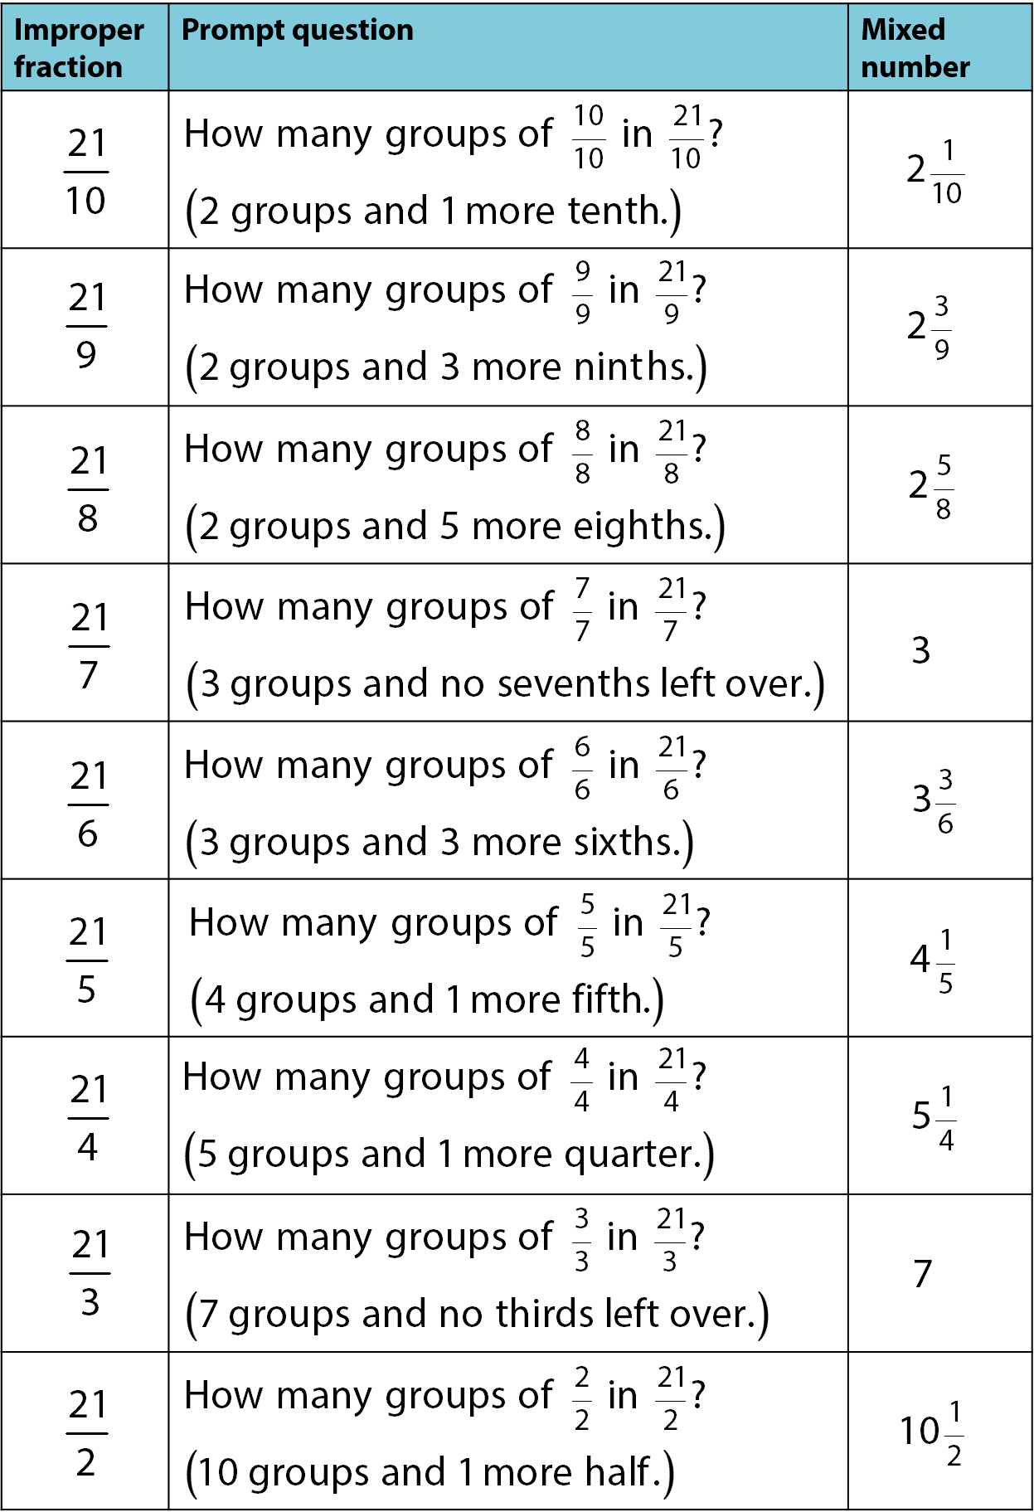
3.5 Improper fractions & mixed numbers
Step 5:14

Slide 51
3.5 Improper fractions & mixed numbers
Step 5:14
Notes:
You can circle these counters to help complete the table from the previous slide.
Answers are given on the next slide.

Slide 52
3.5 Improper fractions & mixed numbers
Step 5:14

Slide 53
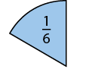
3.5 Improper fractions & mixed numbers
Step 5:16
Notes:
What is the same? What is different?
Use the stem sentence:
These are ____ groups of ____ -sixths which is ____-sixths, and ____ more sixths, so that is ____-sixths.

Slide 54
3.5 Improper fractions & mixed numbers
Step 5:16

Slide 55
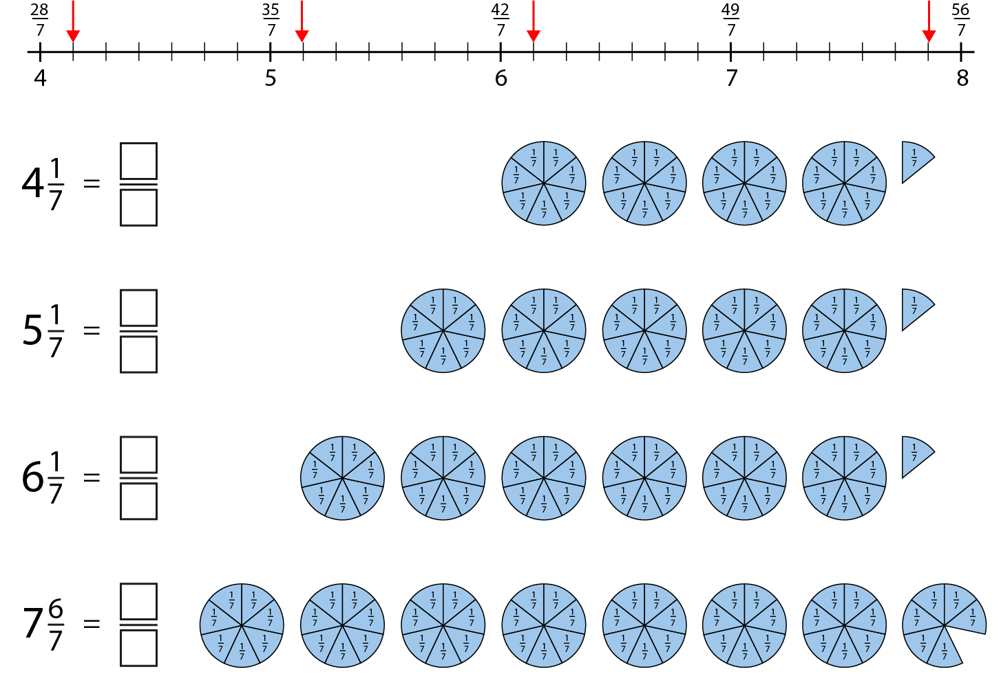
3.5 Improper fractions & mixed numbers
Step 5:16

Slide 56
3.5 Improper fractions & mixed numbers
Step 6:1

Slide 57
3.5 Improper fractions & mixed numbers
Step 6:1

Slide 58
3.5 Improper fractions & mixed numbers
Step 6:1

Slide 59
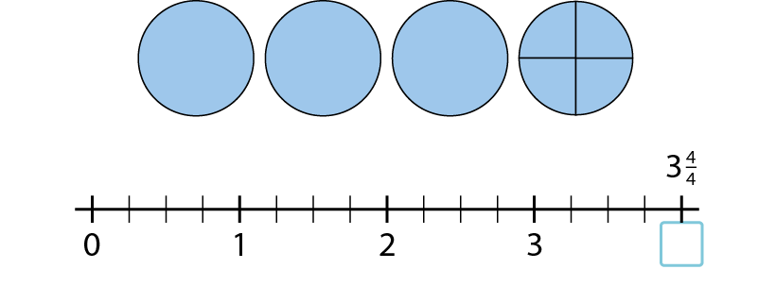
3.5 Improper fractions & mixed numbers
Step 6:2

Slide 60
3.5 Improper fractions & mixed numbers
Step 6:2

Slide 61
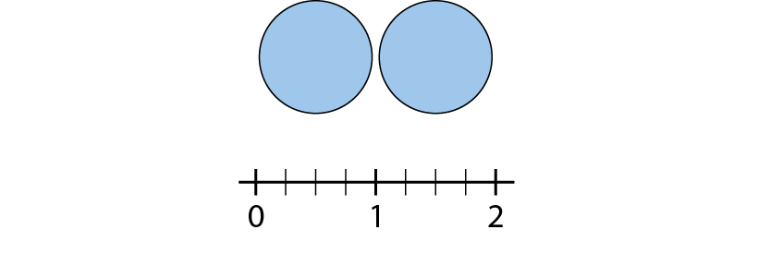
3.5 Improper fractions & mixed numbers
Step 6:2

Slide 62
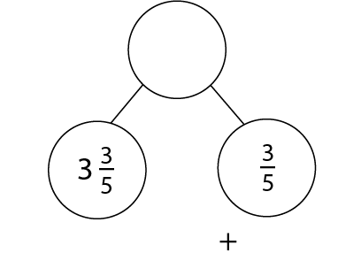
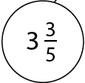
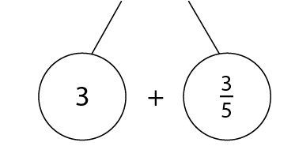
3.5 Improper fractions & mixed numbers
Step 6:3

Slide 63
3.5 Improper fractions & mixed numbers
Step 6:4
Aggregation model:

Slide 64
3.5 Improper fractions & mixed numbers
Step 6:4
Aggregation model:

Slide 65
3.5 Improper fractions & mixed numbers
Step 6:4
Augmentation model

Slide 66
3.5 Improper fractions & mixed numbers
Step 6:5
Notes:
Think of 3 as $2\frac{7}{7}$.
Does this make it easier to subtract $\frac{2}{7}$?

Slide 67
3.5 Improper fractions & mixed numbers
Step 6:8

Slide 68
3.5 Improper fractions & mixed numbers
Step 6:9
Notes:
How could I rewrite the mixed number 3 $\frac{3}{7}$ ?
(It can be rewritten as 3 $\frac{3}{7}$ = $\frac{24}{7}$ )

Slide 69
3.5 Improper fractions & mixed numbers
Step 6:10

Slide 70
3.5 Improper fractions & mixed numbers
Step 6:10

Slide 71
3.5 Improper fractions & mixed numbers
Step 6:10

Slide 72
3.5 Improper fractions & mixed numbers
Step 6:10

Slide 73
3.5 Improper fractions & mixed numbers
Step 6:11
What is the mistake?

Slide 74
3.5 Improper fractions & mixed numbers
Step 6:11
Notes:
Discuss this mistake and then use the number line to show the correct answer.

