Slide 1
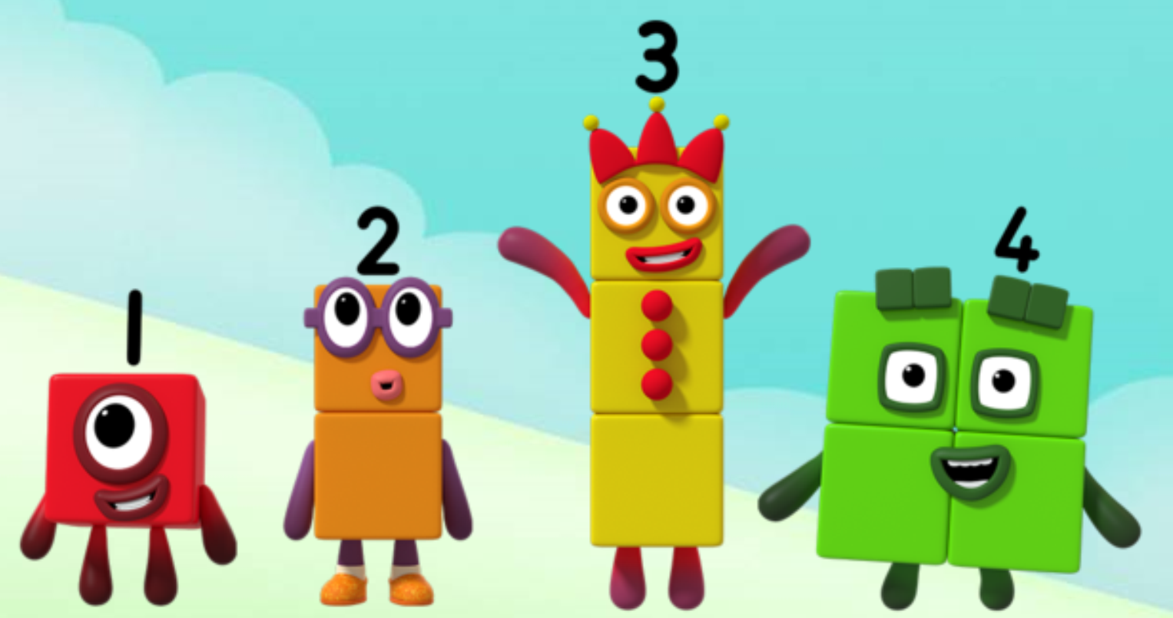
Series 2 Episode 4
Nine

Slide 2
Maths in the Episode
To watch this episode, please go to BBC iPlayer – Numberblocks. Look for Series 2: Nine
Saying the counting numbers to 9
In this episode children can join in with the Numberblocks counting to 9.
Nine is eight and one more
Children can see that Nine is made when Eight and One join (combine) together. Nine can stand next to Eight when the Numberblocks stand in order.
Square numbers
Children can see that Numberblocks Four and Nine can both get into a square shape. This makes them ‘square numbers’.

Slide 3
Talk and discuss together
Watch the episode together.
Ask your child what they noticed and be interested in anything they have to say.
Use the following pictures and activities to explore and talk about the maths involved.

Slide 4
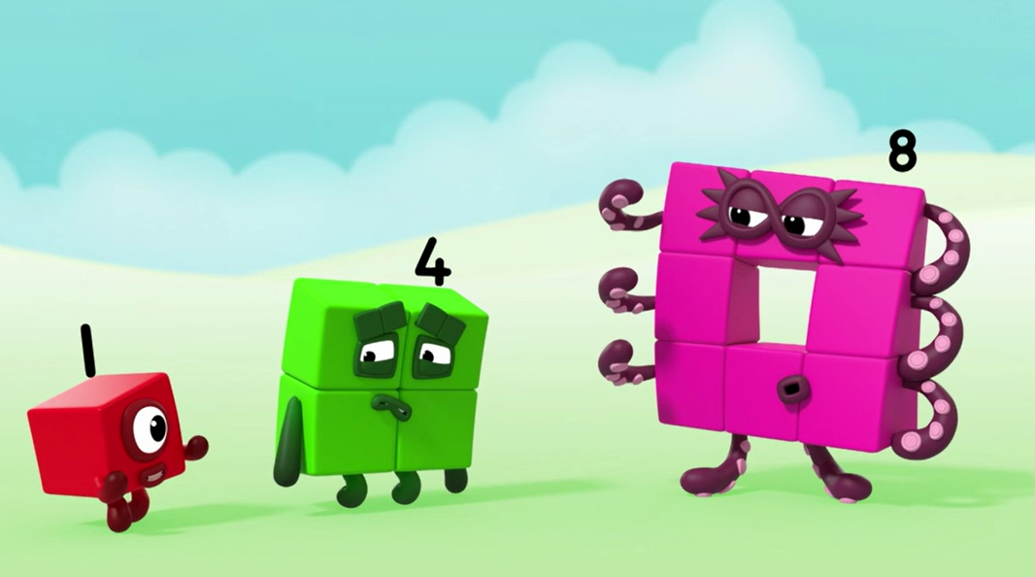
How can we make someone square like me?
Images © 2017 Alphablocks Ltd. All Rights Reserved.

Slide 5
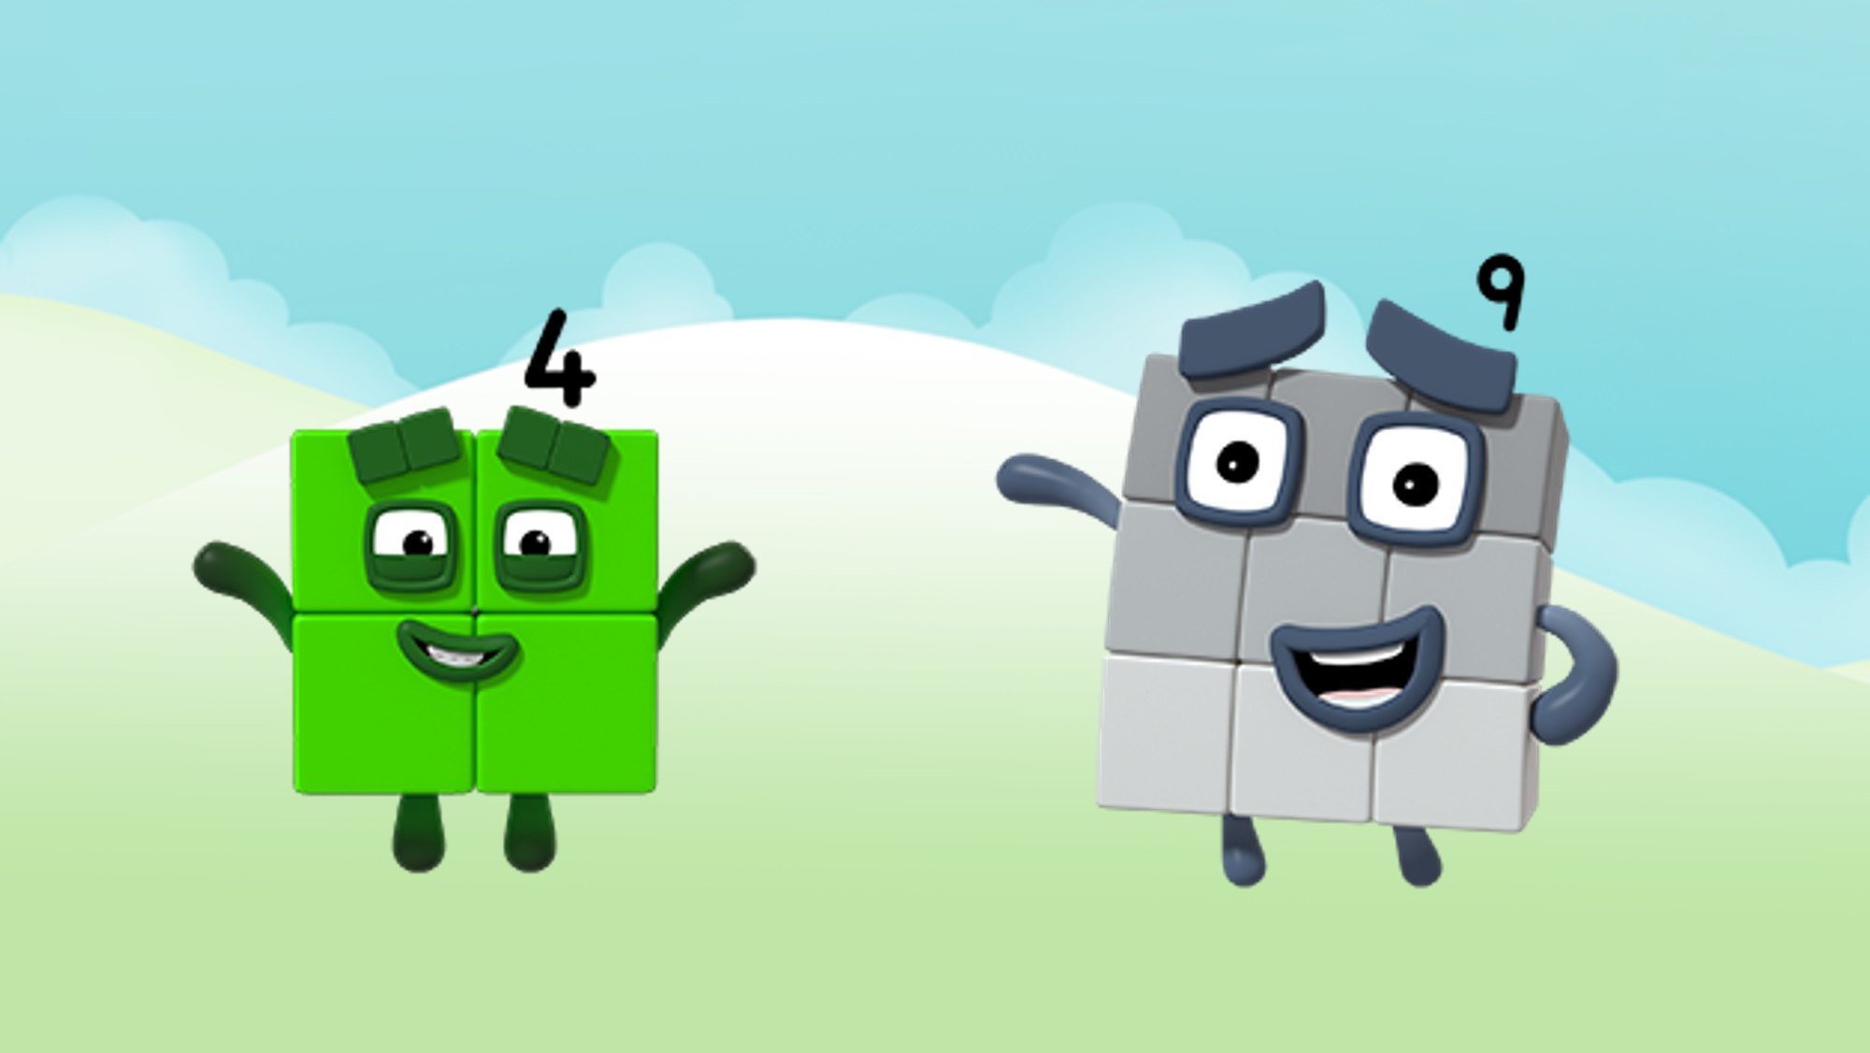
I am Nine! I am like you because we are both squares!
Images © 2017 Alphablocks Ltd. All Rights Reserved.

Slide 6
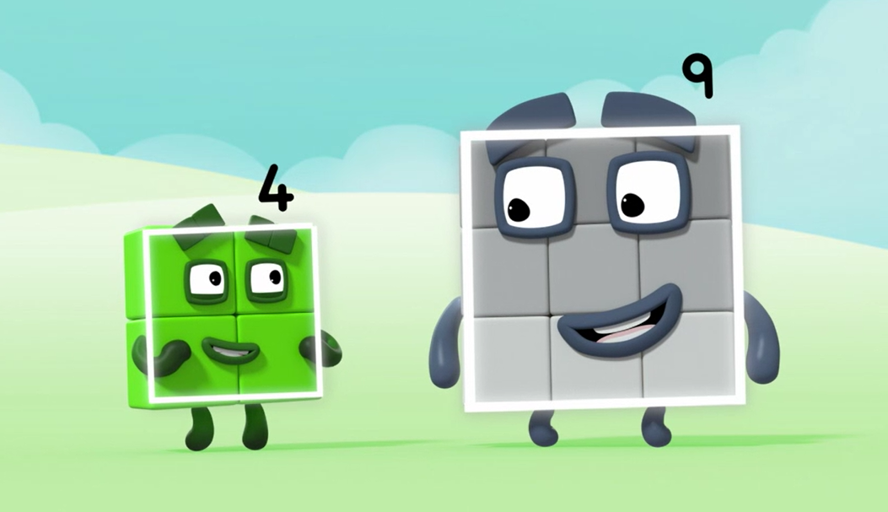
Can you count our sides? How many sides do we each have?
Images © 2017 Alphablocks Ltd. All Rights Reserved.

Slide 7
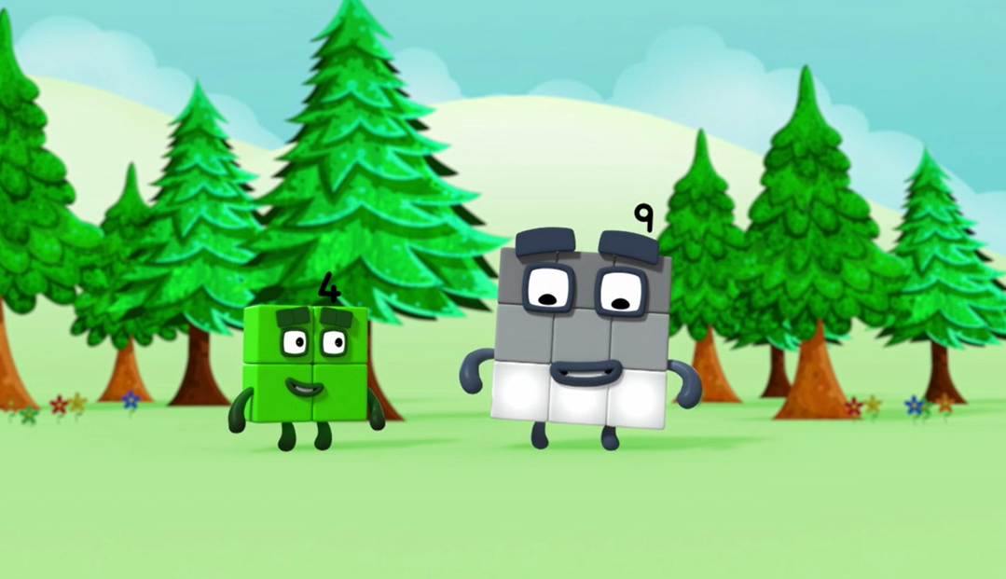
Can you see how many rows of three I have?
Images © 2017 Alphablocks Ltd. All Rights Reserved.

Slide 8
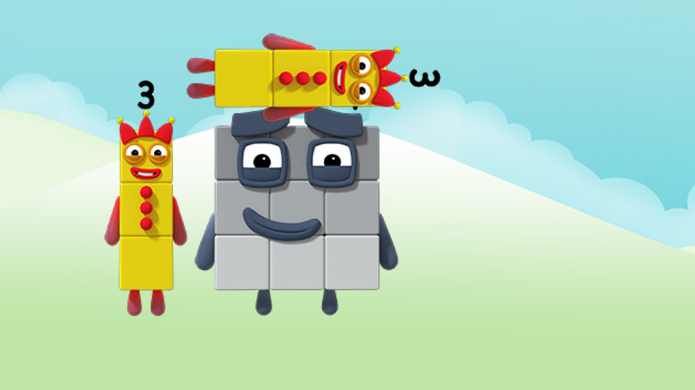
Can you see how many blocks tall and wide I am?
Images © 2017 Alphablocks Ltd. All Rights Reserved.

Slide 9
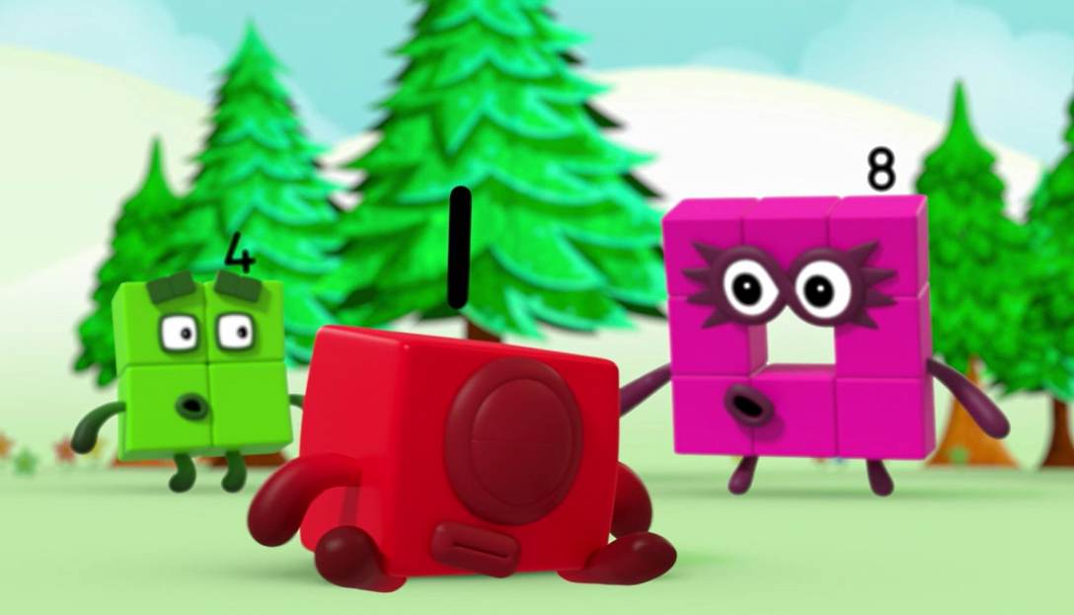
ACHOOOO!
Why am I Eight again?
Images © 2017 Alphablocks Ltd. All Rights Reserved.

Slide 10
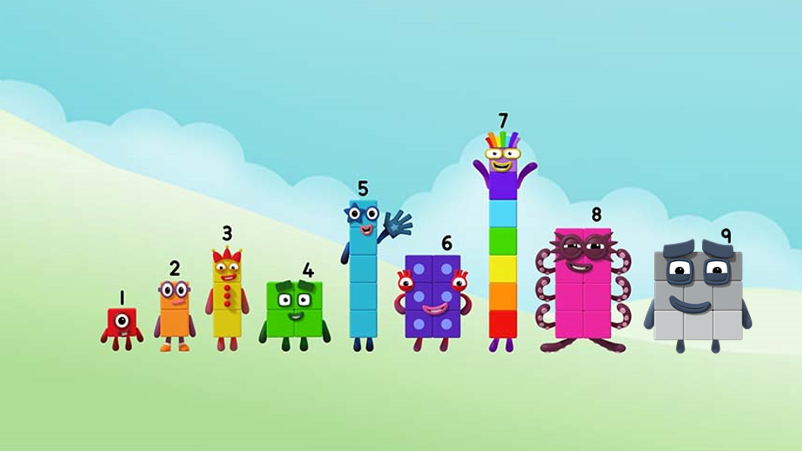
1, 2, 3, 4, 5, 6, 7, 8, 9!
I come after 8!
Images © 2017 Alphablocks Ltd. All Rights Reserved.

Slide 11
Around the home
Practise saying the counting numbers to 9 putting up one finger each time.
Show 9 on your fingers without counting them. Try starting with all your fingers (and thumbs) up and putting down one finger. Do you always end up with nine? What if you put down a different finger or thumb?
See if you can do 9 big steps and say one number for each step. Turn around and do 9 steps back – you could try counting back from 9 to 1!
Use blocks or cut out squares. Arrange them in three rows of three so they are the same shape as Nine. Draw some eyes and a mouth and you have Nine!
Use small objects all the same size (for example, penny coins or bottle tops) and make an arrangement of nine in three rows of three. What happens if you hide one of the objects, how many do you have now?
Draw a big grid which is three by three. Fill it with nine of your favourite things!
Draw a three-by-three grid and see if you can write the numbers 1 to 9 in the squares. Can you do it in any order?

Slide 12
General tips that can make a difference in maths
Provide lots of opportunities to say how many things you can see (up to 5) without counting.
Whenever you talk about a small set of objects, say the number. For example, please pick up those 3 teddies or look at those 2 dogs.
Count up (starting from one) when walking upstairs and count back when walking downstairs.
Count lots of different objects, big and small, and ask ‘How many are there?’ Your child should be able to tell you without going back and re-counting. If they can’t, then tell them: ‘There are 6 altogether’.
Play with fingers, firstly practise counting fingers.
Ask your child to put their fingers down and then say or hold up a number such as 3. Can they do it without counting? Can they do it using different fingers? Can they do it using fingers from two hands?
Play board games with your child which involve moving along numbered tracks, such as ‘Snakes and Ladders’. Check that your child counts along the track correctly, moving one square for each number counted.
Regular use of these simple ideas, whenever the opportunity arises, will improve your child’s maths.

Slide 13
General tips that can make a difference in maths
Notice when there are two amounts and one is more than the other, or they are the same. For example, I have 2 eyes and 2 ears, or I have more chips than peas.
Talk about and describe shapes you can see outside or around your home. For example, count corners, talk about straight/curved edges, flat/curved surfaces. If you have building blocks then talk about and describe the things that are built.
In the bath or at the sink, play with containers, pouring water, counting how many small pots are needed to fill the big container.
Encourage your child to draw a picture of their number work and explain their mark-making to you, for example, how many leaves they find on a walk. This doesn’t necessarily mean writing the numerals (1, 2, 3, 4… etc.).
Sing counting songs and rhymes. You can find some on the internet, but children love it if you join in with them!
Make a deliberate maths mistake from time to time and ask your child to explain why you are wrong. For example, say that 4 is bigger than 5.
Regular use of these simple ideas, whenever the opportunity arises, will improve your child’s maths.

