Slide 1
Year 3, Unit 1
Adding and subtracting across 10

Slide 2
Year 3, Unit 1
These materials heavily reflect the prioritisation approach of the ready-to-progress criteria in the DfE Primary Mathematics Guidance 2020 and on the PPTs that exemplify them on the NCETM website. They also include other relevant National Curriculum content. Related sections of the NCETM Primary Mastery Professional Development Materials provide small-step teaching guidance.
Ready-to-progress criteria addressed by this unit
Teaching of this unit supports the following criteria from the ‘DfE Mathematics Guidance: key stages 1 & 2’ (the 335-page document available as a download)
2AS-1 Page 57
3NF-1 Page 98
Where an RTP is offered from a previous year group, this is to allow time to consolidate learning. If learning is secure teachers can move onto the next unit.

Slide 3
Contents
The links below take you to the starting slide of each learning outcome.
1 | Pupils add 3 addends
2 | Pupils use a ‘First... Then… Now” story to add 3 addends
3 | Pupils explain that addends can be added in any order
4 | Pupils add 3 addends efficiently
5 | Pupils add 3 addends efficiently by finding two addends that total 10
6 | Pupils add two numbers that bridge through 10
7 | Pupils subtract two numbers that bridge through 10
Click the arrow button to return to this Contents slide.

Slide 4
Year 3, Unit 1, Learning Outcome 1
Learning Outcome 1
Pupils add 3 addends
The following slides have been collated to support the teaching of this learning outcome.

Slide 5
Year 3, Unit 1, Learning Outcome 1
Additional teacher guidance for this outcome should be read first and can be found in this segment of the NCETM Primary Mastery Professional Development Materials:
1.11 Addition and subtraction: bridging 10
The spine materials are divided into ‘teaching points’ and ‘steps in learning’.
Teaching point | Steps in learning | Pages
1 | 1:1-1:3 | 3-4

Slide 6
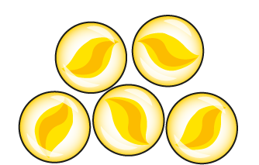
1.11 Addition: three numbers and bridging 10 – step 1:1
2 + 3 + 5
= 10

Slide 7
1.11 Addition: three numbers and bridging 10 – step 1:1
6 + 0 + 3
= 9
Notes:
The children play a game. Now Madison has six marbles, Charlie has no marbles and Asif has three marbles. They have nine marbles altogether.

Slide 8
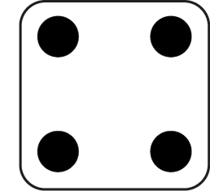
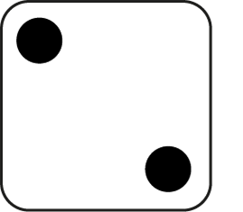
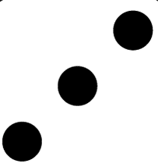
1.11 Addition: three numbers and bridging 10 – step 1:1
2
+
3
+
4
= 9

Slide 9
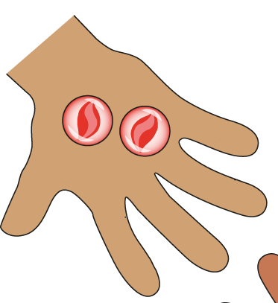
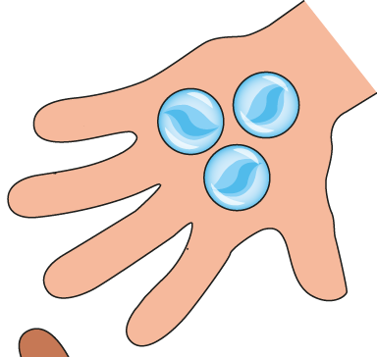
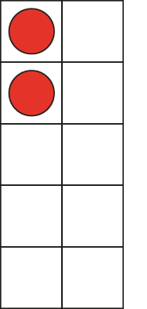
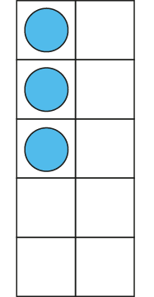
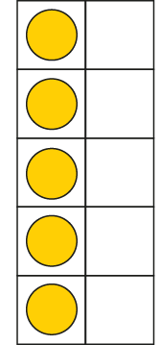
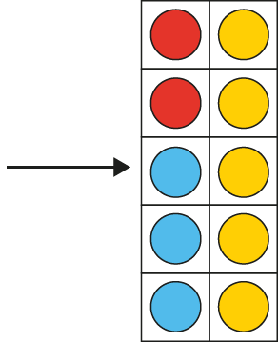
1.11 Addition: three numbers and bridging 10 – step 1:2
2 + 3 + 5
= 10

Slide 10
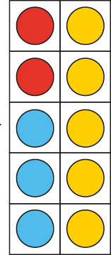
1.11 Addition: three numbers and bridging 10 – step 1:2
10 = 2 + 3 + 5
Notes:
Madison has two red marbles, Charlie has three blue marbles and Asif has five yellow marbles. They have ten marbles altogether.

Slide 11
1.11 Addition: three numbers and bridging 10 – step 1:3
2 + 3 + 5
= 10
Notes:
Madison has two red marbles, Charlie has three blue marbles and Asif has five yellow marbles. They have ten marbles altogether.

Slide 12
Year 3, Unit 1, Learning Outcome 2
Learning Outcome 2
Pupils use a ‘First... Then… Now” story to add 3 addends
The following slides have been collated to support the teaching of this learning outcome.

Slide 13
Year 3, Unit 1, Learning Outcome 2
Additional teacher guidance for this outcome should be read first and can be found in this segment of the NCETM Primary Mastery Professional Development Materials:
1.11 Addition and subtraction: bridging 10
The spine materials are divided into ‘teaching points’ and ‘steps in learning’.
Teaching point | Steps in learning | Pages
2 | 2:1-2:5 | 5-6

Slide 14
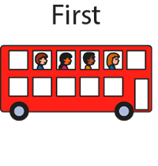
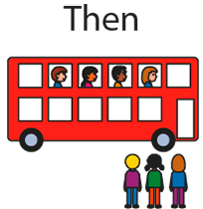
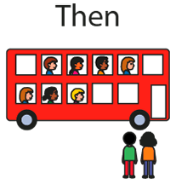
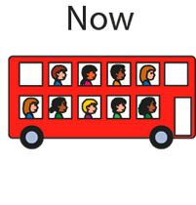
1.11 Addition: three numbers and bridging 10 – step 2:1

Slide 15
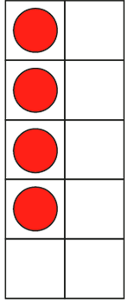
1.11 Addition: three numbers and bridging 10 – step 2:2
First, four children were sitting on a bus.
Then, three more children got on the bus…
… and then two more children got on.
Now, nine children are sitting on the bus.

Slide 16
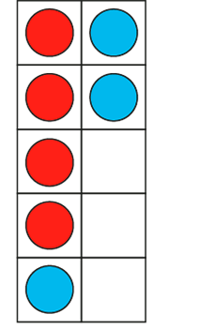
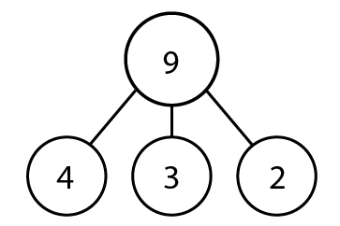
1.11 Addition: three numbers and bridging 10 – step 2:2
9 = 4 + 3 + 2

Slide 17
1.11 Addition: three numbers and bridging 10 – step 2:3
4 + 3 + 2 = 9

Slide 18
1.11 Addition: three numbers and bridging 10 – step 2:4
Notes:
A snail is two centimetres up a flower stalk. Then it crawls up four centimetres, and then one centimetre more. How high up the stalk is it now?’

Slide 19
1.11 Addition: three numbers and bridging 10 – step 2:5
Which equation matches this number line?
3 + 3 = 6
0 + 3 + 3 = 6
3 + 3 + 6 = 12

Slide 20
Year 3, Unit 1, Learning Outcome 3
Learning Outcome 3
Pupils explain that addends can be added in any order
The following slides have been collated to support the teaching of this learning outcome.

Slide 21
Year 3, Unit 1, Learning Outcome 3
Additional teacher guidance for this outcome should be read first and can be found in this segment of the NCETM Primary Mastery Professional Development Materials:
1.11 Addition and subtraction: bridging 10
The spine materials are divided into ‘teaching points’ and ‘steps in learning’.
Teaching point | Steps in learning | Pages
3 | 3:1-3:4 | 7-9

Slide 22
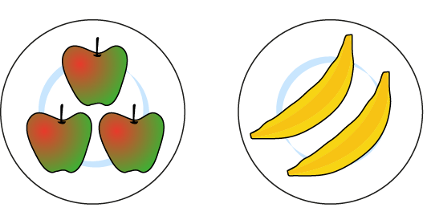
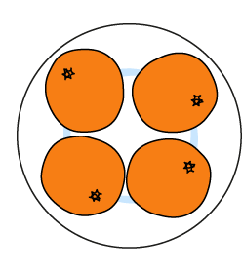
1.11 Addition: three numbers and bridging 10 – step 3:1
3 + 2
+ 4
5
+ 4
3 + 2
+ 4 =
+ 4
= 9
5

Slide 23
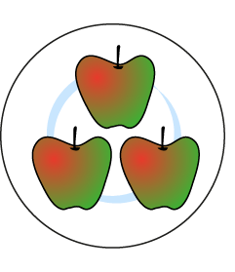
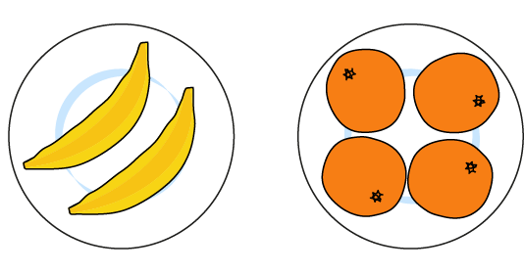
1.11 Addition: three numbers and bridging 10 – step 3:1
3 +
2 + 4
3 +
6
3 +
2 + 4
= 9
6
=
3 +

Slide 24
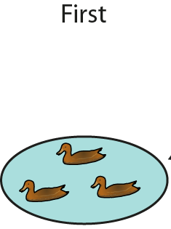
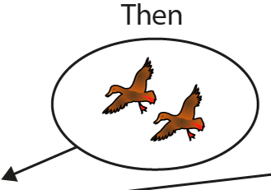
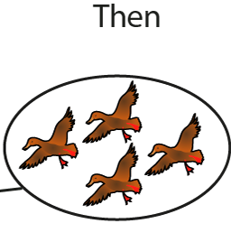
1.11 Addition: three numbers and bridging 10 – step 3:2

Slide 25
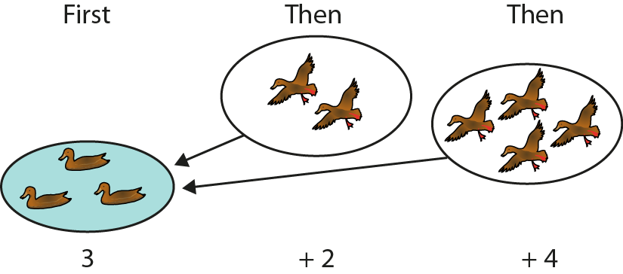
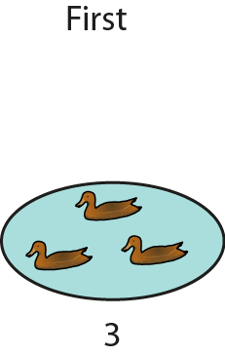
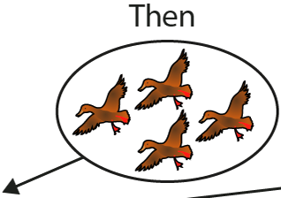
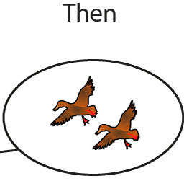
1.11 Addition: three numbers and bridging 10 – step 3:2
3 + 2 + 4 = 3 + 4 + 2

Slide 26
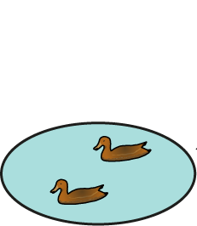
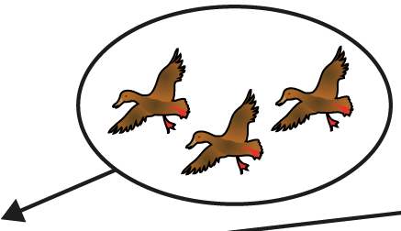
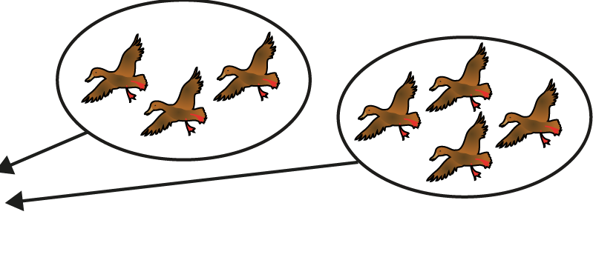
1.11 Addition: three numbers and bridging 10 – step 3:2
3 + 2 + 4 = 2 + 3 + 4

Slide 27
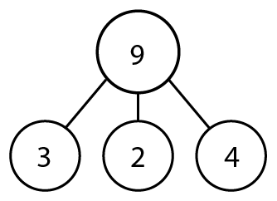
1.11 Addition: three numbers and bridging 10 – step 3:3

Slide 28
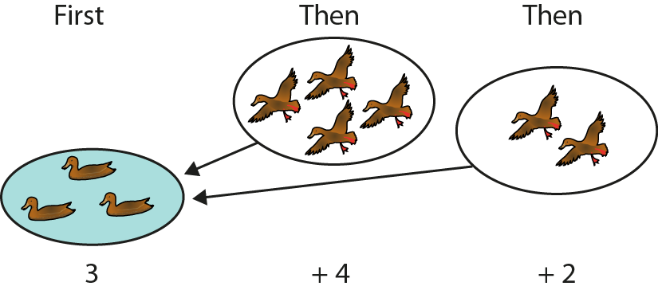
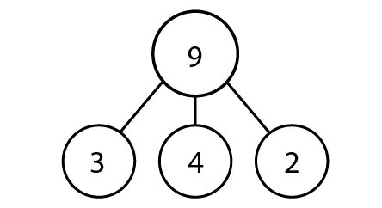
1.11 Addition: three numbers and bridging 10 – step 3:3

Slide 29
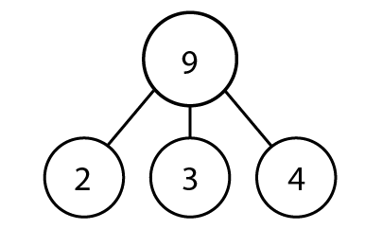
1.11 Addition: three numbers and bridging 10 – step 3:3
2

Slide 30
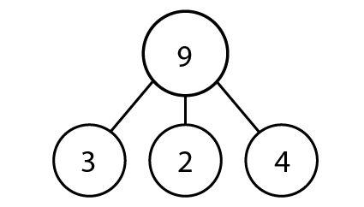
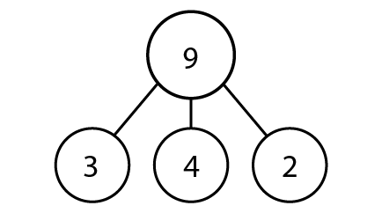
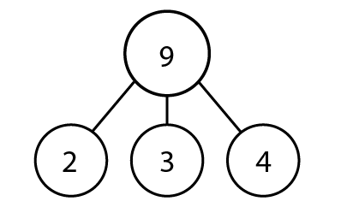
1.11 Addition: three numbers and bridging 10 – step 3:3

Slide 31
1.11 Addition: three numbers and bridging 10 – step 3:4
3 + 2 + 4
= 2 + 4 + 3

Slide 32
MASTER Year 3, Unit 1, Learning Outcome 4
Learning Outcome 4
Pupils add 3 addends efficiently
The following slides have been collated to support the teaching of this learning outcome.

Slide 33
Year 3, Unit 1, Learning Outcome 4
Additional teacher guidance for this outcome should be read first and can be found in this segment of the NCETM Primary Mastery Professional Development Materials:
1.11 Addition and subtraction: bridging 10
The spine materials are divided into ‘teaching points’ and ‘steps in learning’.
Teaching point | Steps in learning | Pages
4 | 4:1-4:4 | 10-11

Slide 34
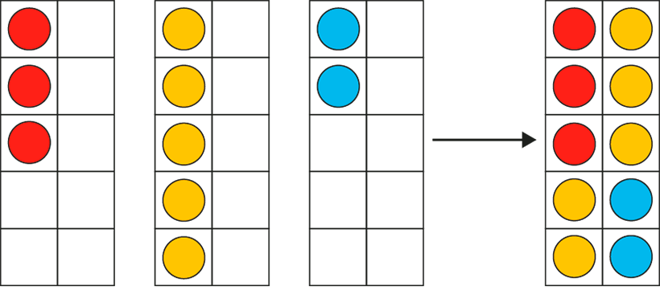
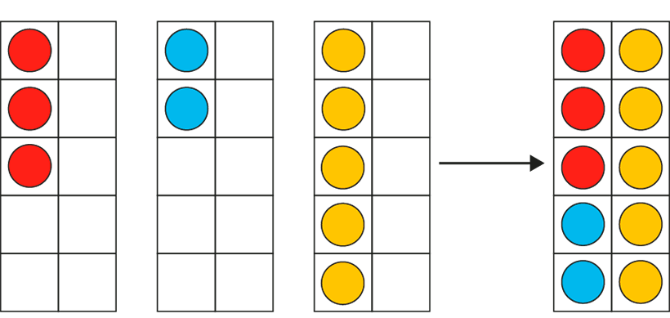
1.11 Addition: three numbers and bridging 10 – step 4:1
Notes:
In my toy box, I have three red cars, five yellow cars and two blue cars. I have ten cars altogether.’

Slide 35
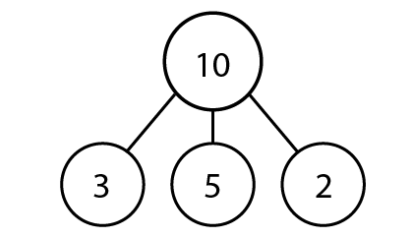
1.11 Addition: three numbers and bridging 10 – step 4:2

Slide 36
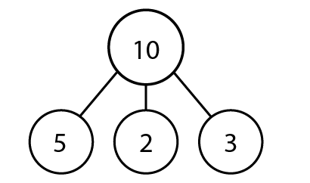
1.11 Addition: three numbers and bridging 10 – step 4:2

Slide 37
1.11 Addition: three numbers and bridging 10 – step 4:3
6
9
2 + 4 + 3 = + 3 =

Slide 38
1.11 Addition: three numbers and bridging 10 – step 4:3
5
9
2 + 4 + 3 = + 4 =

Slide 39
1.11 Addition: three numbers and bridging 10 – step 4:3
7
9
2 + 4 + 3 = + 2 =

Slide 40
1.11 Addition: three numbers and bridging 10 – step 4:3
3
4
7
2 + 1 + 4 = + =

Slide 41
1.11 Addition: three numbers and bridging 10 – step 4:3
2
5
7
2 + 1 + 4 = + =

Slide 42
1.11 Addition: three numbers and bridging 10 – step 4:3
6
1
7
2 + 1 + 4 = + =

Slide 43
1.11 Addition: three numbers and bridging 10 – step 4:4
Fill in the missing squares, using the numbers 0, 1, 2, 4, 5 and 6, so that each row and column adds up to the same number.
4
5
0
3
3
3
2
1
6

Slide 44
Year 3, Unit 1, Learning Outcome 5
Learning Outcome 5
Pupils add 3 addends efficiently by finding two addends that total 10
The following slides have been collated to support the teaching of this learning outcome.

Slide 45
Year 3, Unit 1, Learning Outcome 5
Additional teacher guidance for this outcome should be read first and can be found in this segment of the NCETM Primary Mastery Professional Development Materials:
1.11 Addition and subtraction: bridging 10
The spine materials are divided into ‘teaching points’ and ‘steps in learning’.
Teaching point | Steps in learning | Pages
4 | 4:5-4:10 | 12-14

Slide 46
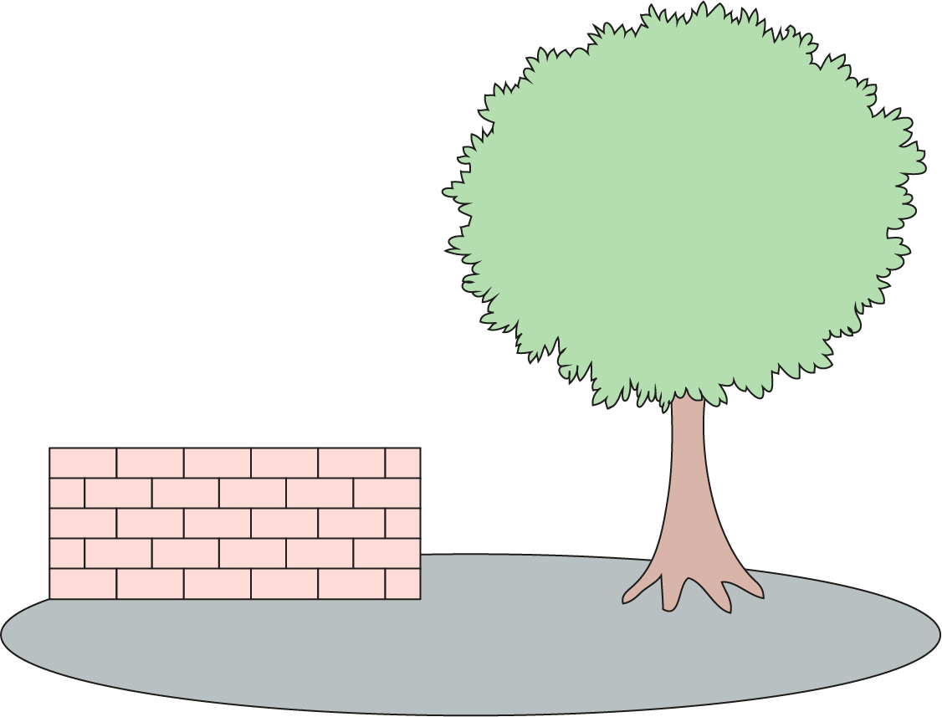
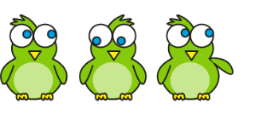
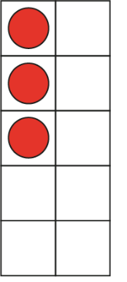
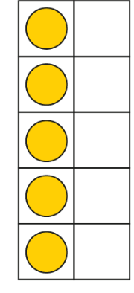
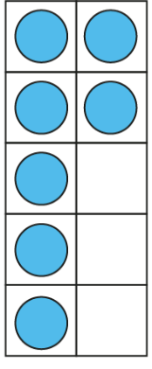
1.11 Addition: three numbers and bridging 10 – step 4:5
5
+ 10
3
+ 5
+ 7
= 5 + 10
3
+ 5
+ 7

Slide 47
1.11 Addition: three numbers and bridging 10 – step 4:6
5 + 6 + 5 =
16

Slide 48
1.11 Addition: three numbers and bridging 10 – step 4:6
3 + 3 + 7 =
13

Slide 49
1.11 Addition: three numbers and bridging 10 – step 4:6
7 + 4 + 3 =
14

Slide 50
1.11 Addition: three numbers and bridging 10 – step 4:6
8 + 4 + 2 =
14

Slide 51
1.11 Addition: three numbers and bridging 10 – step 4:6
2 + 8 + 6 =
16

Slide 52
1.11 Addition: three numbers and bridging 10 – step 4:7
7 + 5 + 5
4 + 8 + 5
7 + 6 + 2
1 + 3 + 9
Can make 10 | Cannot make 10

Slide 53
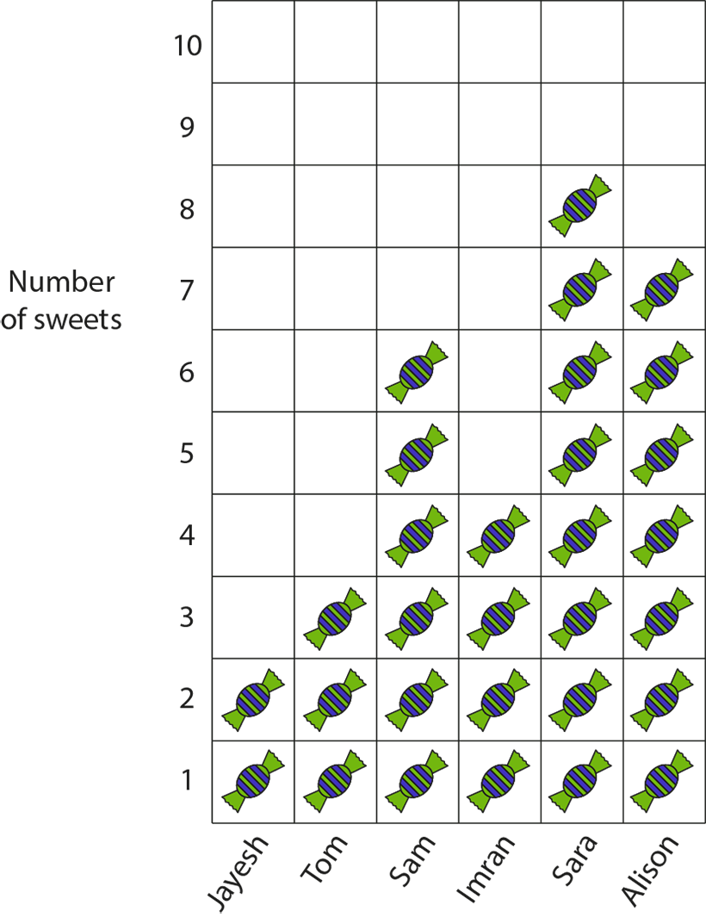
1.11 Addition: three numbers and bridging 10 – step 4:9
Notes:
Ask questions such as ‘How many sweets do Jayesh, Sam and Sara have together?’ (2 + 6 + 8).

Slide 54
Year 3, Unit 1, Learning Outcome 6
Learning Outcome 6
Pupils add two numbers that bridge through 10
The following slides have been collated to support the teaching of this learning outcome.

Slide 55
Year 3, Unit 1, Learning Outcome 6
Additional teacher guidance for this outcome should be read first and can be found in this segment of the NCETM Primary Mastery Professional Development Materials:
1.11 Addition and subtraction: bridging 10
The spine materials are divided into ‘teaching points’ and ‘steps in learning’.
Teaching point | Steps in learning | Pages
5 | 5:1-5:7 | 15-18

Slide 56
1.11 Addition: three numbers and bridging 10 – step 5:1
7 + 5
= 7 + 3 + 2
= 10 + 2
Notes:
A ride at the funfair has ten seats in each carriage. You have to fill up the whole carriage before children can get in a new one. There are seven children in the first carriage. Five more get on. How many children are there altogether?’
‘Three children can get in the first carriage and two children get in the next carriage.

Slide 57
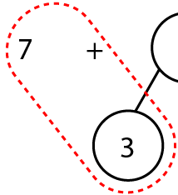
1.11 Addition: three numbers and bridging 10 – step 5:2
7
+
5
3
2
7 + 3
= 10
10 + 2
= 12

Slide 58
1.11 Addition: three numbers and bridging 10 – step 5:4

Slide 59
2AS-1 Add and subtract across 10
7 + 5
= 7 + 3 + 2
= 10 + 2
Look at the picture and the expression. How many red counters are being added to the blue counters?
How many red counters need to go on the first ten frame to fill it up and make ten?
Now we have 10 counters and 2 counters on the ten frames, how many counters are there altogether?
How did we partition the 5 to add it to 7? Why did we do it that way? Try this on your own ten frames.
We can use a making ten strategy to add past ten.

Slide 60
2AS-1 Add and subtract across 10
Try these calculations using two ten frames and different coloured counters.
For each calculation, talk about how we can make ten and how we will have to partition the second number.
As children become more confident, they can record each part of the calculation as they move the counters, and talk about how it represents what is on the ten frames.
Check that children are using known bonds of ten to partition numbers, and place value knowledge to add a single digit to ten, rather than counting.
7 + 6
7 + 8
7 + 5
8 + 5
9 + 5

Slide 61
2AS-1 Add and subtract across 10
7
+
5
Let’s look at 7 + 5 using a part-part-whole diagram.
Why has the 5 been partitioned into 3 and 2?
Let’s add the 7 and 3 first. What does 7 + 3 total?
Now add the 2. Why is it easy to add a single digit number to ten without counting?
3
2
7 + 3
= 10
10 + 2
= 12

Slide 62
2AS-1 Add and subtract across 10
Let’s see what 7 + 5 looks like on a number line.
Why do we need to start our jumps from 7? Why is the first a jump of 3?
Did we need to jump forwards or backwards? Why?
What is the next jump to complete the calculation 7 + 5? How do you know?
What will the total be if we make a jump of 2 from 10? So 7 + 5 is equal to…?

Slide 63
Year 3, Unit 1, Learning Outcome 7
Learning Outcome 7
Pupils subtract two numbers that bridge through 10
The following slides have been collated to support the teaching of this learning outcome.

Slide 64
Year 3, Unit 1, Learning Outcome 7
Additional teacher guidance for this outcome should be read first and can be found in this segment of the NCETM Primary Mastery Professional Development Materials:
1.11 Addition and subtraction: bridging 10
The spine materials are divided into ‘teaching points’ and ‘steps in learning’.
Teaching point | Steps in learning | Pages
6 | 6:1-6:8 | 19-25

Slide 65
1.11 Addition and subtraction: bridging 10 – step 6:1

Slide 66
1.11 Addition and subtraction: bridging 10 – step 6:1
− 4
− 2
− 2
8
10
12

Slide 67
1.11 Addition and subtraction: bridging 10 – step 6:1

Slide 68
1.11 Addition and subtraction: bridging 10 – step 6:1
2
2
12 −
2
= 10
10 −
2
= 8
12 −
4
= 8

Slide 69
1.11 Addition and subtraction: bridging 10 – step 6:2

Slide 70
1.11 Addition and subtraction: bridging 10 – step 6:2
4
10
2
10
−
4
=
6
6
+
2
= 8
12 −
4
= 8

Slide 71
1.11 Addition and subtraction: bridging 10 – step 6:3
12 − 4 = 8
12 −
10
−
4
= 6
2
= 10
6
2
= 8
10 −
+
2
= 8
12 −
4
= 8
12 −
4
= 8

Slide 72
1.11 Addition and subtraction: bridging 10 – step 6:4
15 − 9
5
4
15
− 5
= 10
10
− 4
= 6
15
− 9
= 6

Slide 73
1.11 Addition and subtraction: bridging 10 – step 6:4
− 9
− 4
− 5
6
10
15

Slide 74
1.11 Addition and subtraction: bridging 10 – step 6:4

Slide 75
1.11 Addition and subtraction: bridging 10 – step 6:4
15 − 9
10
5
15
= 1
10
− 9
1
+ 5
= 6
15
− 9
= 6

Slide 76
1.11 Addition and subtraction: bridging 10 – step 6:4
15 − 9 = 6
5
= 10
15 −
10
−
9
= 1
4
= 6
5
= 6
10 −
1
+
9
= 6
9
= 6
15 −
15 −

Slide 77
1.11 Addition and subtraction: bridging 10 – step 6:5
12 − 3
= 9
2
= 10
12 −
10 −
1
= 9

Slide 78
1.11 Addition and subtraction: bridging 10 – step 6:5
= 6
14 − 8
8
= 2
10 −
2 +
4
= 6

Slide 79
1.11 Addition and subtraction: bridging 10 – step 6:5

Slide 80
1.11 Addition and subtraction: bridging 10 – step 6:5

Slide 81
1.11 Addition and subtraction: bridging 10 – step 6:5

Slide 82
2AS-1 Add and subtract across 10
The following slides demonstrate two different methods for subtraction.
Method 1 is to subtract back through the 10.
Method 2 is to subtract from the 10 and then add what is remaining.
As this is a review session you may just to focus on the method that the child is most familiar with, probably method 1. However, if you feel they are ready, you may wish to introduce method 2. Children sometimes find this easier when they are familiar with it as all of the subtrahend is subtracted from 10, which uses their number bonds to 10 knowledge. Encourage them to use the number bonds they know rather than count back in ones.
The nine is partitioned into 5 and 4.
Take away 5 is 10.
Take away 4 from 10 is 6.
The answer is 6
Method 1
The 15 is partitioned into 10 and 5.
Take away 9 from the 10, this leaves 1.
Put 1 and 5 together.
The answer is 6.
Method 2

Slide 83
2AS-1 Add and subtract across 10
Let’s think about 15 − 9. What is the minuend? (15) What is the subtrahend? (9)
How can we partition the 9 (the subtrahend) to make the calculation easier?
Why has 9 been partitioned into 5 and 4?
Let’s start with 15 − 5. How can we think about that without counting?
Now what do we need to subtract?
How can we think about 10 − 4 without counting?
So, what is 15 − 9?
15 – 9
5
4
15 – 9 =
6
We can partition the subtrahend to help us subtract.
We can use a subtracting through 10 strategy.

Slide 84
2AS-1 Add and subtract across 10
− 9
− 4
− 5
6
10
15
Let’s look what 15 − 9 looks like with a bead string using this method. What do you notice about the 15 beads?
Why is subtracting 5 beads easy to start with?
What would we need to subtract after subtracting 5 beads?
How can we think about subtracting 4 from 10 without needing to count?

Slide 85
2AS-1 Add and subtract across 10
Let’s see what 15 − 9 looks like on the number line. Where do we need to start from?
Which way will we make the jumps if we are subtracting?
What number is it easy to jump to without needing to count
What do you think is our next jump? How do you know?
If we make a jump of 4 from 10, what will we land on?
Can you remind me how we chose what each jump should be?

Slide 86
2AS-1 Add and subtract across 10
Let’s look at a different strategy for 15 − 9. Can you tell me a way that we could partition the minuend (15)?
If we partition the minuend into 10 and 5, how can we subtract 9 easily, without needing to count?
15 – 9
10
5
Can you see where we can subtract 9 counters? What will be left?
Can you remind me whether we partitioned the minuend (15) or the subtrahend (9)? Why did we partition it in the way we did? Now you try 15 − 8 using a ten frame to help you.
15 – 9 = 6

Slide 87
2AS-1 Add and subtract across 10
Method 1
Subtracting through 10
Method 2
Subtracting from 10
Let’s compare the methods.
Which number was partitioned in each method - the minuend or the subtrahend?
Can you explain how partitioning 9 into 5 and 4 helped us?
Can you explain how partitioning 15 into 10 and 5 helped us?
Which strategy do you prefer?
15 – 9

Slide 88
2AS-1 Add and subtract across 10
Now repeat the 2 methods for 15 – 9.
Use the words in the boxes as you move the counters.
Work with a partner and aske them to write the equations as you move the counters:
Method 1 Method 2
Now practise with other numbers using your tens frames and the words in the boxes and write the equations.
14 – 6 12 – 5
13 – 7 17 – 9
Can you do these calculations without using
the tens frames?
Method 1
The nine is partitioned into 5 and 4.
Take away 5 is 10.
Take away 4 from 10 is 6.
The answer is 6.
15
− 5
= 10
10 – 9 = 1
10
− 4
= 6
1 + 5 = 6
15
− 9
= 6
15
− 9
= 6
Method 2
The 15 is partitioned into 10 and 5.
Take away 9 from the 10, this leaves 1.
Put 1 and 5 together.
The answer is 6

