Slide 1
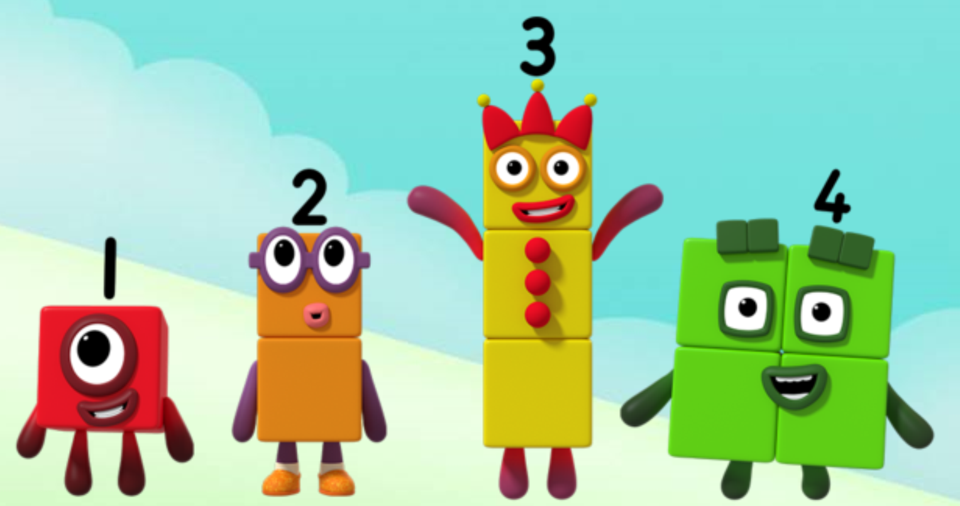
Series 1 Episode 14
Holes

Slide 2
Maths in the Episode
To watch this episode, please go to BBC iPlayer – Numberblocks. Look for Series 1: Holes
Changing quantities by adding or taking away
In this episode children see how a Numberblock can change into another amount by having a block taken away or added to.
Children can see how a quantity gets one smaller if we take one away, and as we give it to another amount, that amount gets one bigger.

Slide 3
Talk and discuss together
Watch the episode together.
Ask your child what they noticed and be interested in anything they have to say.
Use the following pictures and activities to explore and talk about the maths involved.

Slide 4
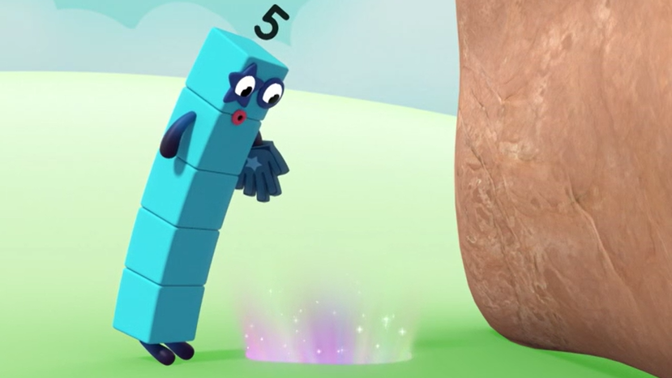
What will happen if I look down the hole? Use the pictures to help you say what happened in my story.
Images © 2017 Alphablocks Ltd. All Rights Reserved.

Slide 5
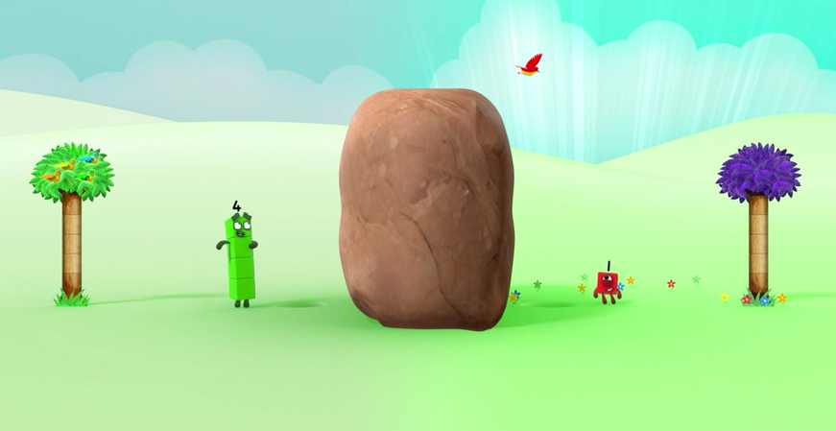
Five lost one block and became Four!
I am the block that fell off Five!
Images © 2017 Alphablocks Ltd. All Rights Reserved.

Slide 6
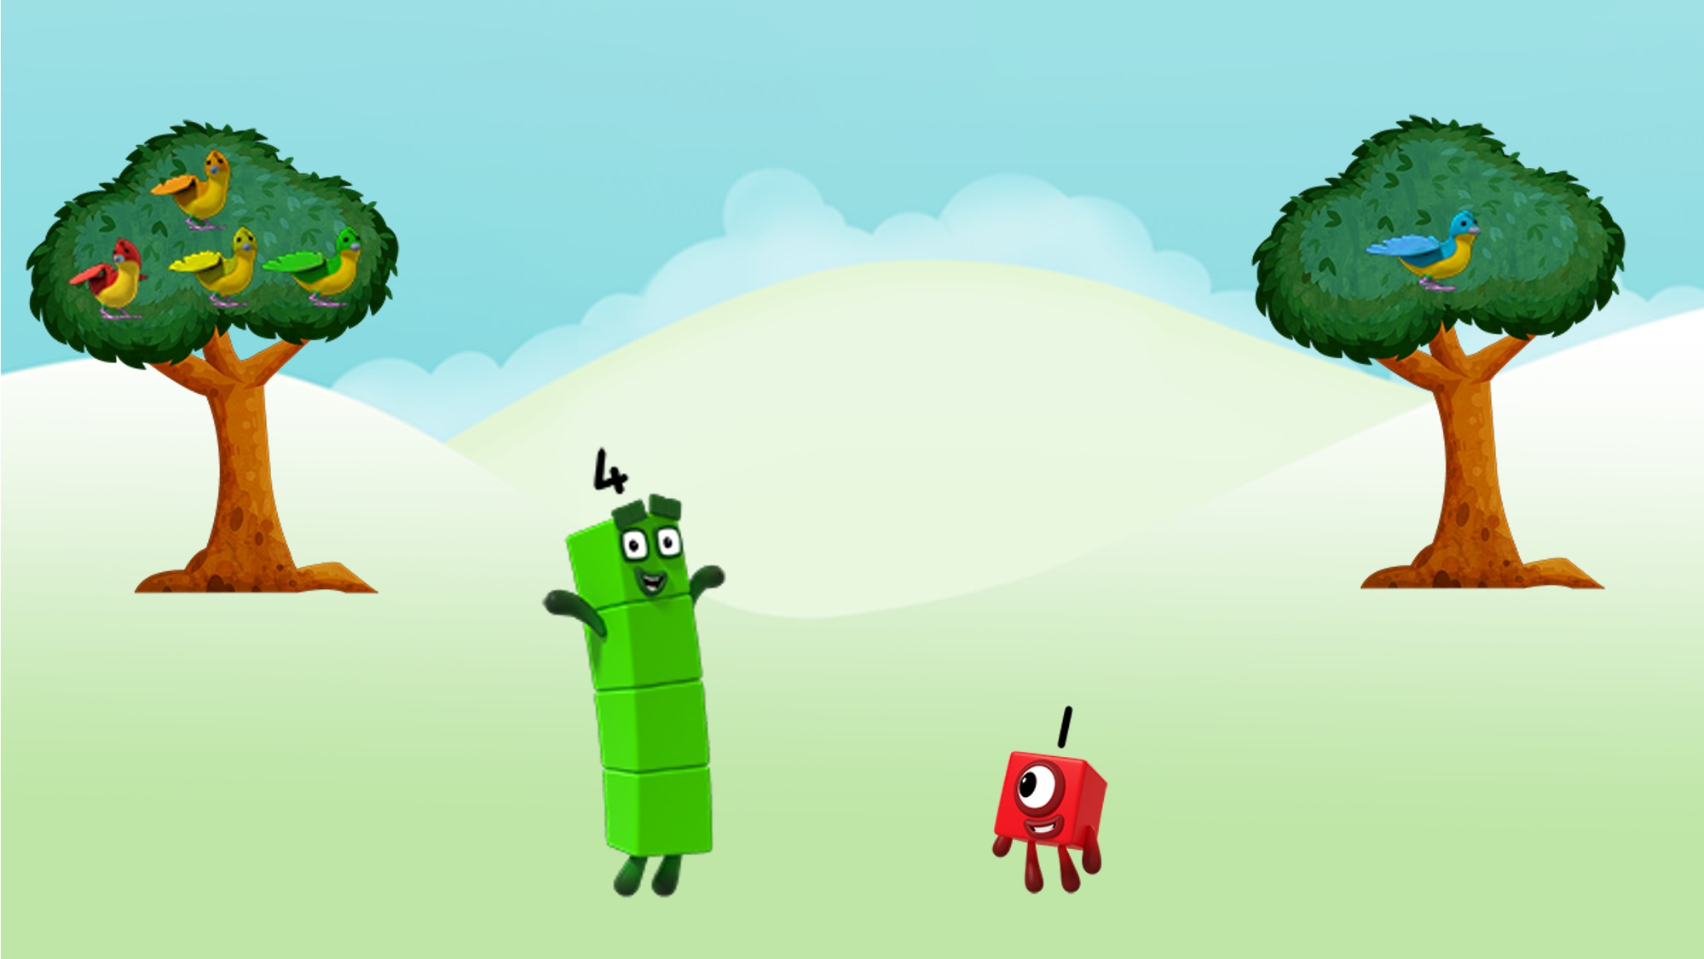
Four is one less than Five!
One is one more than zero!
Images © 2017 Alphablocks Ltd. All Rights Reserved.

Slide 7
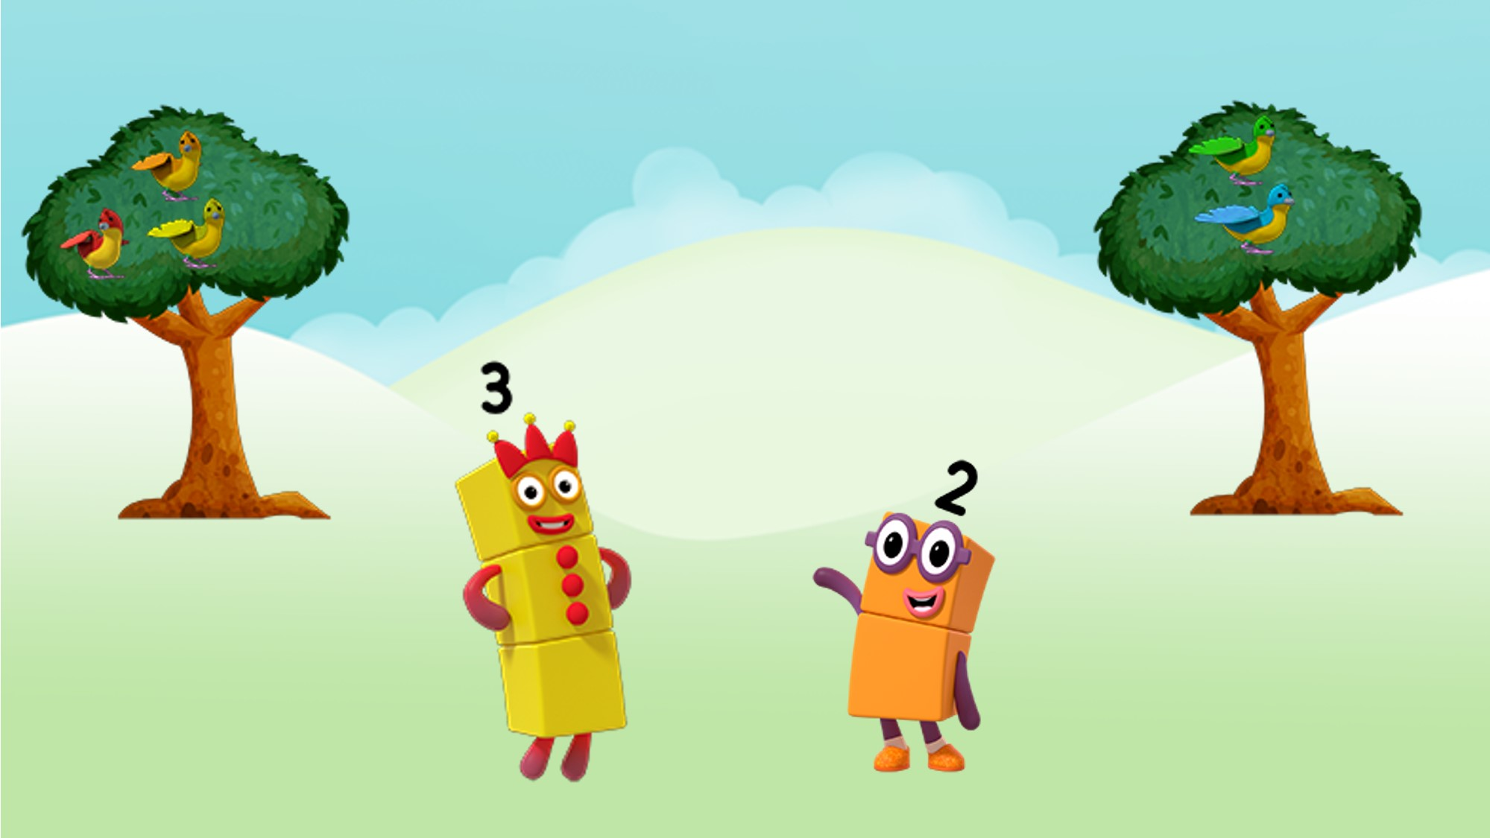
Three is one less than Four!
Two is one more than One!
Images © 2017 Alphablocks Ltd. All Rights Reserved.

Slide 8
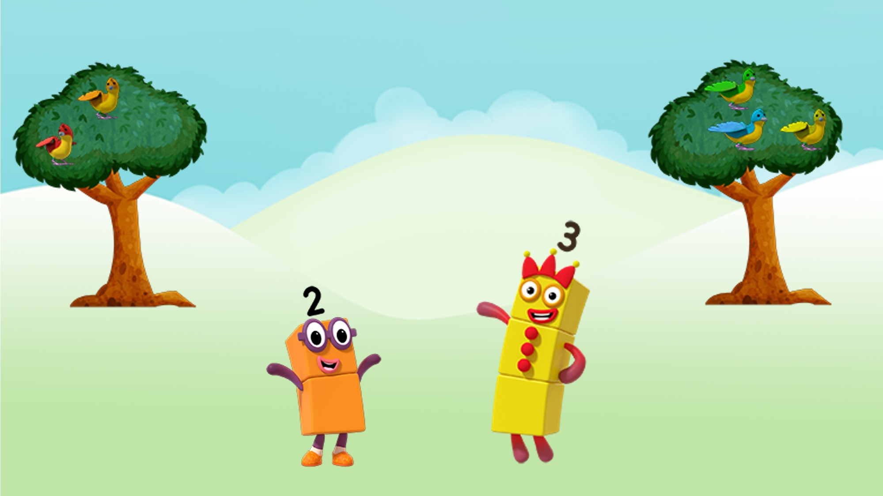
Three is one more than Two!
Two is one less than Three!
Images © 2017 Alphablocks Ltd. All Rights Reserved.

Slide 9
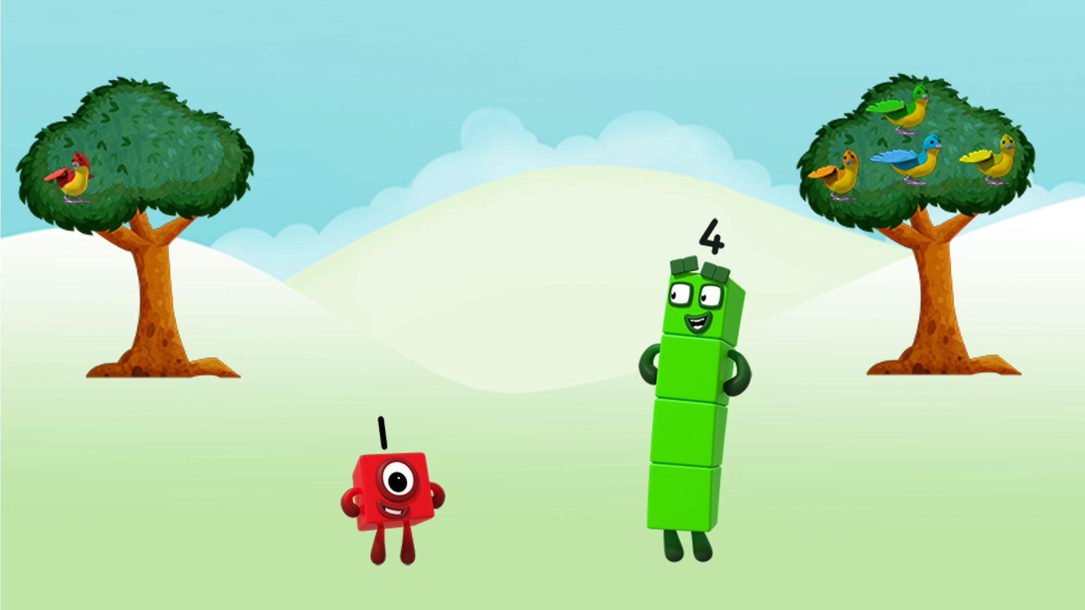
Four is one more than Three!
Four is one less than Five!
Images © 2017 Alphablocks Ltd. All Rights Reserved.

Slide 10
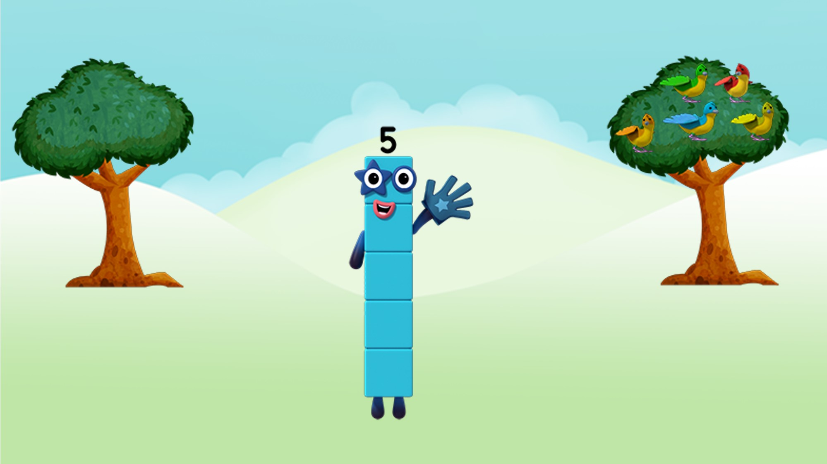
Five is one more than Four!
Images © 2017 Alphablocks Ltd. All Rights Reserved.

Slide 11
Around the home
Look out for times when you can change a quantity of objects by adding or taking away one. For example, when you are eating, can you say how many pieces of fruit or sweets you will have left if you eat one of them? What if someone gives you one more?
Make your own ‘Holes’ story using a cardboard tube! Collect five objects, e.g. marbles, and post one marble down the tube at a time. Can you say what will happen to each collection of marbles before you post one down the tube?
If you have a toy truck or trolley, put five things in it and take one thing at a time to a different room. Can you work out how many things are in each room?
Hide a small number of small things (e.g. five toy cars or bricks) under a cloth. Can you say how many will be there if someone takes one out or puts another one in? Have a look to check if you are right!

Slide 12
General tips that can make a difference in maths
Provide lots of opportunities to say how many things you can see (up to 5) without counting.
Whenever you talk about a small set of objects, say the number. For example, please pick up those 3 teddies or look at those 2 dogs.
Count up (starting from one) when walking upstairs and count back when walking downstairs.
Count lots of different objects, big and small, and ask ‘How many are there?’ Your child should be able to tell you without going back and re-counting. If they can’t, then tell them: ‘There are 6 altogether’.
Play with fingers, firstly practise counting fingers.
Ask your child to put their fingers down and then say or hold up a number such as 3. Can they do it without counting? Can they do it using different fingers? Can they do it using fingers from two hands?
Play board games with your child which involve moving along numbered tracks, such as ‘Snakes and Ladders’. Check that your child counts along the track correctly, moving one square for each number counted.
Regular use of these simple ideas, whenever the opportunity arises, will improve your child’s maths.

Slide 13
General tips that can make a difference in maths
Notice when there are two amounts and one is more than the other, or they are the same. For example, I have 2 eyes and 2 ears, or I have more chips than peas.
Talk about and describe shapes you can see outside or around your home. For example, count corners, talk about straight/curved edges, flat/curved surfaces. If you have building blocks then talk about and describe the things that are built.
In the bath or at the sink, play with containers, pouring water, counting how many small pots are needed to fill the big container.
Encourage your child to draw a picture of their number work and explain their mark-making to you, for example, how many leaves they find on a walk. This doesn’t necessarily mean writing the numerals (1, 2, 3, 4… etc.).
Sing counting songs and rhymes. You can find some on the internet, but children love it if you join in with them!
Make a deliberate maths mistake from time to time and ask your child to explain why you are wrong. For example, say that 4 is bigger than 5.
Regular use of these simple ideas, whenever the opportunity arises, will improve your child’s maths.

