Slide 1
2.2 Structures: multiplication representing equal groups
Representations | Year 2
Multiplication and Division

Slide 2
How to use this presentation
You can find the teacher guide 2.2 Structures: multiplication representing equal groups by following the link below.

Slide 3
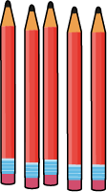
2.2 Multiplication: equal groups Step 1:1
Notes:
Here are some pencils.
The pencils have been grouped.

Slide 4
2.2 Multiplication: equal groups Step 1:1
Notes:
Here are some footballs.
The footballs have been grouped.

Slide 5
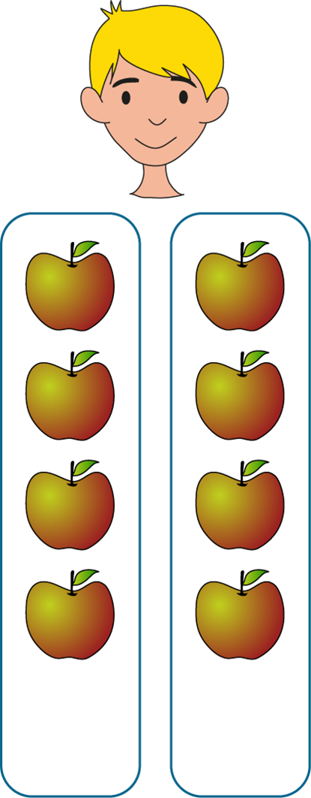
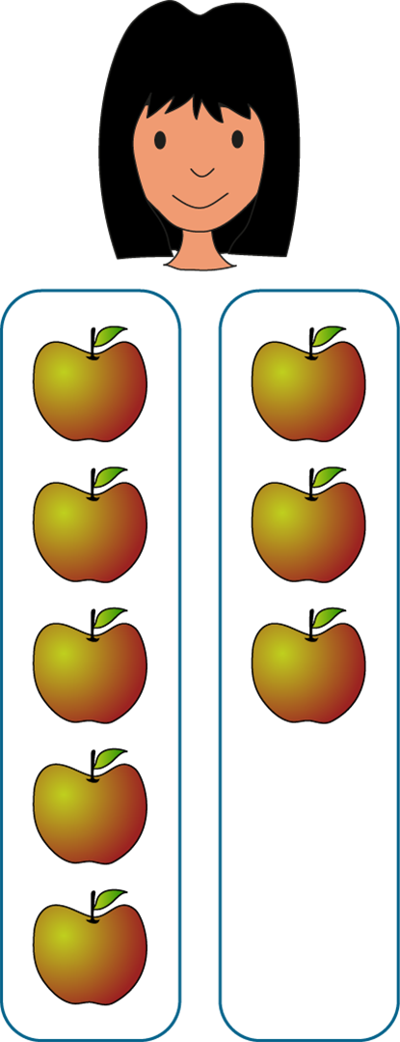
2.2 Multiplication: equal groups Step 1:2
Max
Lucia
Equal
groups
Unequal
groups
Notes:
Max and Lucia each have some apples.
Each of them has put their apples into two groups.
What do you notice about Max’s and Lucia’s apples?
What’s the same?
What’s different?

Slide 6
2.2 Multiplication: equal groups Step 1:3
✓
Equal groups
Unequal groups
Notes:
Tick to say whether the objects are in equal or unequal groups.

Slide 7
2.2 Multiplication: equal groups Step 1:3
✓
Equal groups
Unequal groups
Notes:
Tick to say whether the objects are in equal or unequal groups.

Slide 8
2.2 Multiplication: equal groups Step 1:3
✓
Equal groups
Unequal groups
Notes:
Tick to say whether the objects are in equal or unequal groups.

Slide 9
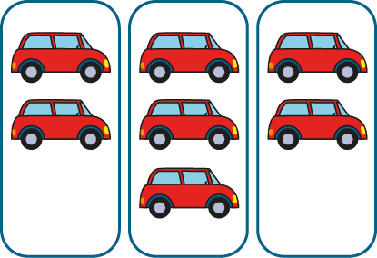
2.2 Multiplication: equal groups Step 1:3
Equal groups
✓
Unequal groups
Notes:
Tick to say whether the objects are in equal or unequal groups.

Slide 10
2.2 Multiplication: equal groups Step 1:3
Equal groups
✓
Unequal groups
Notes:
Tick to say whether the objects are in equal or unequal groups.

Slide 11
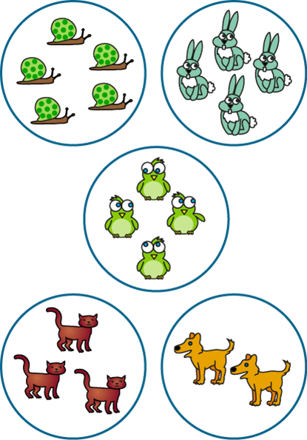
2.2 Multiplication: equal groups Step 1:3
Equal groups
✓
Unequal groups
Notes:
Tick to say whether the objects are in equal or unequal groups.

Slide 12
2.2 Multiplication: equal groups Step 1:3
Notes:
Jess is arranging twelve cubes into equal groups. Can you complete her drawing?

Slide 13
2.2 Multiplication: equal groups Step 1:3
Notes:
Now, Jess is arranging twelve cubes into unequal groups. Can you complete her drawing?

Slide 14
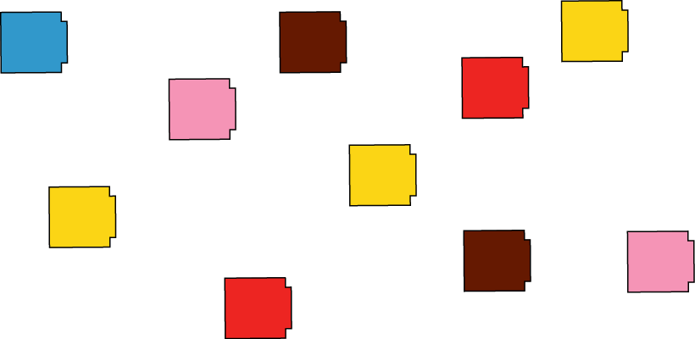
2.2 Multiplication: equal groups Step 1:3
Notes:
Count out ten cubes. How many different ways can you find to arrange them into equal groups?

Slide 15
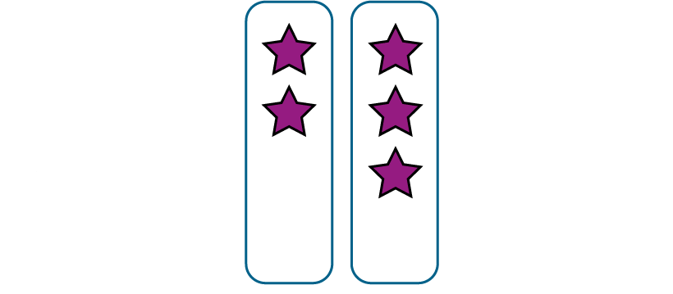
2.2 Multiplication: equal groups Step 1:4
Notes:
Make these groups equal.

Slide 16
2.2 Multiplication: equal groups Step 1:4
Notes:
Make these groups equal.

Slide 17
2.2 Multiplication: equal groups Step 1:4
Notes:
How many equal groups are there?
How many bears are there in each group?
There are four equal groups of bears.
There are two bears in each group.
There are four groups of two.

Slide 18
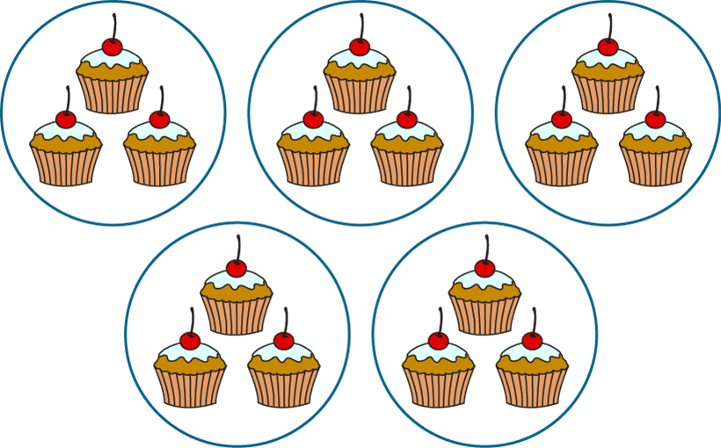
2.2 Multiplication: equal groups Step 2:1
Notes:
How many equal groups are there?
How many cakes are there in each group?
There are five equal groups of cakes.
There are three cakes in each group.
There are five groups of three.

Slide 19
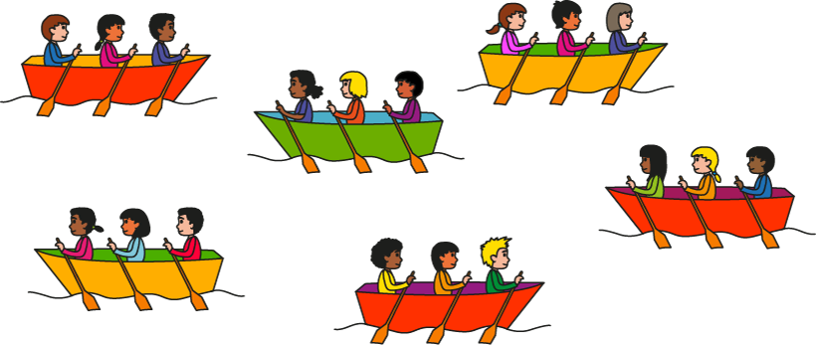
2.2 Multiplication: equal groups Step 2:3
Which sentence correctly describes the picture?
✓
There are 6 equal groups.
There are 3 equal groups.
✗

Slide 20
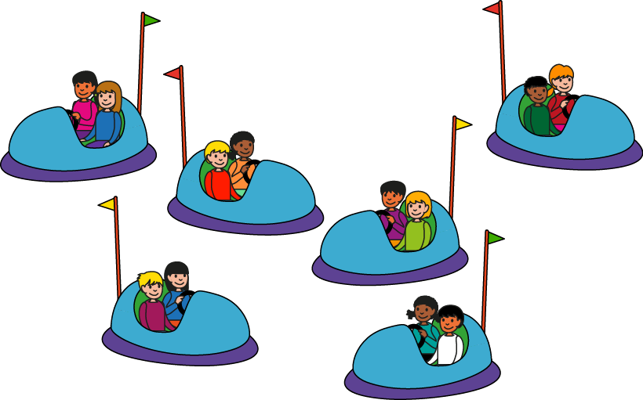
2.2 Multiplication: equal groups Step 2:3
Which sentence correctly describes the picture?
✗
There are 2 groups of 6.
There are 6 groups of 2.
✓
Notes:
Which sentence correctly describes the picture?

Slide 21
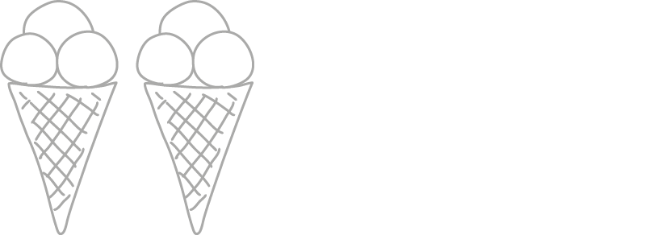
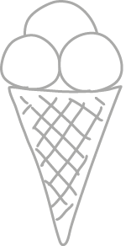
2.2 Multiplication: equal groups Step 2:3
Complete the drawing.
I have 4 groups of 3.
Notes:
James started to draw some equal groups. Complete his drawing.

Slide 22
2.2 Multiplication: equal groups Step 2:3
3
There are ___ equal groups of eggs.
5
There are ___ eggs in each group.
3
5
There are ___ groups of ___ .

Slide 23
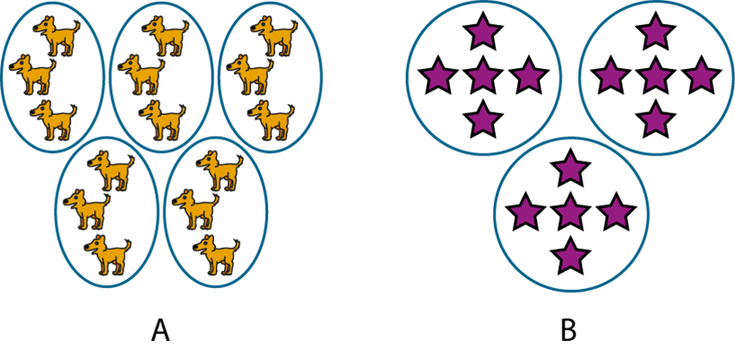
2.2 Multiplication: equal groups Step 2:3
Circle the representation that matches the description.
There are 3 groups of 5.

Slide 24
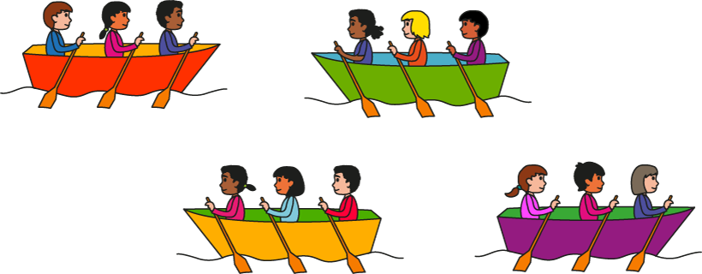
2.2 Multiplication: equal groups Step 2:4
True or false?
There are 4 groups of 3.
True
✓

Slide 25
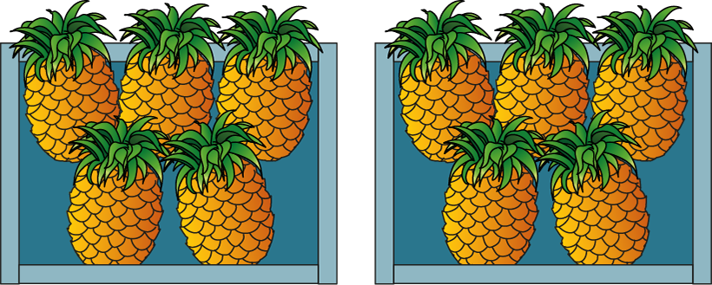
2.2 Multiplication: equal groups Step 2:4
True or false?
There are 5 groups of 2.
✗
False

Slide 26
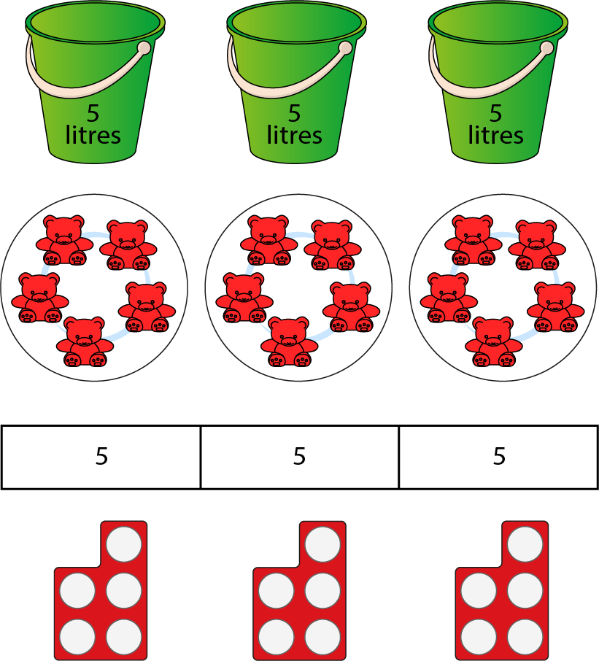
2.2 Multiplication: equal groups Step 2:4
Notes:
Look at these representations.
What’s the same?
What’s different?

Slide 27
2.2 Multiplication: equal groups Step 3:1

Slide 28
2.2 Multiplication: equal groups Step 3:1

Slide 29
2.2 Multiplication: equal groups Step 3:3
Circle the expression that correctly describes the picture.
6 + 6 + 6
3 + 3 + 3 + 3 + 3 + 3

Slide 30
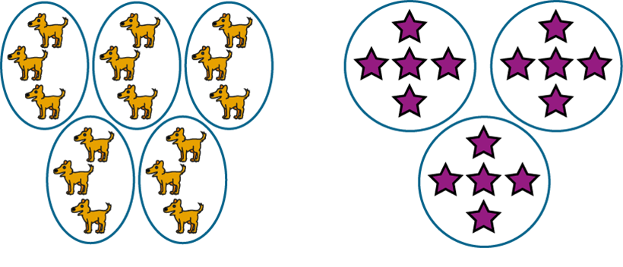
2.2 Multiplication: equal groups Step 3:3
Circle the representation that matches the expression.
5 + 5 + 5

Slide 31
2.2 Multiplication: equal groups Step 3:3
Complete the drawing.
I have 3 + 3 + 3 + 3.
Notes:
James started to draw some equal groups. Complete his drawing.

Slide 32
2.2 Multiplication: equal groups Step 3:3
5
+
5
+
5
Notes:
Complete the expression to match the picture.

Slide 33
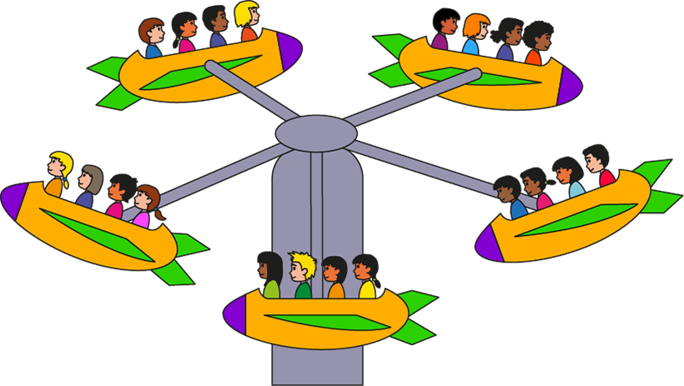
2.2 Multiplication: equal groups Step 3:3
4 + 4 + 4 + 4 + 4
Notes:
Write a repeated addition expression to match the picture.

Slide 34
2.2 Multiplication: equal groups Step 3:3
7 + 7 + 7 + 7 + 7
Notes:
Write a repeated addition expression to match the bar model.

Slide 35
2.2 Multiplication: equal groups Step 3:3
Circle the expression that matches the sentence.
There are 2 groups of 5.
2 + 5
5 + 2
5 + 5
2 + 2 + 2 + 2 + 2
Notes:
Circle the expression that matches the sentence.

Slide 36
2.2 Multiplication: equal groups Step 3:4
two 2p coins
2 + 2
4
Notes:
What’s the same?
What’s different?

Slide 37
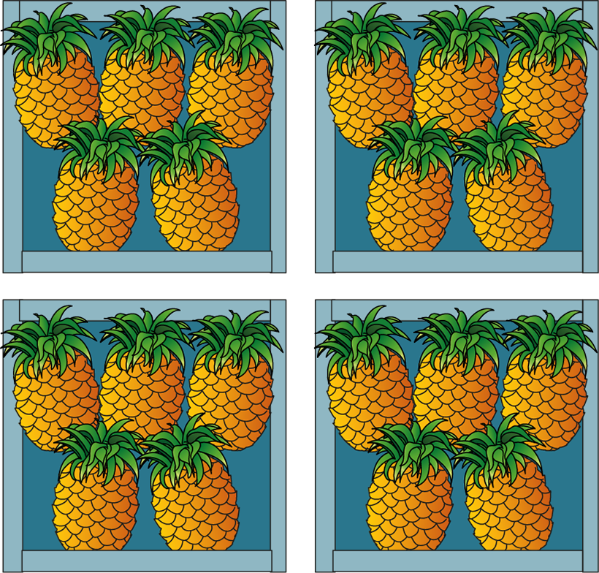
2.2 Multiplication: equal groups Step 3:4
True or false?
This picture shows 5 + 5 + 5 + 5
True
✓

Slide 38
2.2 Multiplication: equal groups Step 3:4
True or false?
There are 6 groups of 2. We can write this as 6 + 6.
True
✓

Slide 39
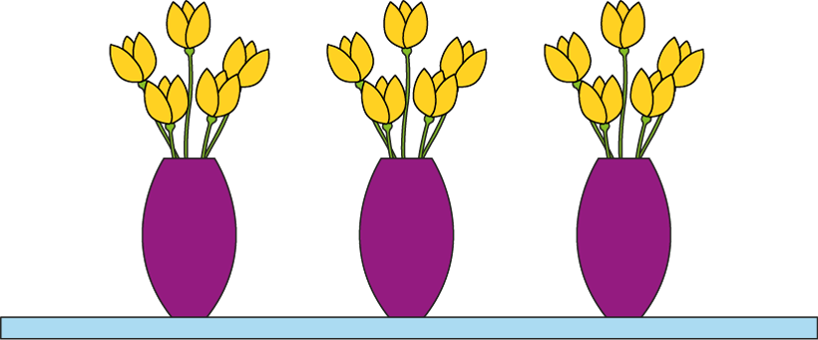
2.2 Multiplication: equal groups Step 4:1
5 + 5 + 5
3 × 5
Notes:
There are three groups of five.
We can write this as five plus five plus five.
We can also write this as three times five.
The ‘3’ represents the number of groups.
The ‘5’ represents the number of flowers in each group.
We can also write this as three times five.
3 x 5
What does the ‘3’ represent?
The ‘3’ represents the number of groups.
What does the ‘5’ represent?
The ‘5’ represents the number of flowers in each group.’

Slide 40
2.2 Multiplication: equal groups Step 4:1
10 + 10 + 10 + 10
4 × 10
Notes:
There are four groups of ten.
We can write this as ten plus ten plus ten plus ten.
We can also write this as four times ten.

Slide 41
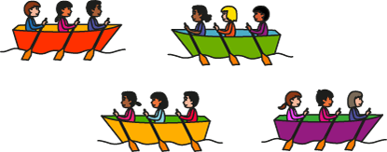
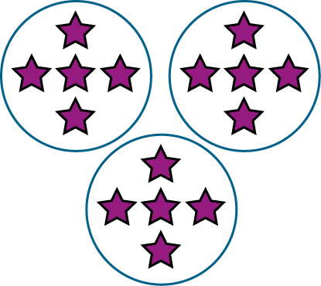
2.2 Multiplication: equal groups Step 4:3
4 × 3
3 × 5
2 × 5
Notes:
Draw lines connecting each picture with the correct multiplication expression.

Slide 42
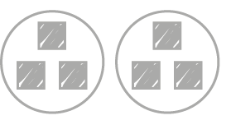
2.2 Multiplication: equal groups Step 4:3
Complete the drawing.
I have 4 × 3.
Notes:
Antonella started to draw some equal groups. Complete her drawing.

Slide 43
2.2 Multiplication: equal groups Step 4:3
6
× 3
Notes:
Complete the expression to match the picture.

Slide 44
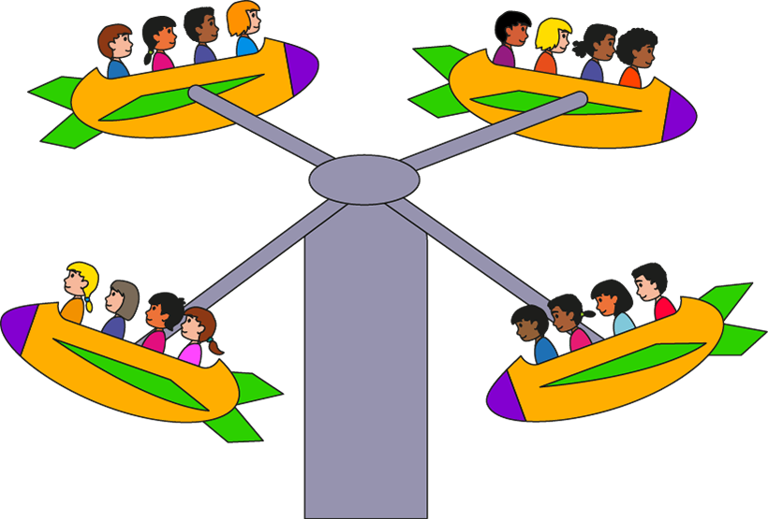
2.2 Multiplication: equal groups Step 4:3
4 × 4
Notes:
Write a multiplication expression to match the picture.

Slide 45
2.2 Multiplication: equal groups Step 4:3
3 × 8
Notes:
Write a multiplication expression to match the bar model.

Slide 46
2.2 Multiplication: equal groups Step 4:3
Circle the expression that matches the sentence.
There are 4 groups of 7.
4 + 7
7 + 4
4 × 7

Slide 47
2.2 Multiplication: equal groups Step 4:4
Does this show 3 x 5 or 5 x 5?
3 × 5
5 × 5

Slide 48
2.2 Multiplication: equal groups Step 4:4
Agree or disagree?
2 × 6
Agree
✓

Slide 49
2.2 Multiplication: equal groups Step 4:4
True or false?
3 × 4
False
✗

Slide 50
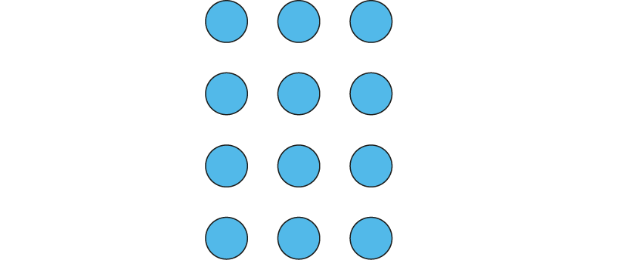
2.2 Multiplication: equal groups Step 4:4
Does this show 3 × 4 or 4 × 3?
Notes:
Dòng nǎo jīn

Slide 51
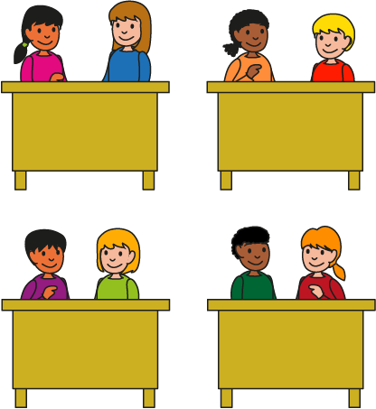
2.2 Multiplication: equal groups Step 5:1
2
2
2
2
2 + 2 + 2 + 2
4 × 2
Notes:
There are four groups of two children.
We can write this as two plus two plus two plus two.
We can write this as four times two.

Slide 52
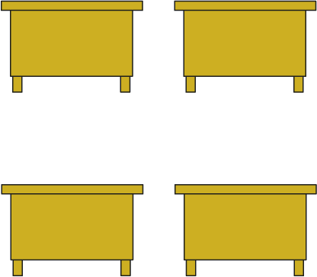
2.2 Multiplication: equal groups Step 5:1
0
0
0
0
0 + 0 + 0 + 0
4 × 0
Notes:
There are four groups of zero children.
We can write this as zero plus zero plus zero plus zero.
We can write this as four times zero.

Slide 53
2.2 Multiplication: equal groups Step 5:1
2
2
0
0
2
2
0
0
2 + 2 + 2 + 2
0 + 0 + 0 + 0
4 × 2
4 × 0

Slide 54
2.2 Multiplication: equal groups Step 5:1
5 + 5 + 5
3 × 5
Notes:
There are three groups of five eggs.
We can write this as five plus five plus five.
We can write this as three times five.

Slide 55
2.2 Multiplication: equal groups Step 5:1
0 + 0 + 0
3 × 0
Notes:
There are three groups of zero eggs.
We can write this as zero plus zero plus zero.
We can write this as three times zero.

Slide 56
2.2 Multiplication: equal groups Step 5:1
5 + 5 + 5
0 + 0 + 0
3 × 5
3 × 0

Slide 57
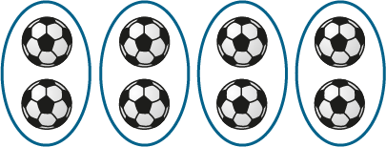
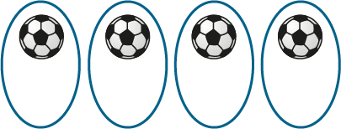
2.2 Multiplication: equal groups Step 5:2
2
2
2
2
1
1
1
1
1 + 1 + 1 + 1
2 + 2 + 2 + 2
2 + 2 + 2 + 2
1 + 1 + 1 + 1
4 ×
2
4 × 2
4 ×
4 × 1
1
Notes:
There are four groups of two footballs.
There are four groups of one football.

Slide 58
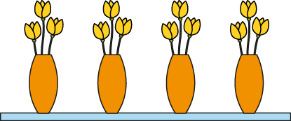
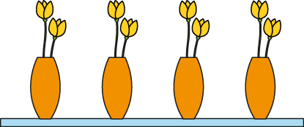
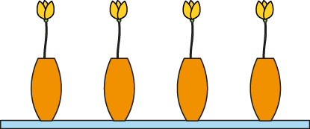
2.2 Multiplication: equal groups Step 5:3
4 × 1
4 × 3
4 × 0
4 ×2
Notes:
Draw lines connecting each picture of flowers with the correct multiplication expression.

Slide 59
2.2 Multiplication: equal groups Step 5:3
Complete the drawing.
I have 6 × 1.
Notes:
Aisha started to draw some equal groups. Complete her drawing.

Slide 60
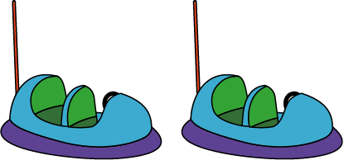
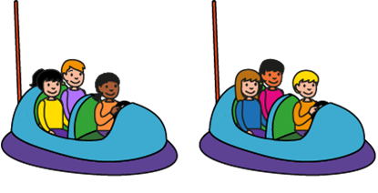
2.2 Multiplication: equal groups Step 5:3
× 3
2 ×
0
2
Notes:
Complete the expressions to describe the children in the dodgem cars.

Slide 61
2.2 Multiplication: equal groups Step 5:3
3 × 1
Notes:
Write a multiplication expression to match the bar model.

Slide 62
2.2 Multiplication: equal groups Step 5:3
Circle the expression that matches the sentence.
There are 7 groups of 0.
0 + 7
7 + 0
7 × 0
Notes:
Circle the expression that matches the sentence.

Slide 63
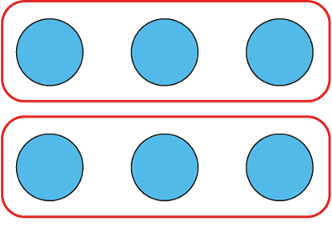
2.2 Multiplication: equal groups Step 5:4
2 × 3
This represents 3 + 3.
Notes:
Tanek has written this. How could he improve what he has written?

Slide 64
2.2 Multiplication: equal groups Step 5:4
4 × 2
Notes:
Can you write a multiplication expression for this image?
What would we need to do to make it match the multiplication expression?

