Slide 1
Writing integers in a range of forms
KS3 Mastery PD Materials: Exemplified Key Ideas
Materials for use in the classroom or to support professional development discussions
(from 1.3 Ordering and comparing)
Summer 2021

Slide 2
About this resource
These slides are designed to complement the 1.3 Ordering and comparing Core Concept document and its associated Theme Overview document 1 The Structure of the number system, both found in the Secondary Mastery Professional Development pages.
These slides re-present the key examples from the Core Concept document so that the examples can be used either directly in the classroom or with a group of teachers. There are prompt questions alongside the examples, and further clarification in the notes.
These slides do not fully replicate the Core Concept document, so should be used alongside it. Reference to specific page numbers, and to other useful NCETM resources, can be found in the notes for each slide.
This slide deck is not designed to be a complete PD session, rather it is a selection of resources that you can adapt and use as needed when planning a session with a group of teachers.

Slide 3


About this resource
The slides are structured as follows:
  The big picture:
    Where does this fit in?
    What do students need to understand?
    Why is this key idea important?
  Prior learning
  Misconceptions
  Exemplified key ideas
  Reflection questions
  Appendices:
    Key vocabulary
    Representations and structure
    Previous and Future learning
    Useful links
The exemplified key idea slides have the following symbols to indicate how they have been designed to be used:
Into the classroom
The examples are presented on these slides so that they could be used in PD, but also directly in the classroom. The notes feature suggested questions and things teachers might consider when using with students.
PD discussion prompts
These slides look at the examples in more detail, with question prompts to promote discussion among maths teachers. The notes feature reference to further information and guidance within the Core Concepts document.

Slide 4
Where does this fit in?
The NCETM has identified a set of six ‘mathematical themes’ within Key Stage 3 mathematics that bring together a group of ‘core concepts’.
The first of these themes is The structure of the number system, which covers the following interconnected core concepts:
    1.1 Place value, estimation and rounding
    1.2 Properties of number
    1.3 Ordering and comparing
    1.4 Simplifying and manipulating expressions, equations and formulae
Notes:
Linked on this slide is the Theme Overview document of The structure of the number system. This document includes why it is important, the key underpinning knowledge and links to prior and future learning. There is also guidance about how the five big ideas of Teaching for Mastery relate specifically to this theme.

Slide 5
Where does this fit in?
Within this core concept, 1.3 Ordering and comparing, there are three statements of knowledge, skills and understanding.
These, in turn, are broken down into sixteen key ideas. The highlighted key idea is exemplified in this slide deck.
Notes:
For key ideas marked with an asterisk, we exemplified the common difficulties and misconceptions that students might have and included elements of what teaching for mastery may look like. We have provided examples of possible student tasks and teaching approaches.
Within these slides are ‘classroom-ready’ versions of the examples for the key idea that has been highlighted. There are also slides that may be useful for discussion in a professional development session.

Slide 6
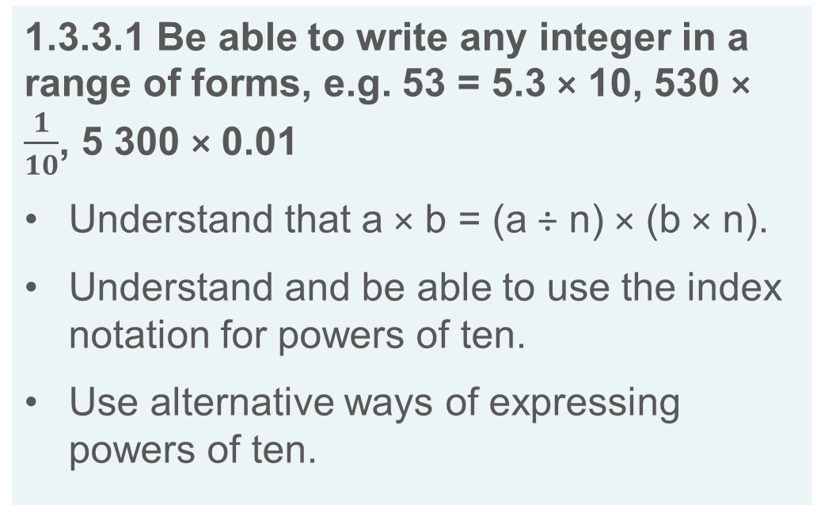
What do students need to understand?
1.3.3.1 Be able to write any integer in a range of forms, e.g. 53 = 5.3 × 10, 530 × $\frac{1}{10}$, 5 300 × 0.01
Understand that a × b = (a ÷ n) × (b × n).
Understand and be able to use the index notation for powers of ten.
Use alternative ways of expressing powers of ten.
  What prior knowledge might your students already have?
  What language might they use to describe this key idea?
  What questions might you want to ask to assess their prior learning?

Slide 7
Why is this key idea important? (1)
At Key Stage 2, students should have developed an awareness that any number can be expressed in a variety of ways that reveal the base-ten structure. Students should not simply name the place-value column headings. Rather, they should recognise that, for example, the number 2 437 consists of 24 hundreds or 243 tens.
At Key Stage 3, students will further develop their understanding of the different ways that numbers can be expressed and will become more proficient in changing from one form to another. This will develop their awareness that different representations of the same number can reveal something of its structure and so can be used to compare and order numbers with ease.
Students should develop their understanding of the infinite nature of the number system and work confidently with a wide range of real numbers. For example, they should recognise that for any given pair of numbers, a third that is greater than both, smaller than both or in between the two can always be found. The process of comparing and ordering these numbers becomes easier by considering numbers expressed as decimals and fractions.
Notes:
A more detailed overview of the core concept 1.3 Ordering and comparing can be found on page 2 of the 1.3 Core Concept document.
The background to each key idea is also explored in more detail on the following pages:
1.3.1 Work interchangeably with terminating decimals and their corresponding fractions – page 6
1.3.2 Compare and order positive and negative integers, decimals and fractions – page 7
1.3.3 Interpret and compare numbers in standard form A × 10^{n}, 1 ≤ A < 10 – pages 8 and 9

Slide 8
Why is this key idea important? (2)
When thinking about very large and very small numbers, working with standard form notation will enable students to develop further their understanding of multiplication and division by powers of ten.
As students develop their understanding that index notation represents powers of ten, and later, of negative powers, they should begin to appreciate that such a representation is a way of writing very large or very small numbers in an efficient manner and aids comparison.
Notes:
A more detailed overview of the core concept 1.3 Ordering and comparing can be found on page 2 of the 1.3 Core Concept document.
The background to each key idea is also explored in more detail on the following pages:
1.3.1 Work interchangeably with terminating decimals and their corresponding fractions – page 6
1.3.2 Compare and order positive and negative integers, decimals and fractions – page 7
1.3.3 Interpret and compare numbers in standard form A × 10^{n}, 1 ≤ A < 10 – pages 8 and 9

Slide 9
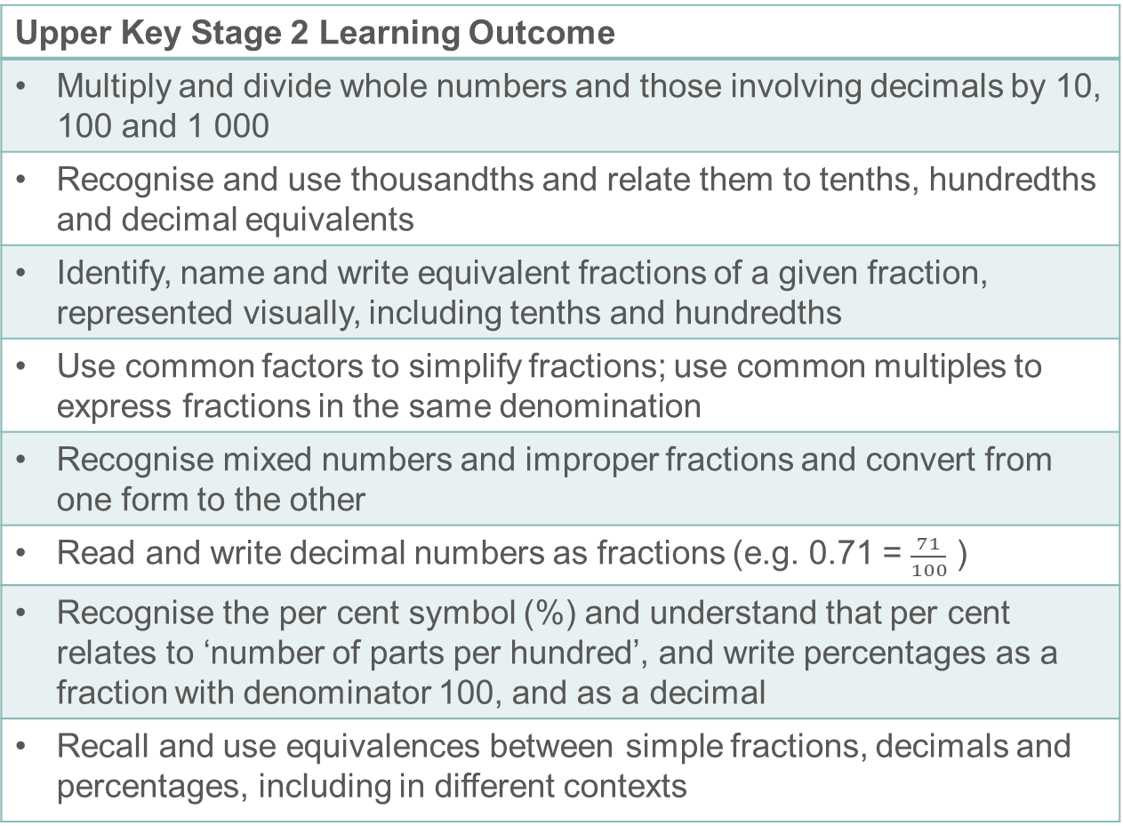
Prior learning
Upper Key Stage 2 Learning Outcome
Multiply and divide whole numbers and those involving decimals by 10, 100 and 1 000
Recognise and use thousandths and relate them to tenths, hundredths and decimal equivalents
Identify, name and write equivalent fractions of a given fraction, represented visually, including tenths and hundredths
Use common factors to simplify fractions; use common multiples to express fractions in the same denomination
Recognise mixed numbers and improper fractions and convert from one form to the other
Read and write decimal numbers as fractions (e.g. 0.71 = $\frac{71}{100}$ )
Recognise the per cent symbol (%) and understand that per cent relates to ‘number of parts per hundred’, and write percentages as a fraction with denominator 100, and as a decimal
Recall and use equivalences between simple fractions, decimals and percentages, including in different contexts
  What prior knowledge might your students already have?
  What language might they use to describe this key idea?
  What questions might you want to ask to assess their prior learning?
Notes:
You may find it useful to speak to your partner schools to see how the above has been covered and the language used.
You can find further details regarding prior learning in the following segments of the NCETM primary mastery professional development materials (linked on final slide):
Year 4: 1.23 Composition and calculation: tenths
Year 4: 1.24 Composition and calculation: hundredths and thousandths
Year 4: 2.13 Calculation: multiplying and dividing by 10 or 100
Year 5: 1.27 Negative numbers: counting, comparing and calculating
Year 5: 2.18 Using equivalence to calculate
Year 5: 3.7 Finding equivalent fractions and simplifying fractions
Year 6: 3.10 Linking fractions, decimals and percentages
Within The structure of the number system Theme Overview document, you can also find a broader description of students’ potential previous learning (page X), alongside further information about key underpinning knowledge (page X).

Slide 10
Prior learning
Key Stage 3 Learning Outcome
1.1.1 Understand the value of digits in decimals, measure and integers
1.2.2 Understand integer exponents and roots
1.3.2 Compare and order positive and negative integers, decimals and fractions
Please note: Numerical codes refer to statements of knowledge, skills and understanding in the NCETM breakdown of Key Stage 3 mathematics.
  What representations might your students already be familiar with?
  What language might they use?
  How does this fit in with your curriculum progression?

Slide 11
Checking prior learning
The following slides contain questions for checking prior learning.
  What representations might students use to support their understanding of these questions?
  What variation might you put in place for these questions to fully assess students’ understanding of the concept?
  How might changing the language of each question change the difficulty?
  Why are these such crucial pre-requisites for this key idea?

Slide 12
Checking prior learning (1)
What do you notice about the following calculations? Can you use one calculation to work out the answer to the other calculations?
2 × 3 =
2 × 30 =
2 × 300 =
20 × 3 =
200 × 3 =
6 × 7 =
6 × 70 =
6 × 700 =
60 × 7 =
600 × 7 =
9 × 8 =
9 × 80 =
9 × 800 =
90 × 8 =
900 × 8 =
Fill in the missing numbers:
8 ÷ 2 =
÷ 4 = 32 ÷
= 64 ÷
Notes:
References to the questions (links on final slide):
a) NCETM Primary assessment materials: Year 4, page 16
b) NCETM Primary assessment materials: Year 5, page 16

Slide 13
Checking prior learning (2)
It is correct that 273 × 32 = 8736. Use this fact to work out:
  27.3 × 3.2
  2.73 × 32 000
  873.6 ÷ 0.32
  87.36 ÷ 27.3
  8736 ÷ 16
  4368 ÷ 1.6
33 630 = 354 × 95
Use this multiplication to complete the calculations below.
354 × 9.5 =
3,540 × 95 =
3,363 ÷ 95 =
Notes:
References to the questions (links on final slide):
c) NCETM Primary assessment materials: Year 6, page 16
d) 2018 Key Stage 2 Mathematics Paper 3: Reasoning, Question 19

Slide 14
Common difficulties and misconceptions
What aspects of this key idea might pupils find challenging?
What misconceptions might pupils have?
When teaching this topic, you may find students encounter difficulties with…
Learning manipulations by rote, without understanding the structure
More information, and some suggestions for overcoming these challenges, can be found on the following slides.

Slide 15
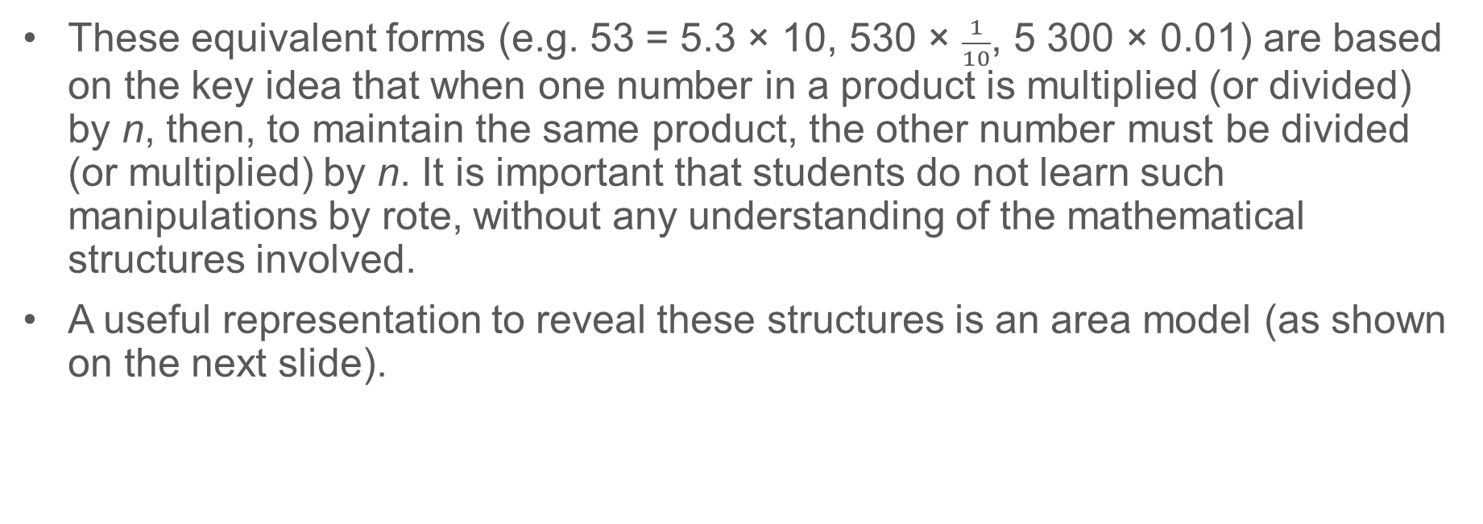
Common difficulties and misconceptions (1)
These equivalent forms (e.g. 53 = 5.3 × 10, 530 × $\frac{1}{10}$, 5 300 × 0.01) are based on the key idea that when one number in a product is multiplied (or divided) by n, then, to maintain the same product, the other number must be divided (or multiplied) by n. It is important that students do not learn such manipulations by rote, without any understanding of the mathematical structures involved.
A useful representation to reveal these structures is an area model (as shown on the next slide).
Notes:
More detail can be found on page 19 of the 1.3 Core Concept document.

Slide 16
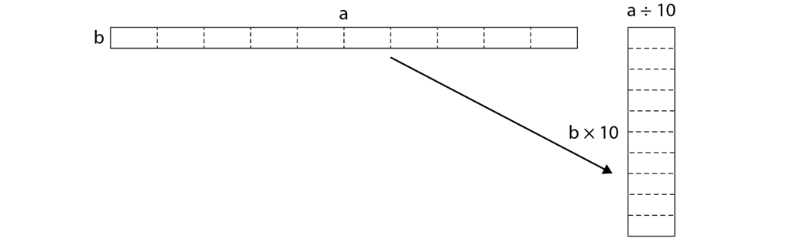
Common difficulties and misconceptions (1 cont’d)
The area model can be used to show how, when one dimension (factor) is reduced to one tenth of its size, the area is maintained by making the other dimension (factor) ten times longer.
This gives rise to equivalent products such as 53 × 10 = 5.3 × 100 = 0.53 × 1 000 = 530 × 1 = 5 300 × 0.1, etc.
This can be generalised to a multiplication (and corresponding division) by any scale factor, e.g. 40 × 2.5 = 10 × 10 (by dividing and multiplying by four). Students should appreciate that this gives rise to other useful calculation strategies.
Notes:
More detail can be found on page 19 of the 1.3 Core Concept document.

Slide 17
Understand that a × b = (a ÷ n) × (b × n)
Example 1
Given that 3.2 × 2.5 = 8, calculate, as efficiently as possible:
  1.6 × 2.5
  3.2 × 1.25
Notes:
Suggested questioning:
If you know 3.2 x 2.5 = 8, what else do you know?
How does calculation a)/b) relate to our original calculation? What has changed? What has stayed the same? What will change/stay the same about the product?
What is the same/different about a) and b)? Why do they have the same product?
Things for you to think about:
You could encourage students to draw a diagram to explain why, in Example 1, halving one of the numbers results in halving the product and why the answers to parts a) and b) are the same. For example, see the image on the next slide.

Slide 18
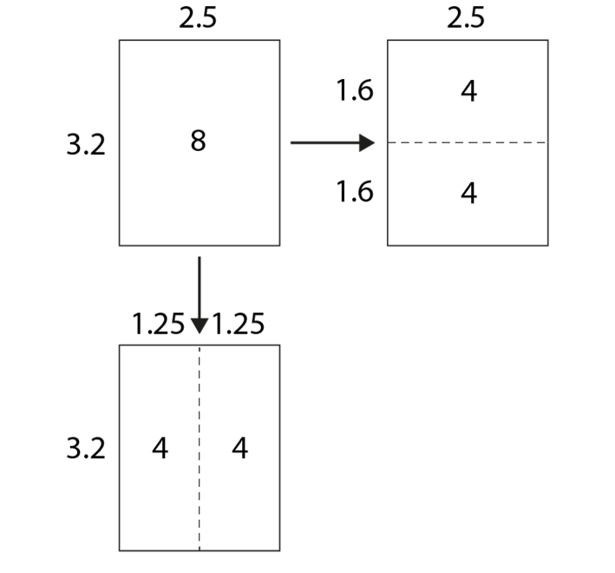
Understand that a × b = (a ÷ n) × (b × n)
Example 1
  What language or notation will you expect students to use here? How will you model this?
  How stringent will you be with your expectations for language/notation? Why?
  How might an area model, such as the one here, support students to understand the relationships between the calculations?
Given that
3.2 × 2.5 = 8, calculate, as efficiently as possible:
  1.6 × 2.5
  3.2 × 1.25
Notes:
More detail about this example can be found on pages 19 and 20 of the 1.3 Core Concept document.

Slide 19
Understand that a × b = (a ÷ n) × (b × n)
Example 2
Given that 160 × 0.4 = 64, calculate, as efficiently as possible:
  16 × 0.4
  160 × 0.04
Notes:
Suggested questioning:
If you know 160 x 0.4 = 64, what else do you know?
How does calculation a)/b) relate to our original calculation? What has changed? What has stayed the same? What will change/stay the same about the product?
What is the same/different about a) and b)? Why do they have the same product?
Things for you to think about:
For Example 2, you could encourage students to construct a similar argument and diagram as in Example 1.

Slide 20
Understand that a × b = (a ÷ n) × (b × n)
Example 2
  Would an area model, such as the one given for example 1, be useful here? Why or why not?
  What other representations might you consider?
  What language structures might you want to introduce to support students to explain these relationships clearly?
Given that
160 × 0.4 = 64, calculate, as efficiently as possible:
  16 × 0.4
  160 × 0.04
Notes:
More detail about this example can be found on page 20 of the 1.3 Core Concept document.

Slide 21
Understand that a × b = (a ÷ n) × (b × n)
Example 3
Complete this family of equations by filling in the gaps.
(i) | 0.3 | × |  | = | 1 200
(ii) | 3 | × | 400 | = | 1 200
(iii) | 30 | × | 40 | = | 1 200
(iv) | 300 | × |  | = | 1 200
(v) |  | × | 0.4 | = | 1 200
How would you calculate
0.0003 × 4 000 000?
Notes:
Suggested questioning:
What do you notice about the pattern of multipliers/multiplicands?
Can you create another equation that would be in this family? Can you create an equation that no-one else will have thought of?
What happens when one factor is multiplied by __? What will need to happen to the other factor in order to keep the same product?
Can you create another sequence/family of equations?
Things for you to think about:
After students complete Example 3, you could encourage them to create their own sequences with gaps and share with other students to complete.
Consider prompting students to think about what happens when:
one factor is multiplied by three, or four, or …
one factor is divided by three, or four, or …
both factors are multiplied (or divided) by three, or four, or … .

Slide 22
Understand that a × b = (a ÷ n) × (b × n)
Example 3
Complete this family of equations by filling in the gaps.
  What would you hope students would gain from this activity?
  What would you plan to do with them next?
  How might you support them to generalise that a × b = (a ÷ n) × (b × n)?
(i) | 0.3 | × |  | = | 1 200
(ii) | 3 | × | 400 | = | 1 200
(iii) | 30 | × | 40 | = | 1 200
(iv) | 300 | × |  | = | 1 200
(v) |  | × | 0.4 | = | 1 200
How would you calculate 0.0003 × 4 000 000?
Notes:
Due to space constraints, the image on this PD discussion slide is very small. PD Leads might like to use or print the ‘in the classroom’ version of this slide for teachers to access during discussions.
More detail about the sequencing of this example can be found on page 20 of the 1.3 Core Concept document.

Slide 23
Understand that a × b = (a ÷ n) × (b × n)
Example 4
Given that 240 × 0.25 = 60
Calculate:
80 × 0.75
20 × 3
0.2 × 300
0.6 × 100
30 × 2
Notes:
Suggested questioning:
How do these relate to our original product? What is the same/what is different?
Describe how each of the original factors has changed. How will this affect the product?
What else do you know? What other equations can you derive from this equation?
Things for you to think about:
Students should be encouraged to articulate the structures that they have noticed, using clear and precise mathematical language. For example:
‘When one factor is multiplied (or divided) by n, the product is multiplied (or divided) by n.’
‘When one factor is multiplied (or divided) by n and the other factor is divided (or multiplied) by n, the product remains the same.’

Slide 24
Understand that a × b = (a ÷ n) × (b × n)
Example 4
Given that 240 × 0.25 = 60
Calculate:
80 × 0.75
20 × 3
0.2 × 300
0.6 × 100
30 × 2
  Why might clear and precise mathematical language be so important in the context of this example?
  Why do you think the questions have been sequenced in this way? Which part will students find most/least challenging?
  How might fluency with multiplication facts contribute to students’ access to this task?
Notes:
More detail about the sequencing of this example can be found on page 21 of the 1.3 Core Concept document.

Slide 25
Understand and be able to use the index notation for powers of ten
Example 5
Consider the following sequence of equalities:
10 × 10 × 10 × 10 | = | 10 000 | = | 10⁴
10 × 10 × 10 | = | 1 000 | = | 10³
10 × 10 | = | 100 | = | 10²
Discuss the patterns you see. Can you explain them?
What would the next lines of the sequence of calculations be?
Notes:
Suggested questioning:
How is the power of ten changing from line to line? Why is this?
If you extended the pattern of powers of ten into negative numbers, what equalities would be created?
Can you give a meaning to 10⁰, 10⁻¹, 10⁻², etc?
Things for you to think about:
Students should be encouraged to reason about the patterns they see in Example 5. The prompts above could support them in doing this.

Slide 26
Understand and be able to use the index notation for powers of ten
Example 5
Consider the following sequence of equalities:
  Students should already know and understand the index notation for powers of ten. In what order do you introduce different notations for negative powers of ten in your department?
  This example relies on spotting a pattern in a sequence to build understanding; what other key ideas might be effectively explored in this way?
10 × 10 × 10 × 10 | = | 10 000 | = | 10⁴
10 × 10 × 10 | = | 1 000 | = | 10³
10 × 10 | = | 100 | = | 10²
Discuss the patterns you see. Can you explain them?
What would the next lines of the sequence of calculations be?
Notes:
Due to space constraints, the image on this PD discussion slide is very small. PD Leads might like to use or print the ‘in the classroom’ version of this slide for teachers to access during discussions.
More detail about the sequencing of this example can be found on page 21 of the 1.3 Core Concept document.

Slide 27

Use alternative ways of expressing powers of ten
Example 6
Work out:
6.7 ×100
$\frac{67}{10}$ × 10
6.7 × 10²
34 × 0.01
34 × $\frac{1}{100}$
34 × $\frac{1}{{10}^{2}}$
Notes:
Suggested questioning:
What is the same? What is different?
How many different ways can you write e.g. 6.7, 100, 34, 0.01?
In Example 6, discussion could focus on the structure of the calculations and not the answers. Prompts to support this might include:
Why are the answers to parts a), b) and c) equal? How has each term in the calculation changed?
In parts d), e) and f), what has changed and what has stayed the same?
Things for you to think about:
Students should already know and understand the index notation for powers of ten. In what order do you introduce different notations for negative powers of ten in your department?
In Example 6, it is suggested that the decimal version is introduced first (e.g. 0.01), then the fractional equivalent (e.g. 1/100) then the fractional equivalent with the denominator expressed as a power of ten (e.g. 1/(10²) ), leading to the introduction of standard form for very small numbers later.
Students should be able to recognise that 0.1 is equivalent to 1/10 and so when using decimals there are a number of alternative ways the decimal product can be written.
For example, 80 × 1/10 = 80 × 0.1, etc.
Additionally, 100 = 10² and 1 000 = 10³, etc.
Furthermore, 1/100 = 1/(10²) and 1/1000 = 1/(10³) , etc.
You could ask students to find as many ways as they can to write a number, such as 670, using decimals, fractions with denominators that are powers of ten and negative powers of ten.

Slide 28

Use alternative ways of expressing powers of ten
Example 6
Work out:
6.7 ×100
$\frac{67}{10}$ × 10
6.7 × 10²
34 × 0.01
34 × $\frac{1}{100}$
34 × $\frac{1}{{10}^{2}}$
  In each group of three, which do you think will be most challenging for students to ‘see’ as equivalent? Why?
  Why is it important for students to be able to think flexibly about numbers, and write them in different ways?
  What other areas of mathematical understanding might this support?
Notes:
Due to space constraints, the image on this PD discussion slide is very small. PD Leads might like to use or print the ‘in the classroom’ version of this slide for teachers to access during discussions.
More detail about the sequencing of this example can be found on page 21 of the 1.3 Core Concept document.

Slide 29
Reflection questions
What other mathematical concepts will be supported by students’ stronger understanding of this key idea?
What mathematical language will you continue to use to support pupils to make connections with other areas?
Which representations might you continue to use to further develop students’ understanding?

Slide 31
Appendices
You may choose to use the following slides when planning or delivering a PD session. They cover:
  Key vocabulary
  Representations and structure
  Previous learning
  Future learning
  Library of links

Slide 32
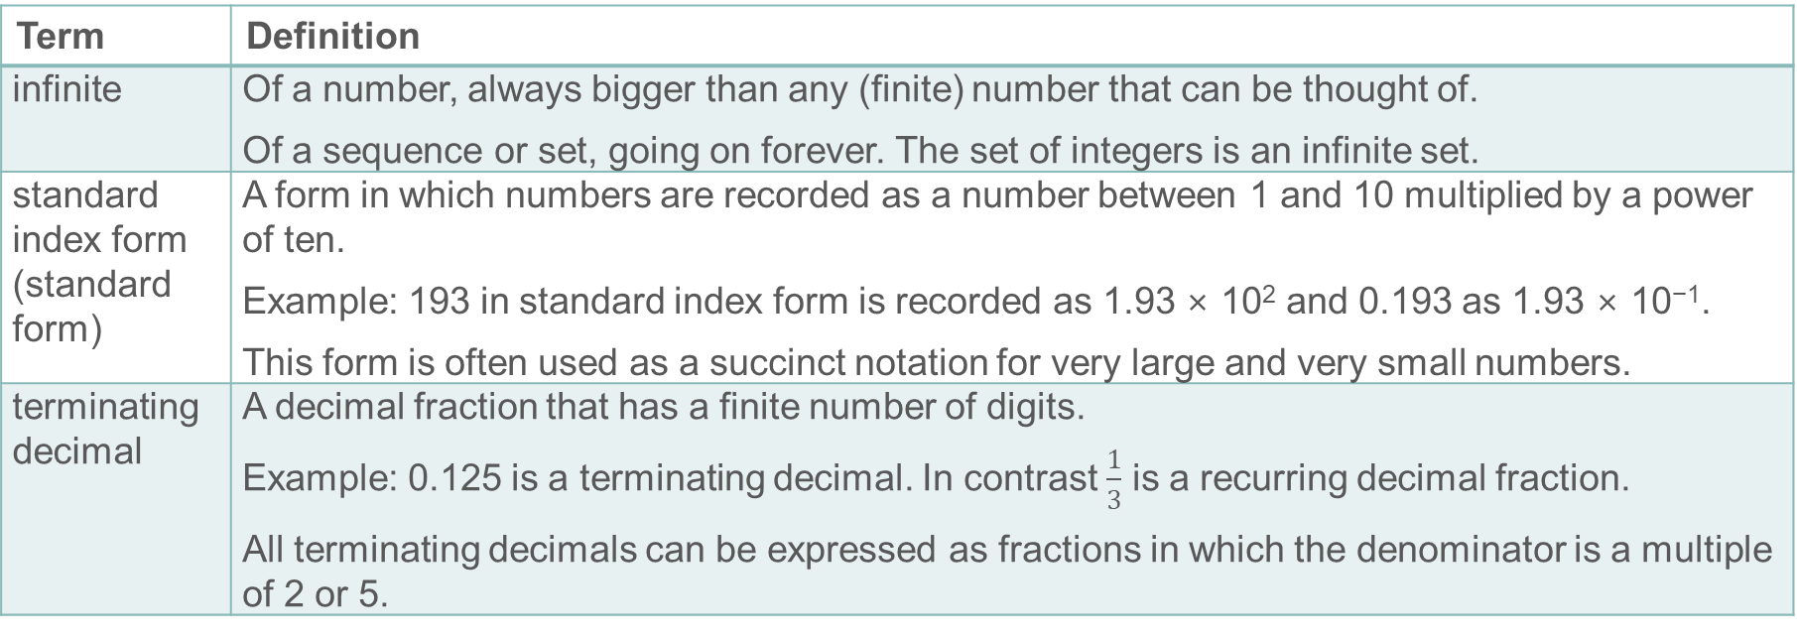
Key vocabulary
Term | Definition
infinite | Of a number, always bigger than any (finite) number that can be thought of. Of a sequence or set, going on forever. The set of integers is an infinite set.
standard index form (standard form) | A form in which numbers are recorded as a number between 1 and 10 multiplied by a power of ten. Example: 193 in standard index form is recorded as 1.93 × 10² and 0.193 as 1.93 × 10⁻¹. This form is often used as a succinct notation for very large and very small numbers.
terminating decimal | A decimal fraction that has a finite number of digits. Example: 0.125 is a terminating decimal. In contrast $\frac{1}{3}$ is a recurring decimal fraction. All terminating decimals can be expressed as fractions in which the denominator is a multiple of 2 or 5.

Slide 33
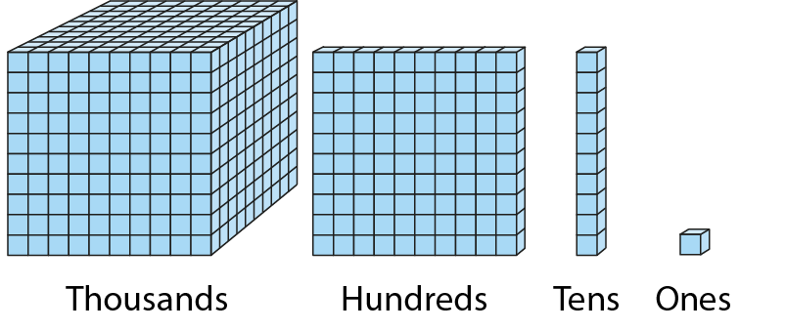
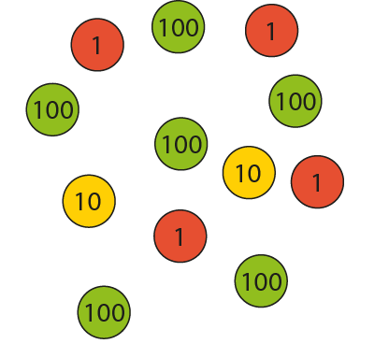
Representations and structure (1)
There are a number of different representations that you may wish to use to support students’ understanding of this key idea. These might include:
Diene base-ten blocks
Place value counters
  Dienes apparatus and place-value counters will probably have been an important representation used in Key Stage 2 to support students’ understanding of the base-ten structure of numbers (both integers and decimals). In Key Stage 3, students are required to generalise this structure and to become as fluent with the base-ten structure of decimals as they are with integers. Re-visiting these familiar manipulatives with an emphasis on tenths, hundredths, and so on, will support this generalisation.
Notes:
More information about the representations and structure involved in this key idea can be found:
On pages 6 and 7 of The Structure of the number system Theme Overview document
Within the ‘Using mathematical representations at KS3’ guidance on the NCTEM website
Links to all of these can be found on the final slide.

Slide 34
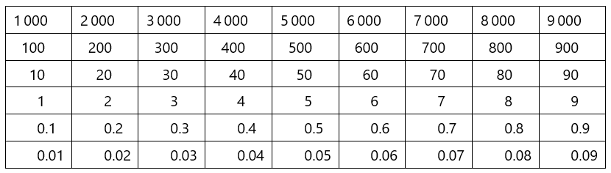
Representations and structure (2)
There are a number of different representations that you may wish to use to support students’ understanding of this key idea. These might include:
Gattegno chart
  Moving (up or down) from one row to another to represent multiplying and dividing by powers of ten helps students to understand these operations and their results.
Arrays and other area models
  The array is a useful image for revealing the commutative and distributive properties of multiplication. When the rectangle has continuous measures for the dimensions, it becomes a useful way of thinking about the product of any two numbers including decimals and fractions.
Notes:
More information about the representations and structure involved in this key idea can be found:
On page 7 of The Structure of the number system Theme Overview document
Within the ‘Using mathematical representations at KS3’ guidance on the NCTEM website
Links to all of these can be found on the final slide.

Slide 35
Previous learning
From Upper Key Stage 2, students will bring experience of:
reading, writing, ordering and comparing numbers up to 10 000 000 and determining the value of each digit
rounding any whole number to a required degree of accuracy
using negative numbers in context
identifying the value of each digit in numbers given to three decimal places and multiplying and dividing numbers by 10, 100 and 1 000, giving answers up to three decimal places
using, reading, writing and converting between standard units, converting measurements of length, mass, volume and time from a smaller unit of measure to a larger unit and vice versa, using decimal notation up to three decimal places
using symbols and letters to represent variables and unknowns in mathematical situations that they already understand, such as:
  missing numbers, lengths, coordinates and angles
  formulae in mathematics and science
Notes:
Theme 1 The structure of the number system

Slide 36
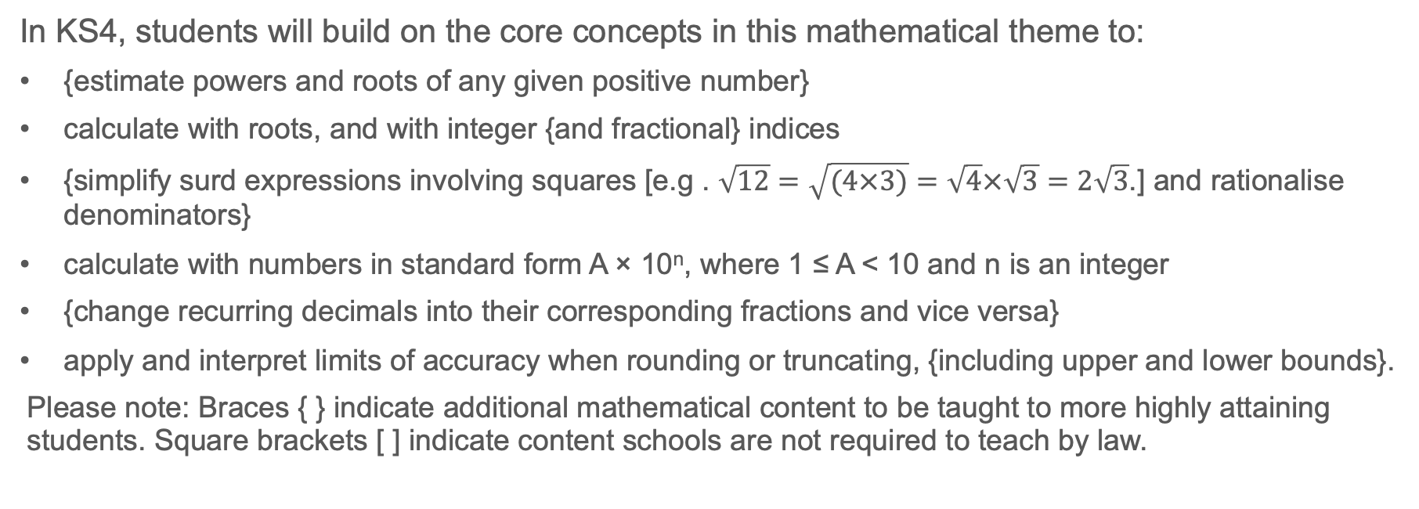
Future learning
In KS4, students will build on the core concepts in this mathematical theme to:
{estimate powers and roots of any given positive number}
calculate with roots, and with integer {and fractional} indices
{simplify surd expressions involving squares [e.g . $\sqrt{12}=\sqrt{(4×3)}=\sqrt{4}×\sqrt{3}=2\sqrt{3}$.] and rationalise denominators}
calculate with numbers in standard form A × 10^{n}, where 1 ≤ A < 10 and n is an integer
{change recurring decimals into their corresponding fractions and vice versa}
apply and interpret limits of accuracy when rounding or truncating, {including upper and lower bounds}.
Please note: Braces { } indicate additional mathematical content to be taught to more highly attaining students. Square brackets [ ] indicate content schools are not required to teach by law.
Notes:
Theme 1 The structure of the number system

Slide 37
Library of links
The following resources from the NCETM website have been referred to within this slide deck:
  NCETM Secondary Mastery Professional Development
    1 The Structure of the number system Theme Overview Document
    1.3 Ordering and comparing Core Concept Document
  Using mathematical representations at KS3 | NCETM
  NCETM primary mastery professional development materials
  NCETM primary assessment materials
There are also references to:
  Standards & Testing Agency’s past mathematics papers

