Slide 1
Year 2, Unit 1
Numbers 10 to 100

Slide 2
Year 2, Unit 1
These materials heavily reflect the prioritisation approach of the ready-to-progress criteria in the DfE Primary Mathematics Guidance 2020 and on the PPTs that exemplify them on the NCETM website. They also include other relevant National Curriculum content. Related sections of the NCETM Primary Mastery Professional Development Materials provide small-step teaching guidance.
Ready-to-progress criteria addressed by this unit
Teaching of this unit supports the following criteria from the ‘DfE Mathematics Guidance: key stages 1 & 2’ (the 335-page document available as a download)
2NPV-1 Page 51
2NPV-2 Page 53
Prior learning
If the following ready-to-progress criteria, contained in the same DfE guidance document as above, were secured in Year 1, children will be ready to start on this unit.
1NPV-2 Page 20

Slide 3
Contents
The links below take you to the starting slide of each learning outcome.
1 | Pupils explain that one ten is equivalent to ten ones
2 | Pupils represent multiples of ten using their numerals
3 | Pupils represent multiples of ten using their numerals and names
4 | Pupils represent multiples of ten in an expression or an equation
5 | Pupils estimate the position of multiples of ten on a 0-100 number line
6 | Pupils explain what happens when you add and subtract ten to a multiple of ten
Click the arrow button to return to this Contents slide.

Slide 4
Contents
The links below take you to the starting slide of each learning outcome.
7 | Pupils use knowledge of facts and unitising to add and subtract multiples of ten
8 | Pupils add and subtract multiples of ten
9 | Pupils explore the counting sequence for counting to 100 and beyond
10 | Pupils count a large group of objects by counting groups of tens and the extra ones
11 | Pupils count a large group of objects by using knowledge of unitising by counting tens and ones
12 | Pupils represent a number from 20-99 in different ways
Click the arrow button to return to this Contents slide.

Slide 5
Contents
The links below take you to the starting slide of each learning outcome.
13 | Pupils explain and mark the position of numbers 20-99 on a number line
14 | Pupils explain that numbers 20-99 can be represented as a length
15 | Pupils compare two, two-digit numbers
16 | Pupils partition a two-digit number into tens and ones
17 | Pupils add two, two-digit numbers by partitioning into tens and ones
Click the arrow button to return to this Contents slide.

Slide 6
Year 2, Unit 1, Learning Outcome 1
Learning Outcome 1
Pupils explain that one ten is equivalent to ten ones
The following slides have been collated to support the teaching of this learning outcome.

Slide 7
Year 2, Unit 1, Learning Outcome 1
Additional teacher guidance for this outcome should be read first and can be found in this segment of the NCETM Primary Mastery Professional Development Materials:
1.8 Composition of numbers: multiples of 10 up to 100
The spine materials are divided into ‘teaching points’ and ‘steps in learning’.
Teaching point | Steps in learning | Pages
1 | 1:1-1:5 | 3-6

Slide 8
1.8 Composition: multiples of 10 up to 100 – step 1:1

Slide 9
1.8 Composition: multiples of 10 up to 100 – step 1:1

Slide 10
1.8 Composition: multiples of 10 up to 100 – step 1:1

Slide 11
1.8 Composition: multiples of 10 up to 100 – step 1:1

Slide 12
1.8 Composition: multiples of 10 up to 100 – step 1:1

Slide 13
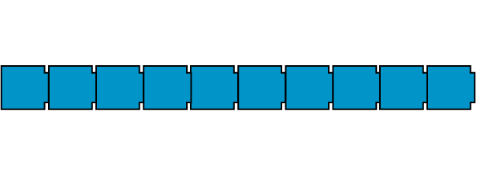
1.8 Composition: multiples of 10 up to 100 – step 1:1

Slide 14
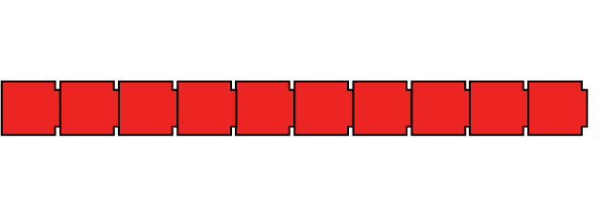
1.8 Composition: multiples of 10 up to 100 – step 1:1
Notes:
ANIMATIONS NOT RIGHT

Slide 15
1.8 Composition: multiples of 10 up to 100 – step 1:1
Notes:
ANIMATIONS NOT RIGHT

Slide 16
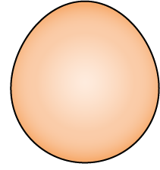
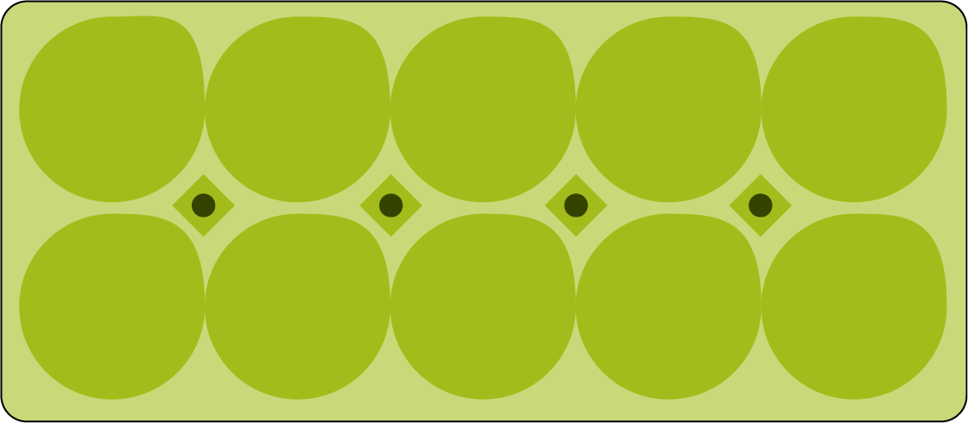
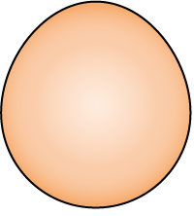
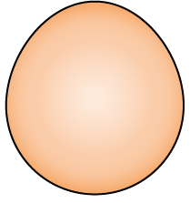
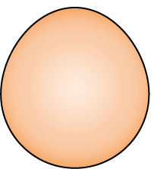
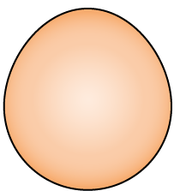
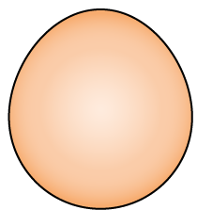
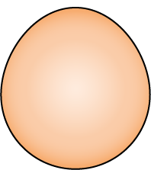
1.8 Composition: multiples of 10 up to 100 – step 1:2

Slide 17
1.8 Composition: multiples of 10 up to 100 – step 1:2

Slide 18
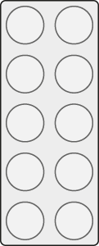
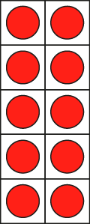
1.8 Composition: multiples of 10 up to 100 – step 1:4

Slide 19
1.8 Composition: multiples of 10 up to 100 – step 1:5

Slide 20
Year 2, Unit 1, Learning Outcome 2
Learning Outcome 2
Pupils represent multiples of ten using their numerals
The following slides have been collated to support the teaching of this learning outcome.

Slide 21
Year 2, Unit 1, Learning Outcome 2
Additional teacher guidance for this outcome should be read first and can be found in this segment of the NCETM Primary Mastery Professional Development Materials:
1.8 Composition of numbers: multiples of 10 up to 100
The spine materials are divided into ‘teaching points’ and ‘steps in learning’.
Teaching point | Steps in learning | Pages
2 | 2:1-2:4 | 7-11

Slide 22
1.8 Composition: multiples of 10 up to 100 – step 2:1

Slide 23
1.8 Composition: multiples of 10 up to 100 – step 2:1

Slide 24
1.8 Composition: multiples of 10 up to 100 – step 2:1

Slide 25
1.8 Composition: multiples of 10 up to 100 – step 2:1

Slide 26
1.8 Composition: multiples of 10 up to 100 – step 2:1

Slide 27
1.8 Composition: multiples of 10 up to 100 – step 2:2
90
70
100
80
20
30
40
50
10
60

Slide 28
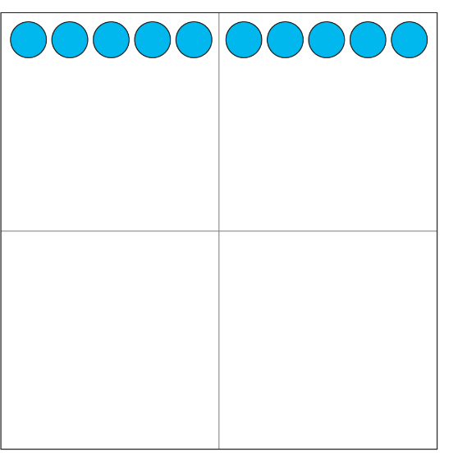
1.8 Composition: multiples of 10 up to 100 – step 2:2
10
20
30
40
50
60
70
80
90
100

Slide 29
1.8 Composition: multiples of 10 up to 100 – step 2:3

Slide 30
1.8 Composition: multiples of 10 up to 100 – step 2:3

Slide 31
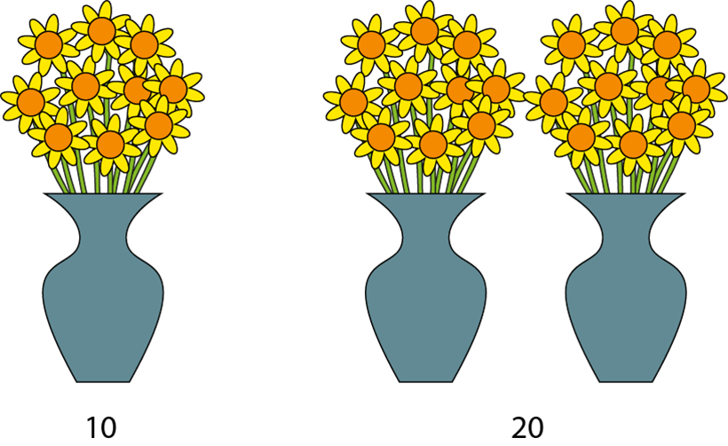
1.8 Composition: multiples of 10 up to 100 – step 2:3

Slide 32
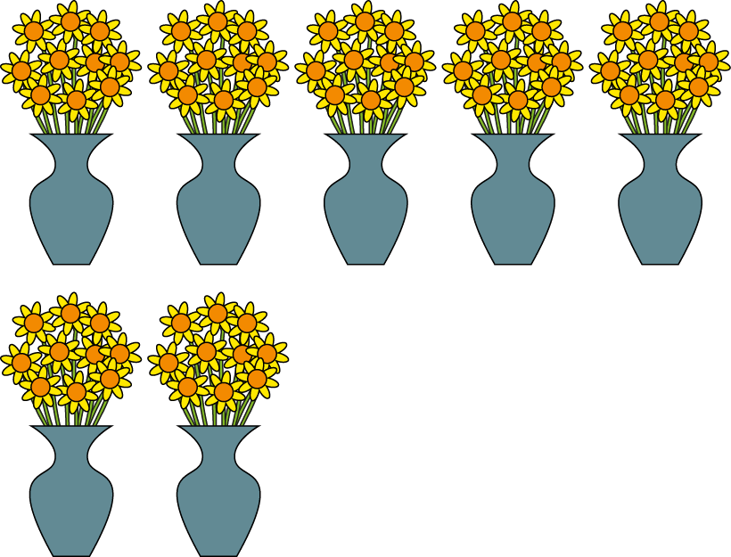
1.8 Composition: multiples of 10 up to 100 – step 2:4
70

Slide 33
1.8 Composition: multiples of 10 up to 100 – step 2:4
10
50
30

Slide 34
1.8 Composition: multiples of 10 up to 100 – step 2:4
10
60
40

Slide 35
Year 2, Unit 1, Learning Outcome 3
Learning Outcome 3
Pupils represent multiples of ten using their numerals and names
The following slides have been collated to support the teaching of this learning outcome.

Slide 36
Year 2, Unit 1, Learning Outcome 3
Additional teacher guidance for this outcome should be read first and can be found in this segment of the NCETM Primary Mastery Professional Development Materials:
1.8 Composition of numbers: multiples of 10 up to 100
The spine materials are divided into ‘teaching points’ and ‘steps in learning’.
Teaching point | Steps in learning | Pages
2 | 2:5-2:6 | 11-13

Slide 37
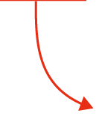
1.8 Composition: multiples of 10 up to 100 – step 2:5

Slide 38
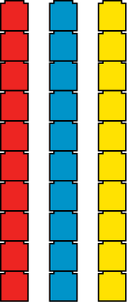
1.8 Composition: multiples of 10 up to 100 – step 2:6
10
30
60

Slide 39
Year 2, Unit 1, Learning Outcome 4
Learning Outcome 4
Pupils represent multiples of ten in an expression or an equation
The following slides have been collated to support the teaching of this learning outcome.

Slide 40
Year 2, Unit 1, Learning Outcome 4
Additional teacher guidance for this outcome should be read first and can be found in this segment of the NCETM Primary Mastery Professional Development Materials:
1.8 Composition of numbers: multiples of 10 up to 100
The spine materials are divided into ‘teaching points’ and ‘steps in learning’.
Teaching point | Steps in learning | Pages
2 | 2:7-2:8 | 13-15

Slide 41
1.8 Composition: multiples of 10 up to 100 – step 2:7
10
+
10
+
10
+
10
+
10
+
10
+
10
=
70
Notes:
ANIMATIONS NOT RIGHT

Slide 42
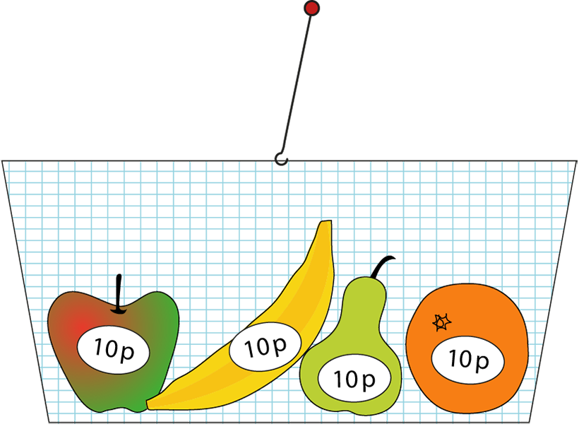
1.8 Composition: multiples of 10 up to 100 – step 2:7
10 p
+
10 p
+
10 p
+
10 p
=
40 p

Slide 43
Year 2, Unit 1, Learning Outcome 5
Learning Outcome 5
Pupils estimate the position of multiples of ten on a 0-100 number line
The following slides have been collated to support the teaching of this learning outcome.

Slide 44
Year 2, Unit 1, Learning Outcome 5
Additional teacher guidance for this outcome should be read first and can be found in this segment of the NCETM Primary Mastery Professional Development Materials:
1.8 Composition of numbers: multiples of 10 up to 100
The spine materials are divided into ‘teaching points’ and ‘steps in learning’.
Teaching point | Steps in learning | Pages
3 | 3:1-3:7 | 16-20

Slide 45
1.8 Composition: multiples of 10 up to 100 – step 3:1

Slide 46
1.8 Composition: multiples of 10 up to 100 – step 3:1

Slide 47
1.8 Composition: multiples of 10 up to 100 – step 3:2

Slide 48
1.8 Composition: multiples of 10 up to 100 – step 3:2

Slide 49
1.8 Composition: multiples of 10 up to 100 – step 3:2
1000 | 2000 | 3000 | 4000 | 5000 | 6000 | 7000 | 8000 | 9000
100 | 200 | 300 | 400 | 500 | 600 | 700 | 800 | 900
1 | 2 | 3 | 4 | 5 | 6 | 7 | 8 | 9
10
20
30
40
50
60
70
80
90
Notes:
ANIMATIONS NOT RIGHT – they seem to have begun to automatically be advancing to the next animation without clicking them?!

Slide 50
1.8 Composition: multiples of 10 up to 100 – step 3:3
Notes:
ANIMATIONS NOT RIGHT

Slide 51
1.8 Composition: multiples of 10 up to 100 – step 3:3
Notes:
ANIMATIONS NOT RIGHT

Slide 52
1.8 Composition: multiples of 10 up to 100 – step 3:3
Notes:
ANIMATIONS NOT RIGHT

Slide 53
1.8 Composition: multiples of 10 up to 100 – step 3:4
Notes:
ANIMATIONS NOT RIGHT

Slide 54
1.8 Composition: multiples of 10 up to 100 – step 3:4

Slide 55
1.8 Composition: multiples of 10 up to 100 – step 3:5
Notes:
ANIMATIONS NOT RIGHT

Slide 56
1.8 Composition: multiples of 10 up to 100 – step 3:5
Notes:
ANIMATIONS NOT RIGHT

Slide 57
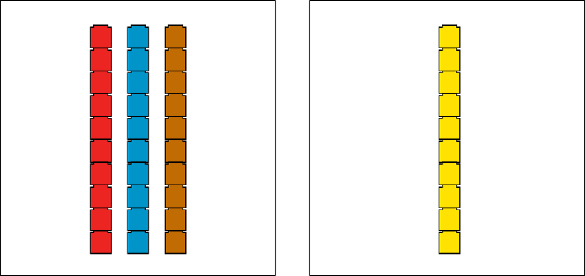
1.8 Composition: multiples of 10 up to 100 – step 3:6

Slide 58
1.8 Composition: multiples of 10 up to 100 – step 3:6
Notes:
Teddy says that forty is less than sixty. Is he right? Convince me.

Slide 59
1.8 Composition: multiples of 10 up to 100 – step 3:7
Sarah
Deb
Notes:
Sarah and Deb have some 10 p coins. Sarah has fewer coins than Deb. If Deb has 50 p, how much money might Sarah have?

Slide 60
Year 2, Unit 1, Learning Outcome 6
Learning Outcome 6
Pupils explain what happens when you add and subtract ten to a multiple of ten
The following slides have been collated to support the teaching of this learning outcome.

Slide 61
Year 2, Unit 1, Learning Outcome 6
Additional teacher guidance for this outcome should be read first and can be found in this segment of the NCETM Primary Mastery Professional Development Materials:
1.8 Composition of numbers: multiples of 10 up to 100
The spine materials are divided into ‘teaching points’ and ‘steps in learning’.
Teaching point | Steps in learning | Pages
4 | 4:1-4:7 | 21-25

Slide 62
1.8 Composition: multiples of 10 up to 100 – step 4:1
1 ten
2 tens
3 tens
4 tens
5 tens
6 tens
7 tens
8 tens
9 tens
10 tens

Slide 63
1.8 Composition: multiples of 10 up to 100 – step 4:1
1 ten
2 tens
3 tens
4 tens
5 tens
6 tens
7 tens
8 tens
9 tens
10 tens

Slide 64
1.8 Composition: multiples of 10 up to 100 – step 4:1
ten 10
twenty 20
thirty 30
forty 40
fifty 50
sixty 60
seventy 70
eighty 80
ninety 90
one hundred 100

Slide 65
1.8 Composition: multiples of 10 up to 100 – step 4:1
ten 10
twenty 20
thirty 30
forty 40
fifty 50
sixty 60
seventy 70
eighty 80
ninety 90
one hundred 100

Slide 66
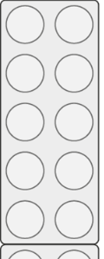
1.8 Composition: multiples of 10 up to 100 – step 4:2
30
40

Slide 67
1.8 Composition: multiples of 10 up to 100 – step 4:2
40
30

Slide 68
1.8 Composition: multiples of 10 up to 100 – step 4:6

Slide 69
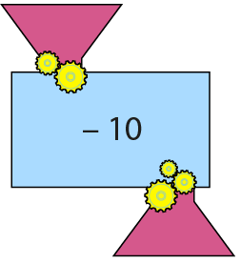
1.8 Composition: multiples of 10 up to 100 – step 4:6

Slide 70
1.8 Composition: multiples of 10 up to 100 – step 4:6

Slide 71
1.8 Composition: multiples of 10 up to 100 – step 4:6

Slide 72
Year 2, Unit 1, Learning Outcome 7
Learning Outcome 7
Pupils use knowledge of facts and unitising to add and subtract multiples of ten
The following slides have been collated to support the teaching of this learning outcome.

Slide 73
Year 2, Unit 1, Learning Outcome 7
Additional teacher guidance for this outcome should be read first and can be found in this segment of the NCETM Primary Mastery Professional Development Materials:
1.8 Composition of numbers: multiples of 10 up to 100
The spine materials are divided into ‘teaching points’ and ‘steps in learning’.
Teaching point | Steps in learning | Pages
5 | 5:1-5:5 | 26-28

Slide 74
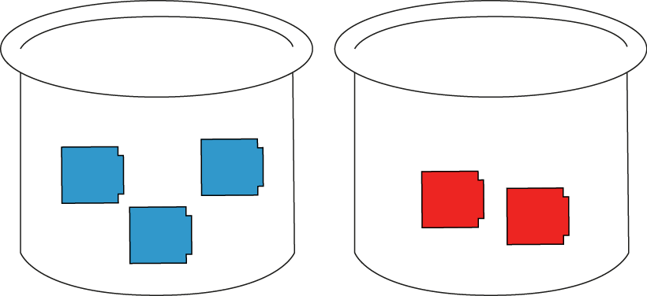
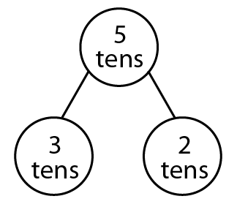
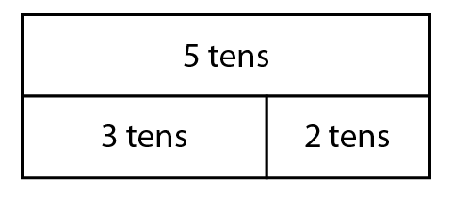
1.8 Composition: multiples of 10 up to 100 – step 5:1

Slide 75
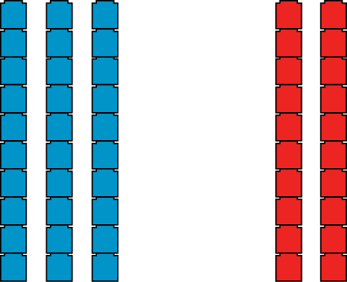
1.8 Composition: multiples of 10 up to 100 – step 5:2

Slide 76
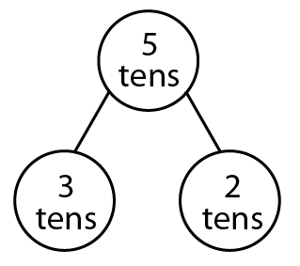
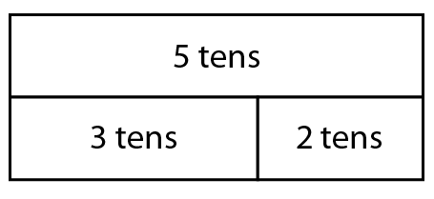
1.8 Composition: multiples of 10 up to 100 – step 5:2

Slide 77
1.8 Composition: multiples of 10 up to 100 – step 5:3

Slide 78
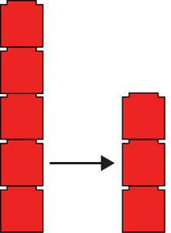
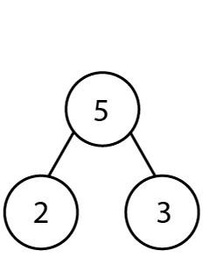
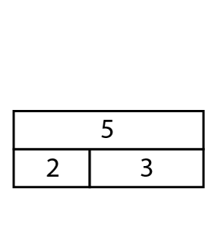
1.8 Composition: multiples of 10 up to 100 – step 5:4
5
− 2
= 3

Slide 79
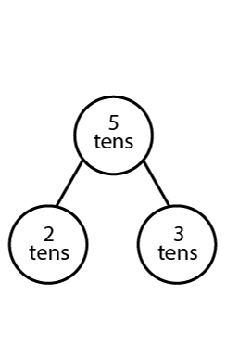
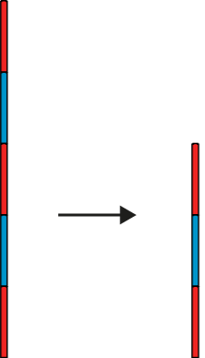
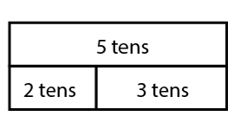
1.8 Composition: multiples of 10 up to 100 – step 5:4
5 tens
− 2 tens
= 3 tens

Slide 80
Year 2, Unit 1, Learning Outcome 8
Learning Outcome 8
Pupils add and subtract multiples of ten
The following slides have been collated to support the teaching of this learning outcome.

Slide 81
Year 2, Unit 1, Learning Outcome 8
Additional teacher guidance for this outcome should be read first and can be found in this segment of the NCETM Primary Mastery Professional Development Materials:
1.8 Composition of numbers: multiples of 10 up to 100
The spine materials are divided into ‘teaching points’ and ‘steps in learning’.
Teaching point | Steps in learning | Pages
5 | 5:6-5:9 | 28-31

Slide 82
1.8 Composition: multiples of 10 up to 100 – step 5:6

Slide 83
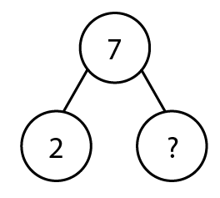
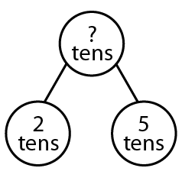
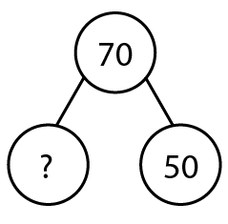
1.8 Composition: multiples of 10 up to 100 – step 5:7

Slide 84
1.8 Composition: multiples of 10 up to 100 – step 5:7

Slide 85
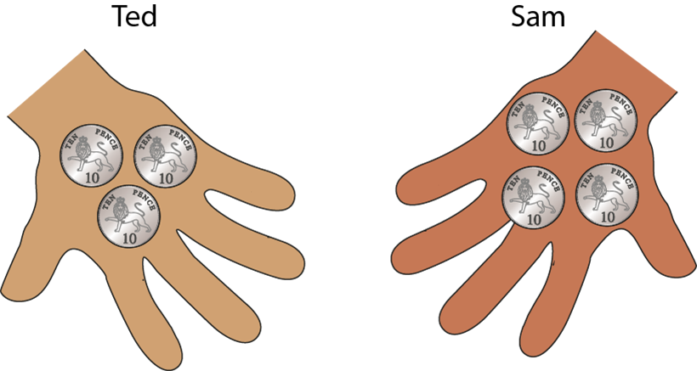
1.8 Composition: multiples of 10 up to 100 – step 5:8

Slide 86
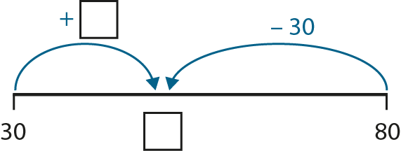
1.8 Composition: multiples of 10 up to 100 – step 5:8

Slide 87
1.8 Composition: multiples of 10 up to 100 – step 5:9

Slide 88
Year 2, Unit 1, Learning Outcome 9
Learning Outcome 9
Pupils explore the counting sequence for counting to 100 and beyond
The following slides have been collated to support the teaching of this learning outcome.

Slide 89
Year 2, Unit 1, Learning Outcome 9
Additional teacher guidance for this outcome should be read first and can be found in this segment of the NCETM Primary Mastery Professional Development Materials:
1.9 Composition of numbers: 20-100
The spine materials are divided into ‘teaching points’ and ‘steps in learning’.
Teaching point | Steps in learning | Pages
1 | 1:1 | 4-5

Slide 90
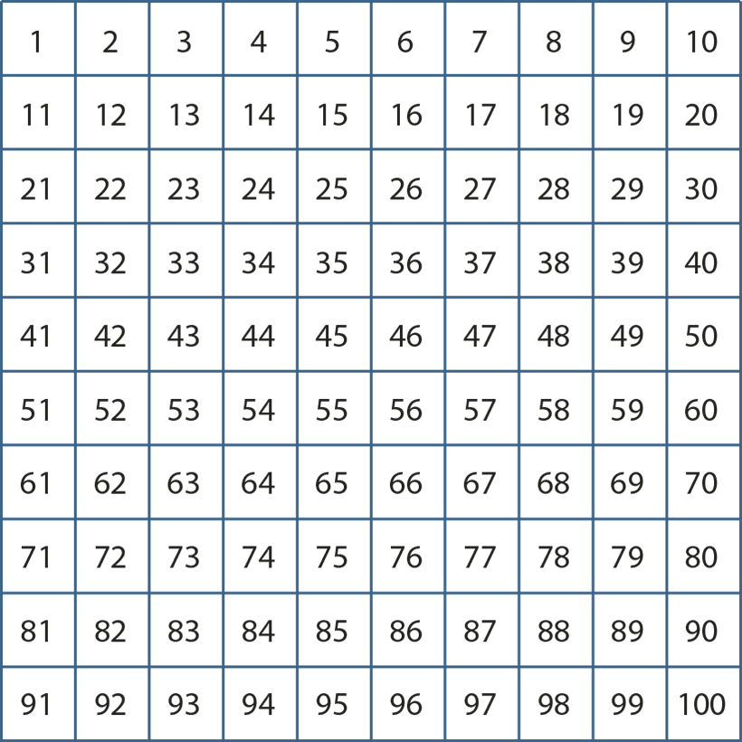
1.9 Composition: 20–100 – step 1:1

Slide 91
1.9 Composition: 20–100 – step 1:1
1000 | 2000 | 3000 | 4000 | 5000 | 6000 | 7000 | 8000 | 9000
100 | 200 | 300 | 400 | 500 | 600 | 700 | 800 | 900
10 | 20 | 30 | 40 | 50 | 60 | 70 | 80 | 90
1 | 2 | 3 | 4 | 5 | 6 | 7 | 8 | 9

Slide 92
Year 2, Unit 1, Learning Outcome 10
Learning Outcome 10
Pupils count a large group of objects by counting groups of tens and the extra ones
The following slides have been collated to support the teaching of this learning outcome.

Slide 93
Year 2, Unit 1, Learning Outcome 10
Additional teacher guidance for this outcome should be read first and can be found in this segment of the NCETM Primary Mastery Professional Development Materials:
1.9 Composition of numbers: 20-100
The spine materials are divided into ‘teaching points’ and ‘steps in learning’.
Teaching point | Steps in learning | Pages
2 | 2:1-2:5 | 7-9

Slide 94
1.9 Composition: 20–100 – step 2:1

Slide 95
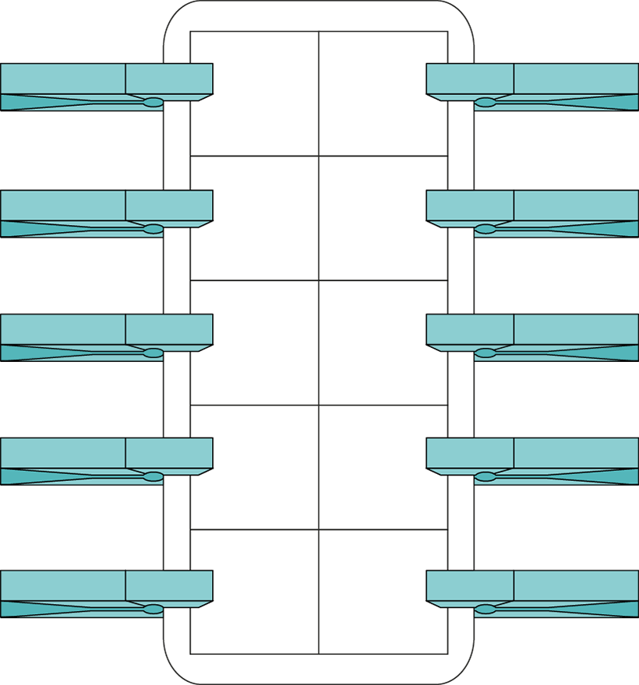
1.9 Composition: 20–100 – step 2:1

Slide 96
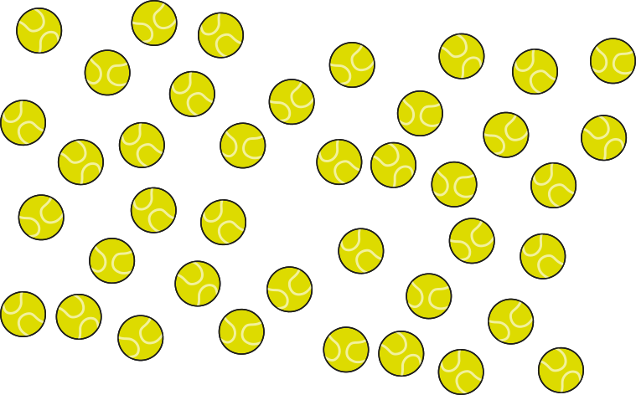
1.9 Composition: 20–100 – step 2:2

Slide 97
1.9 Composition: 20–100 – step 2:4
forty-two

Slide 98
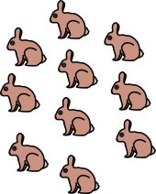
1.9 Composition: 20–100 – step 2:5
10s | 1s
2
7

Slide 99
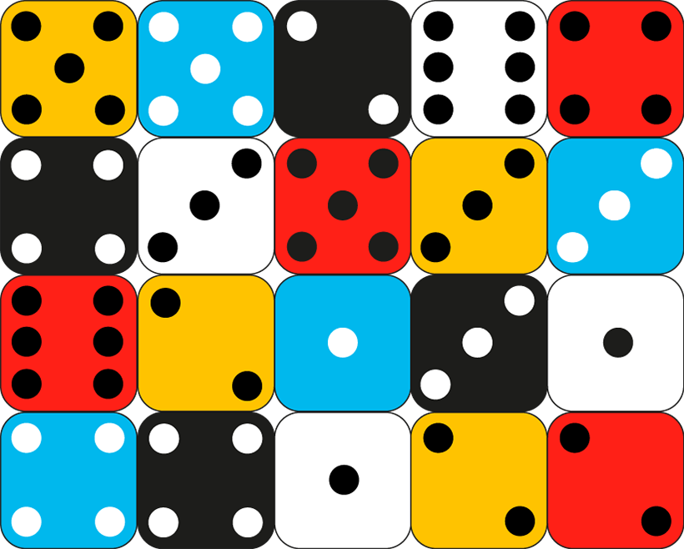
1.9 Composition: 20–100 – step 2:5

Slide 100
Year 2, Unit 1, Learning Outcome 11
Learning Outcome 11
Pupils count a large group of objects by using knowledge of unitising by counting tens and ones
The following slides have been collated to support the teaching of this learning outcome.

Slide 101
Year 2, Unit 1, Learning Outcome 11
Additional teacher guidance for this outcome should be read first and can be found in this segment of the NCETM Primary Mastery Professional Development Materials:
1.9 Composition of numbers: 20-100
The spine materials are divided into ‘teaching points’ and ‘steps in learning’.
Teaching point | Steps in learning | Pages
2 | 2:6-2:9 | 10-12

Slide 102
1.9 Composition: 20–100 – step 2:6
Notes:
ANIMATIONS NOT RIGHT

Slide 103
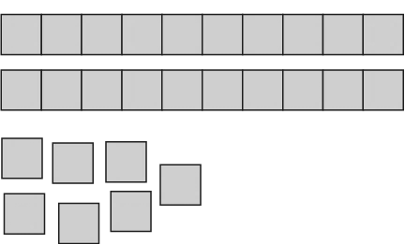
1.9 Composition: 20–100 – step 2:7
10s | 1s
2
7
27

Slide 104
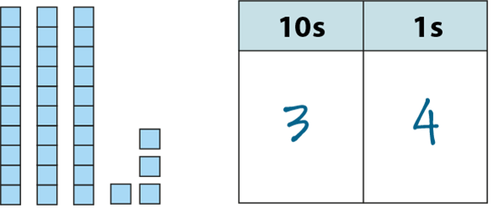
1.9 Composition: 20–100 – step 2:8

Slide 105
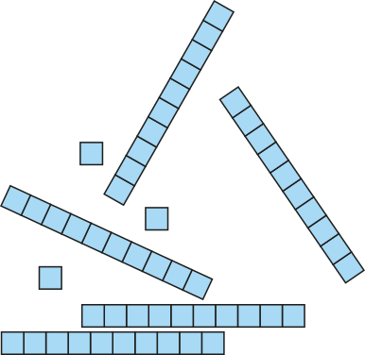
1.9 Composition: 20–100 – step 2:8
53

Slide 106
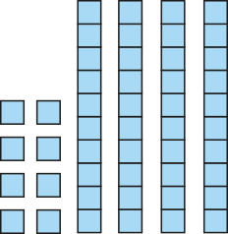
1.9 Composition: 20–100 – step 2:8
48

Slide 107
1.9 Composition: 20–100 – step 2:8
32

Slide 108
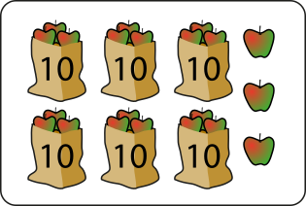
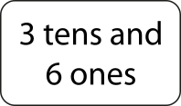
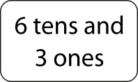
1.9 Composition: 20–100 – step 2:9
Notes:
ANIMATIONS NOT RIGHT

Slide 109
Year 2, Unit 1, Learning Outcome 12
Learning Outcome 12
Pupils represent a number from 20-99 in different ways
The following slides have been collated to support the teaching of this learning outcome.

Slide 110
Year 2, Unit 1, Learning Outcome 12
Additional teacher guidance for this outcome should be read first and can be found in this segment of the NCETM Primary Mastery Professional Development Materials:
1.9 Composition of numbers: 20-100
The spine materials are divided into ‘teaching points’ and ‘steps in learning’.
Teaching point | Steps in learning | Pages
2 | 2:10-2:13 | 12-15

Slide 111
1.9 Composition: 20–100 – step 2:10
45

Slide 112
1.9 Composition: 20–100 – step 2:10
45

Slide 113
1.9 Composition: 20–100 – step 2:10
45

Slide 114
1.9 Composition: 20–100 – step 2:13
29
twenty-nine
2 tens and 9 ones

Slide 115
1.9 Composition: 20–100 – step 2:13
48
forty-eight
4 tens and 8 ones

Slide 116
1.9 Composition: 20–100 – step 2:13
67
sixty-seven
6 tens and 7 ones

Slide 117
2NPV-1 Place value in two-digit numbers
Let’s make some numbers on the hundred square. How can you say what number is represented without counting in ones?
How would you write this in a place value chart? What do you notice when you write the digits in the chart?
10s | 1s

Slide 118
Year 2, Unit 1, Learning Outcome 13
Learning Outcome 13
Pupils explain and mark the position of numbers 20-99 on a number line
The following slides have been collated to support the teaching of this learning outcome.

Slide 119
Year 2, Unit 1, Learning Outcome 13
Additional teacher guidance for this outcome should be read first and can be found in this segment of the NCETM Primary Mastery Professional Development Materials:
1.9 Composition of numbers: 20-100
The spine materials are divided into ‘teaching points’ and ‘steps in learning’.
Teaching point | Steps in learning | Pages
3 | 3:1-3:5 | 16-19

Slide 120
1.9 Composition: 20–100 – step 3:1

Slide 121
1.9 Composition: 20–100 – step 3:1

Slide 122
1.9 Composition: 20–100 – step 3:3
a
b
0
10
20
30
40
50
60
70
80
90
100

Slide 123
1.9 Composition: 20–100 – step 3:3
46
0
10
20
30
40
50
60
70
80
90
100

Slide 124
1.9 Composition: 20–100 – step 3:4
21
35
52
67
84
99
0
10
20
30
40
50
60
70
80
90
100

Slide 125
1.9 Composition: 20–100 – step 3:4
a
b
c
d
57
0
10
20
30
40
50
60
70
80
90
100
Notes:
Which of these numbers has a ones digit which is larger than the tens digit?

Slide 126
1.9 Composition: 20–100 – step 3:4
a
b
73
d
c
0
10
20
30
40
50
60
70
80
90
100
Notes:
Which of these numbers has two digits that add up to ten?

Slide 127
2NPV-2 Two-digit numbers in the linear number system
0
10
20
30
40
50
60
70
80
90
100
Move the arrow to a number.
Can you reason about the number the arrow is pointing at? Think about how to use multiples of ten and numbers which are half-way between other pairs of numbers.
Say some numbers which would be between these pairs of numbers: 70 and 80; 40 and 50; 0 and 10; 25 and 35; 45 and 55.
Can you say ‘stop!’ when I move the arrow to a number with a 9 as the ones digit?

Slide 128
2NPV-2 Two-digit numbers in the linear number system
60
60
60
0
50
100
What do you notice about the number line? Which number sits half-way between zero and one hundred?
Can you say some numbers which come before 50? After 50?
Where would 60 sit on the number line? Would it be nearer to 50 or to 100? How do you know?

Slide 129
Year 2, Unit 1, Learning Outcome 14
Learning Outcome 14
Pupils explain that numbers 20-99 can be represented as a length
The following slides have been collated to support the teaching of this learning outcome.

Slide 130
Year 2, Unit 1, Learning Outcome 14
Additional teacher guidance for this outcome should be read first and can be found in this segment of the NCETM Primary Mastery Professional Development Materials:
1.9 Composition of numbers: 20-100
The spine materials are divided into ‘teaching points’ and ‘steps in learning’.
Teaching point | Steps in learning | Pages
3 | 3:6-3:7 | 19-20

Slide 131
1.9 Composition: 20–100 – step 3:6
32
Notes:
ANIMATIONS NOT RIGHT

Slide 132
1.9 Composition: 20–100 – step 3:6
32

Slide 133
1.9 Composition: 20–100 – step 3:7
41

Slide 134
1.9 Composition: 20–100 – step 3:7

Slide 135
Year 2, Unit 1, Learning Outcome 15
Learning Outcome 15
Pupils compare two, two-digit numbers
The following slides have been collated to support the teaching of this learning outcome.

Slide 136
Year 2, Unit 1, Learning Outcome 15
Additional teacher guidance for this outcome should be read first and can be found in this segment of the NCETM Primary Mastery Professional Development Materials:
1.9 Composition of numbers: 20-100
The spine materials are divided into ‘teaching points’ and ‘steps in learning’.
Teaching point | Steps in learning | Pages
4 | 4:1-4:5 | 21-24

Slide 137
1.9 Composition: 20–100 – step 4:1

Slide 138
1.9 Composition: 20–100 – step 4:1

Slide 139
1.9 Composition: 20–100 – step 4:2
47
62
four tens
four tens
seven ones
six tens
two ones
six tens

Slide 140
1.9 Composition: 20–100 – step 4:2
4
7
6
2
0
10
20
30
40
50
60
70
80
90
100

Slide 141
1.9 Composition: 20–100 – step 4:2
44
65
four tens
four tens
four ones
six tens
five ones
six tens

Slide 142
1.9 Composition: 20–100 – step 4:2
4
5
4
6
0
10
20
30
40
50
60
70
80
90
100

Slide 143
1.9 Composition: 20–100 – step 4:3

Slide 144
1.9 Composition: 20–100 – step 4:3

Slide 145
1.9 Composition: 20–100 – step 4:3
57
54
?
?
?
?
five tens
seven ones
?
five tens
four ones
seven ones
?
four ones

Slide 146
1.9 Composition: 20–100 – step 4:3
5?
57
7
0
10
20
30
40
4
50
60
70
80
90
100
5?
54
4

Slide 147
Year 2, Unit 1, Learning Outcome 16
Learning Outcome 16
Pupils partition a two-digit number into tens and ones
The following slides have been collated to support the teaching of this learning outcome.
Notes:
ANIMATIONS NOT RIGHT

Slide 148
Year 2, Unit 1, Learning Outcome 16
Additional teacher guidance for this outcome should be read first and can be found in this segment of the NCETM Primary Mastery Professional Development Materials:
1.9 Composition of numbers: 20-100
The spine materials are divided into ‘teaching points’ and ‘steps in learning’.
Teaching point | Steps in learning | Pages
5 | 5:1-5:4 | 25-27

Slide 149
1.9 Composition: 20–100 – step 5:1
34
30
4

Slide 150
1.9 Composition: 20–100 – step 5:2
23
?

Slide 151
1.9 Composition: 20–100 – step 5:2
35
?

Slide 152
1.9 Composition: 20–100 – step 5:3
57
?

Slide 153
1.9 Composition: 20–100 – step 5:3
35
?

Slide 154
1.9 Composition: 20–100 – step 5:4
42
4
?
2 ones
tens

Slide 155
1.9 Composition: 20–100 – step 5:4
89
9
?
8 tens
ones

Slide 156
1.9 Composition: 20–100 – step 5:4
28
?
2 tens
8 ones

Slide 157
1.9 Composition: 20–100 – step 5:4
25
?
20
5

Slide 158
1.9 Composition: 20–100 – step 5:4
61
60
1
?

Slide 159
1.9 Composition: 20–100 – step 5:4
45
?
40
5

Slide 160
1.9 Composition: 20–100 – step 5:4
61
6
?
1
60
✓
✗

Slide 161
1.9 Composition: 20–100 – step 5:4
39
30
3
?
9
✓
✗

Slide 162
1.9 Composition: 20–100 – step 5:4
27
72
?
✓
✗
2
70

Slide 163
1.9 Composition: 20–100 – step 5:4
25
10
?
10
5

Slide 164
1.9 Composition: 20–100 – step 5:4
56
6
30
20
?

Slide 165
1.9 Composition: 20–100 – step 5:4
67
?
40
20
7

Slide 166
Year 2, Unit 1, Learning Outcome 17
Learning Outcome 17
Pupils add two, two-digit numbers by partitioning into tens and ones
The following slides have been collated to support the teaching of this learning outcome.

Slide 167
Year 2, Unit 1, Learning Outcome 17
Additional teacher guidance for this outcome should be read first and can be found in this segment of the NCETM Primary Mastery Professional Development Materials:
1.9 Composition of numbers: 20-100
The spine materials are divided into ‘teaching points’ and ‘steps in learning’.
Teaching point | Steps in learning | Pages
6 | 6:1-6:6 | 28-32

Slide 168
1.9 Composition: 20–100 – step 6:1
20 + 8 = 28
28 – 20 = 8
8 + 20 = 28
28 – 8 = 20
28 = 20 + 8
8 = 28 – 20
28 = 8 + 20
20 = 28 – 8

Slide 169
1.9 Composition: 20–100 – step 6:2
85
?
80
5
85
= 80 + 5

Slide 170
1.9 Composition: 20–100 – step 6:2
29
20
9
?
29 – 9 =
20

Slide 171
1.9 Composition: 20–100 – step 6:2
56
?
6
50
6 + 50 =
56

Slide 172
1.9 Composition: 20–100 – step 6:2
42
2
?
40
42 – 40 =
2

Slide 173
1.9 Composition: 20–100 – step 6:5
49
40
9
49
40
9
Notes:
At first there were forty-nine grapes in a bowl. Then I ate nine of them. Now there are forty grapes left.

Slide 174
1.9 Composition: 20–100 – step 6:5
34
?
30
4
Notes:
I have thirty maths books to mark and four English books to mark. How many books do I need to mark altogether?

Slide 175
1.9 Composition: 20–100 – step 6:5
28
?
8
20
Notes:
I have twenty-eight pencils to sharpen. I have already sharpened twenty. How many more do I need to sharpen?

